Slide 1

Revision Suggestions:
Notes:
Way too complicated:
Narrow it down to
Is it News? OR NOT?
Get rid of multi-examples of NON-Journalism categories
Then spend end of class talking about specific chunks of information

Slide 2
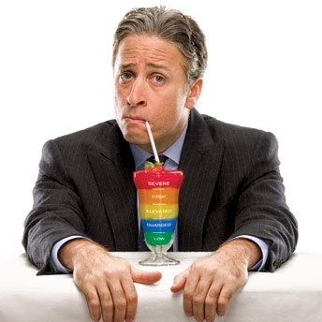
Can You Trust The Daily Show
to Give You the News?
Notes:
Last week we talked about the battle to control information.
That battle is waged daily on the websites and social media sites you use, as information peddlers of all kinds try to get your attention, push a point of view, sell something, promote their self interest, or just entertain you.
And often they disguise their effort as news.
We will begin to fill out the grid that helps you distinguish different types of information, and establish our first lesson for smart news consumers: Always know what information neighborhood you are in.
Big word I want you to memorize and learn today…Taxonomy: An arrangement of objects or ideas into a hierarchy or systematic set of classifications.
A taxonomy works like this: Park Slope is a subset of Brooklyn and Brooklyn is a subset of New York City.
Using A Taxonomy of Information Neighborhoods we will break the information map into news, promotion, propaganda, and raw information.
We’ll tackle three questions today: Why and how is news different from other types of information? How can we tell the difference? Why does it matter?

Slide 3
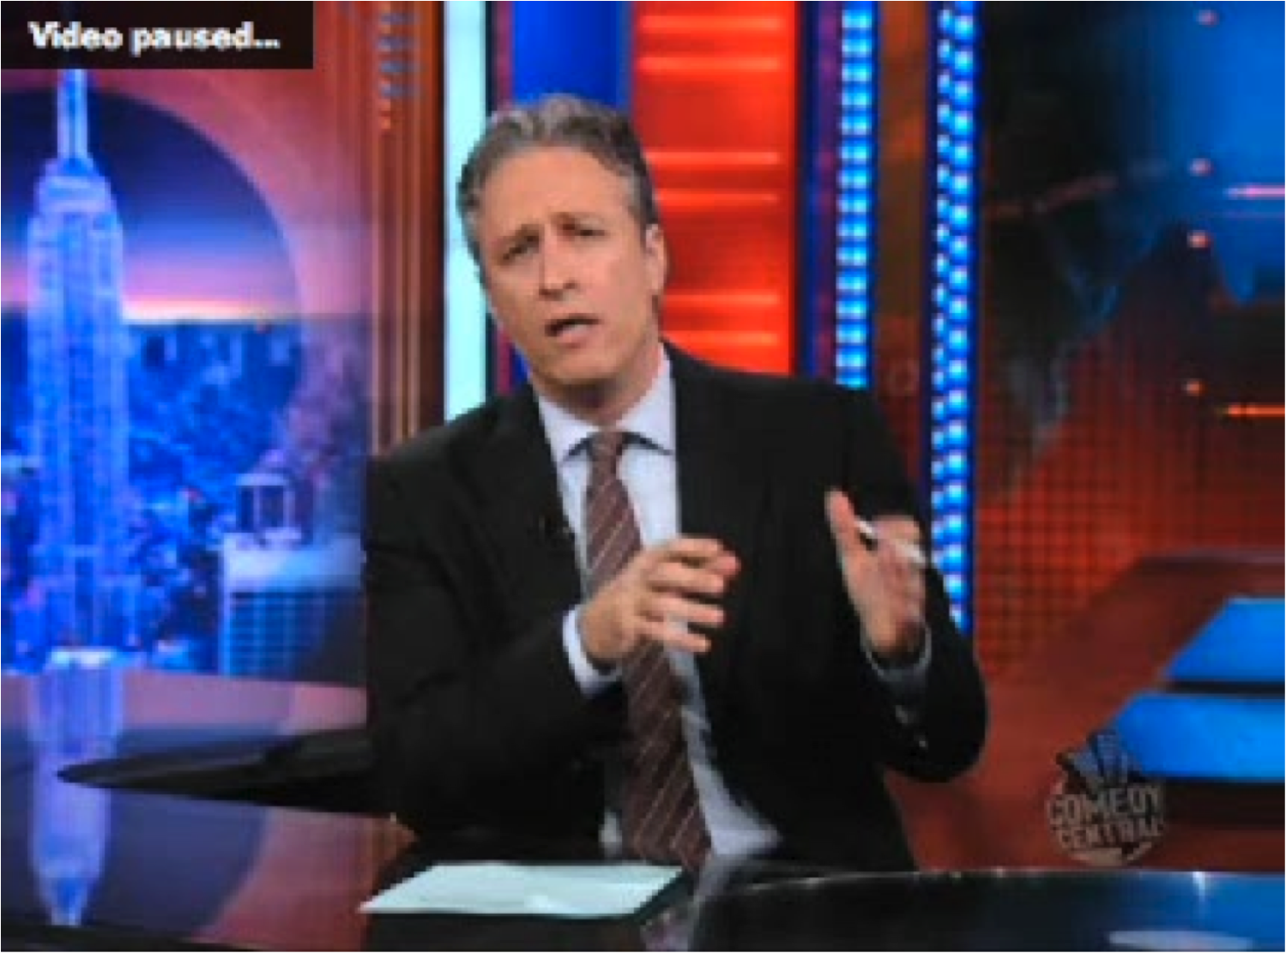
Notes:
POINT: WHY ISN’T JON STEWART A JOURNALIST?
ASK:
-What is journalism?
-Who is a journalist?
-So…Is Jon Stewart a journalist?
-This is just meant to stimulate discussion and set the table for the lecture.
Here’s a story about a small political movement on Long Island to secede, which means Long Island would become a separate state from New York.
LECTURER: CLICK NOW TO LAUNCH DAILY SHOW SAMANTHA BEE STORY ABOUT LONG ISLAND SECESSION MOVEMENT (2:16)

Slide 4
lisecede.wmv
Notes:
NEWS FELLOW: LINK (INSERT) VIDEO TO THIS SLIDE AND SELECT “START AUTOMATICALLY”
…Is it Journalism or Not?
Today, you’ll start using a new set of critical thinking skills that will help you decide for yourself

Slide 5

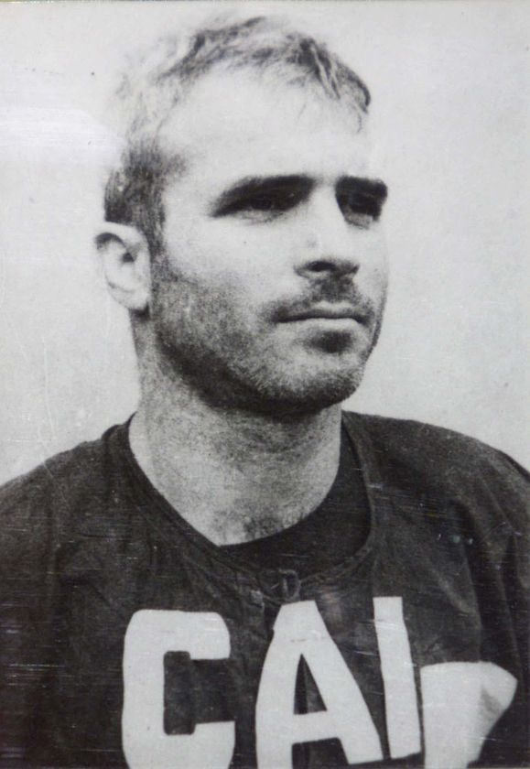
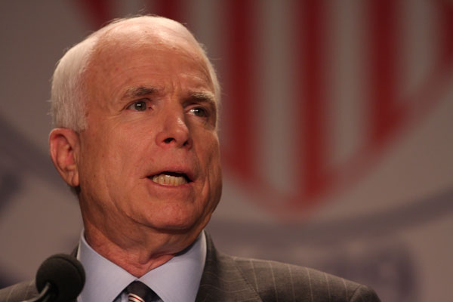
The Power of Information, Redux
During five and a half years as a prisoner of war…
“The thing I missed most was information…free uncensored, undistorted, abundant information.”
Notes:
SLIDE: DURING FIVE AND A HALF…
IN 1967, HE WAS A P.O.W. IN HANOI
What is it he says he missed the most?

Slide 6


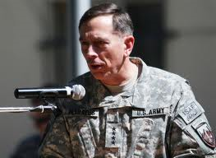


News Matters
Notes:
News Fellow: Add News Matters slides here.

Slide 7

News Matters
Notes:
News Fellow: Add News Matters slides here.

Slide 8
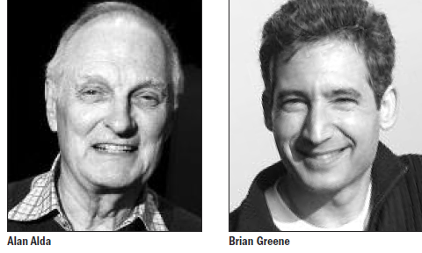
Why Communicating Science Matters:
A conversation between Alan Alda and Physicist Brian Greene
Thursday, September 23, 2010 4:00pm to 5:00pm
Staller Center Auditorium- Free and open to the public
Notes:
Animation: Image and text fade in together
SLIDE: Communicating Science Promo

Slide 9

News Matters: You Decide
Suggest a news story for a News Matters that illustrates a course point, or has relevance to student lives, and if we use your suggestion,
you get extra credit.
Send stories, with URLs, a short summary, to:

Slide 10
Know Your Neighborhood:
What Makes News Different?
What is Journalism?
Who is a Journalist?
Notes:
LESSON #1 OF NEWS LITERACY: ALWAYS KNOW WHAT INFORMATION NEIGHBORHOOD YOU ARE IN
This is a course on News Literacy.
We need to find the news before we can evaluate it.
Not all of the reports you see or read are legitimate news. They fall into other categories. This lecture is designed to help you understand the different types of information and what makes news different from other types. We’ve devised an information grid to help you find your way.

Slide 11
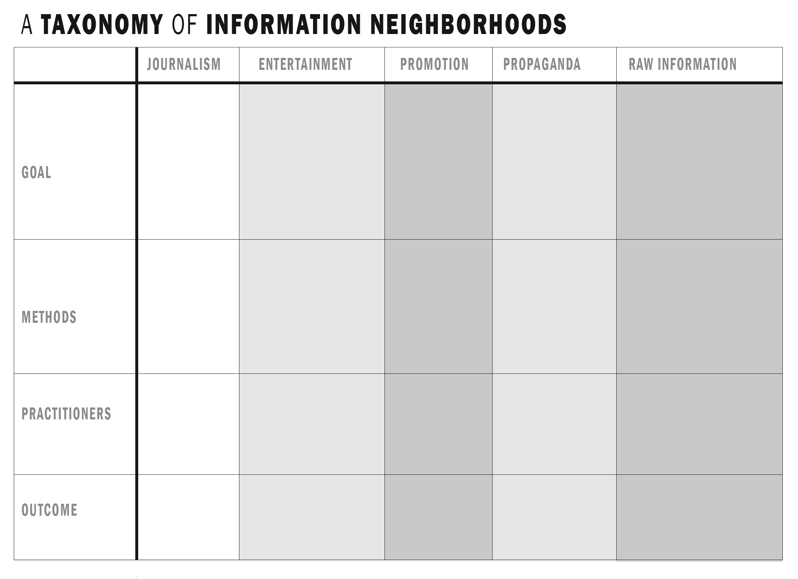
How Is News Different?
Taxonomy: a classification system
Notes:
POINT: One mark of an educated mind, in any field, is a muscular kind of critical thinking…the ability to recognize and describe fine distinctions among similar ideas, objects and people. You cannot succeed as an engineer, doctor, lawyer, banker, businesswoman or biologist unless you sharpen this skill. Every specialty uses Taxonomy.
To help you educate your mind in this way, we have built this grid. Once you can fill in this grid with clarity, you will have taken the first major step toward becoming News Literate.

Slide 12
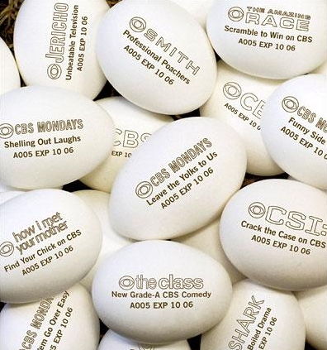
Taxonomy Starts with Definitions
Promotion
Is the marketing of goods, services and personalities designed to increase their appeal to consumers
Notes:
Promotion is the process by which we sell and market goods, services and personalities. Sometimes that is accomplished through simple advertising, sometimes through the more indirect methods called Public Relations. PR tools include sponsorships, staged events, product placement, press releases, carefully worded public statements and other efforts to make goods, services and personalities more appealing.

Slide 13
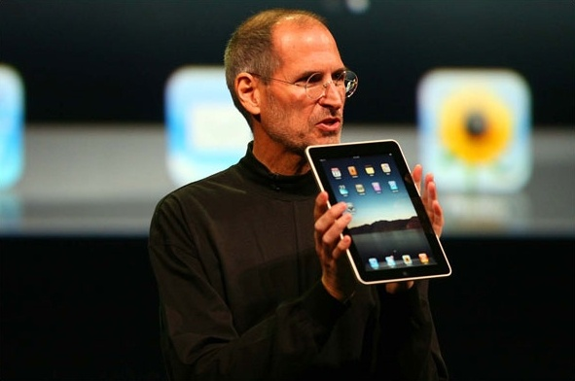

Taxonomy: Promotion
A Subset: Publicity
The measures, process or business of securing public notice. Information designed to enhance an image.
Notes:
Publicity: the measures, process, or business of securing public notice. Information designed to enhance an image.
Emphasize that publicity is often an attempt to get news media outlets interested in covering a story. Called “free media” as contrasted with paid advertising.
ASK: Which is more effective?
Is Publicity ever News or Newsworthy?

Slide 14
Taxonomy: Promotion
A Subset: Advertising
Attracting attention by paying to have advertisements place on billboards, in newspapers and broadcasts or on websites.
Notes:
Advertising is…The use of paid ads to attract attention to a product, service or other item for sale.
ASK: Which is more effective?

Slide 15

Taxonomy: Propaganda
Information, ideas or rumors deliberately spread widely to help or harm a person, group, movement,
Institution or nation.
It is often biased or misleading, in order to promote an ideology or political point of view.
Notes:
POINT: Propaganda is Political, Not Commercial.
Propaganda: information, ideas, or rumors deliberately spread widely to help or harm a person, group, movement, institution, nation. It is often biased or misleading in order to promote an ideology or political point of view.
Example is Al Qaeda’s “Inspire” Magazine

Slide 16


Taxonomy: Entertainment
Something affording pleasure, diversion, or amusement, often a performance of some kind.
Notes:
(Animated)
Entertainment: something affording pleasure, diversion, or amusement, often a performance of some kind. (As opposed to recreation, which you participate in)
ASK: Why isn’t “The Tillman Story” news?
(Recreated dialogue, actors, etc)

Slide 17

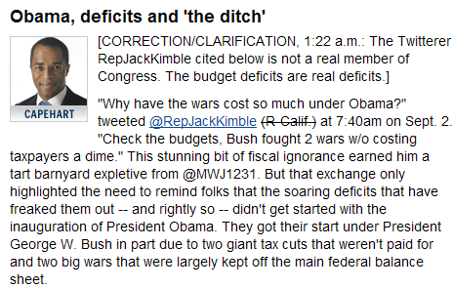
Taxonomy: Raw Information
Information that has yet to be examined or verified. It is unfiltered information that bypasses traditional gatekeepers and mediators.
Notes:
ANIMATION: 2ND CLICK BRINGS UP CORRECTION
Raw Information: Information that has yet to examined or verified. It is unfiltered information that bypasses traditional gatekeepers and mediators.
Tweets or Facebook Posts are a good example.
In this example, Washington Post columnist Jonathan Capehart spotted a Tweet from “Rep. Jack Kimble, R-California” and used that as a jumping-off point for an entire article in which he examined in detail the origins of our current federal budget deficit.
One problem…There is no Congressman named Jack Kimble, from California or anywhere else…

Slide 18

What is News?
Information of some public interest that is shared and subject to a journalistic process of verification.
Notes:
News: Information of interest to some portion of the public that is shared by a person working for the news organization and no one else, subject to a journalistic process of verification and for which the individual and organization are directly accountable.

Slide 19
How Is News Different?
Taxonomy = Clarity about differences among similar things
Notes:
Lecturer Fills out (on chalkboard, or using Sympodium Pen) just the Primary Goals section of the top of the Information Neighborhoods grid.
(“Primary” has been added to focus on simple terms)
ASK for suggestions, which you can write on the board, on Sympodium Pen, or just collect.
(Next Click brings up the Grid with Primary Goals in place)
(They will be)
Journalism: To Inform
Entertainment: To Amuse or otherwise engage people during their leisure.
Promotion: To Sell
Propaganda: To Build Political Support.
Raw Information: To Bypass filters
POINT OUT: That advertising and publicity are methods of Promotion.
(AVOID: Long conversations about the other categories. This is News Literacy, not Media Literacy. For the purposes of this course, there is news and then there’s everything else.)

Slide 20
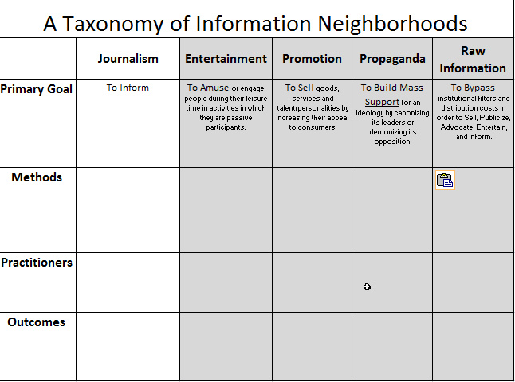
How Is News Different?
Taxonomy = Clarity about differences among similar things
Notes:
(LECTURER: NOW THE GOALS ARE FILLED IN)
Journalism: To Inform
Entertainment: To Amuse or otherwise engage people during their leisure.
Promotion: To Sell
Propaganda: To Build Mass Support.
Raw Information: To Bypass filters
POINT OUT: That advertising and publicity are methods of Promotion.

Slide 21
What Methods Make Journalism Different?
Verification
Independence
Accountability
(Mnemonic device: “Via”)
Notes:
ANIMATION: EACH CLICK BRINGS UP A WORD
POINT: Introduce three characteristics that are as essential to the Taxonomy of Information as color, shape and size are to the taxonomy of animals. These are terms students are expected to begin using in class and in homework assignments, starting today.
--Verification: evidence that establishes or confirms the accuracy or truth of something.
--Independence: freedom from the control, influence, or support of interested parties.
--Accountability: Responsible or answerable for your work.

Slide 22
What Makes News Different?
Verification
Process that establishes or confirms the accuracy or truth of something
Notes:
ANIMATION: CLICK BRING UP DEFINITION
-- Verification: evidence that establishes or confirms the accuracy or truth of something.
Good place to plant seeds about evidence vs. interference.
(Tell ‘em the phrase: “Correlation does not equal causation” can be used to stun a verbal opponent into silence…provided you use it correctly.)

Slide 23
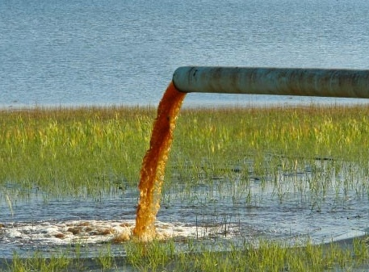


Verification
Notes:
Point: Verification by independent means not just taking one person’s word for it.
In this December 2009 story about polluted water systems , The New York Times compiled and analyzed millions of records from water systems and regulators around the nation. The documents showed Safe Drinking Water Act violations have occurred in every state. In Ramsey, N.J., for instance, water tests since 2004 have detected illegal concentrations of arsenic, a carcinogen, and the dry cleaning solvent tetrachloroethylene.
In New York state, 205 water systems have broken the law by delivering tap water that contained illegal amounts of bacteria since 2004.

Slide 24
What Makes News Different?
Independence
Freedom from the control, influence, or support of interested parties, coupled with a conscious effort to set aside any preexisting beliefs and a system of checks and balances.
Notes:
ANIMATION: CLICK BRINGS UP DEFINITION
Independence: freedom (of the journalist and the journalism organization) from the control, influence, or support of interested parties.
As important, (since objectivity is a fictional state of mind) Independence is guarded by a journalist’s conscious effort to set aside pre-existing beliefs AND a system of checks and balances by peers with the same goal.
ASK: What Other Professions attempt independence?

Slide 25


Independence
Journalists must not have a relationship to their subjects.
Notes:
ANIMATION: CLICK BRINGS UP SUB-HEAD
Remember the Air Races over New York Harbor and around the Statue of Liberty on June 19 and 20?
Was this publication an independent source of information about the safety, environmental impact and fairness of the race?
(2nd click brings up the “almost independent” line under the title)
To their credit, they tip their hat to the value of journalism with this subheadline: “An Almost Independent Magazine.”
Professional Journalists have developed guidelines to ensure there is a difference between journalism and everything else. Here is one version, from an organization called SPJ.
Here’s what the SPJ Code of Ethics says:
Journalists should be free of obligation to any interest other than the public’s right to know.
Avoid conflicts of interest, real or perceived.
Remain free of associations and activities that may compromise integrity or damage credibility.
Refuse gifts, favors, fees, travel, and special treatment, and shun secondary employment, political involvement, political office and service in community organizations if they compromise journalistic integrity.
Disclose unavoidable conflicts.
Be vigilant and courageous about holding those with power accountable. Deny favored treatment to advertisers and special interests and resist their pressure to influence news coverage.
Be wary of sources offering information for favors or money; avoid bidding for news.

Slide 26
What Makes News Different?
Accountability
Responsible or answerable
for your work.
Notes:
ANIMATION: CLICK BRINGS UP DEFINITION
Accountability: Responsible or answerable for your work.
Journalists put their name on their work. In many cases, their email address or phone number is attached to each report. That way, if the report is factually wrong, a news consumer or subject of a news story can report the mistake.
ASK: What other professions or crafts do this?

Slide 27
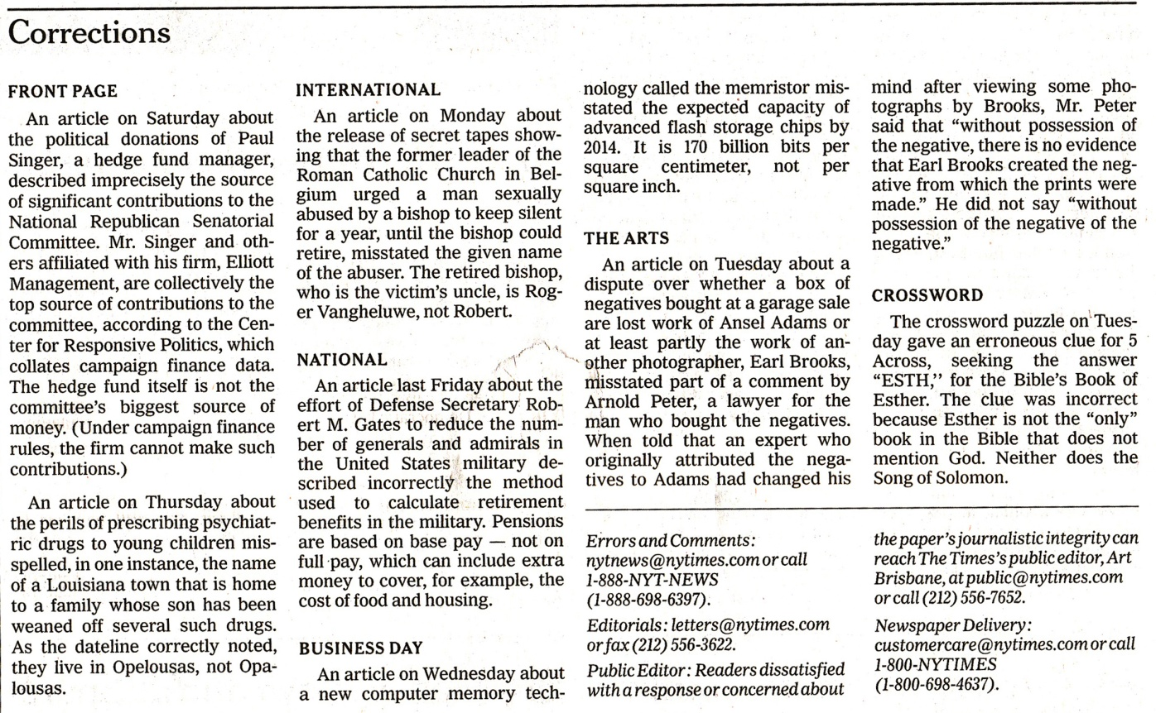
Accountability
Corrections are one way journalists are accountable for their work.
Notes:
Here’s one way the New York Times is accountable.
Here’s the applicable section from SPJ’s industry-standard code of ethics:
“Journalists are accountable to their readers, listeners, viewers and each other. Journalists should:
Clarify and explain news coverage and invite dialogue with the public over journalistic conduct.
Encourage the public to voice grievances against the media.
Admit mistakes and correct them promptly.
Expose unethical practices of journalists and the news media.
Abide by the same high standards to which they hold others.”

Slide 28
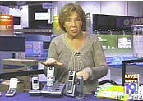
Which Neighborhood?:
Notes:
Point: Watch this report that aired on television and decide which information neighborhood you are in.

Slide 29
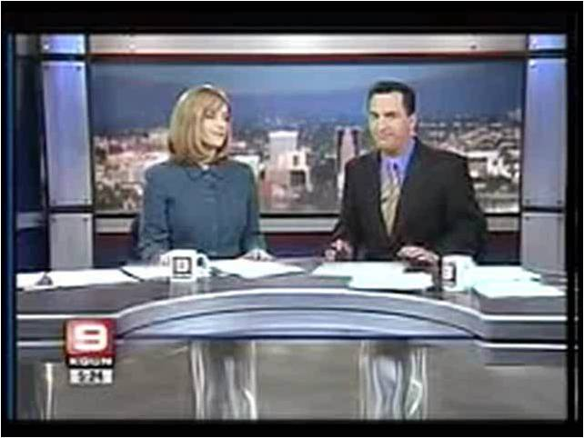
Notes:
It starts with Tucson, Arizona Channel 9’s News Anchors, who toss to Robin Raskin for some information about holiday gifts.
LECTURER: CLICK NOW TO LAUNCH VIDEO (3:38)

Slide 30
KGUN_Tucson_VNR.wmv
Notes:
NEWS FELLOW: LINK (INSERT) VIDEO TO THIS SLIDE AND SELECT “START AUTOMATICALLY”
(Lecturer…after video runs, but before you click to next slide)
ASK: Look at your Information Neighborhoods Grid…
ASK: Which neighborhood was that report in, and why? (Push for distinctions based on definitions, etc)

Slide 31
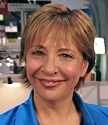
“Tech Expert” Robin Raskin on Her Role in VNRs
“I actually joked with my colleagues that, ‘Hey,
I’m off to go do Whore TV.”
I was fully aware that that’s what it was.”
-Excerpted from “True Enough,”
by journalist Farhad Manjoo
Notes:
Now…explain VNRs (See background)
PR firms write and film ready-to-run television stories about a client’s product. Say it’s a candy company. The package includes interesting video of candy being made. Interviews with employees. A script with background and context…
This is sent, with a suggested script, to TV news directors. If they like it, they’ll use the video and maybe even the script.
Here’s how Alton Miller, a PR professor from Chicago and former Public Relations Director for the Mayor of Chicago describes it:
“The whole idea is that you're making it easy for the TV station to do a thorough, visually-interesting report without having to invest their own resources -- a camera crew to come visit the candy factory -- to illustrate it.”
What’s missing from a story like this?
Who was Raskin working for? Apple’s rivals.

Slide 32
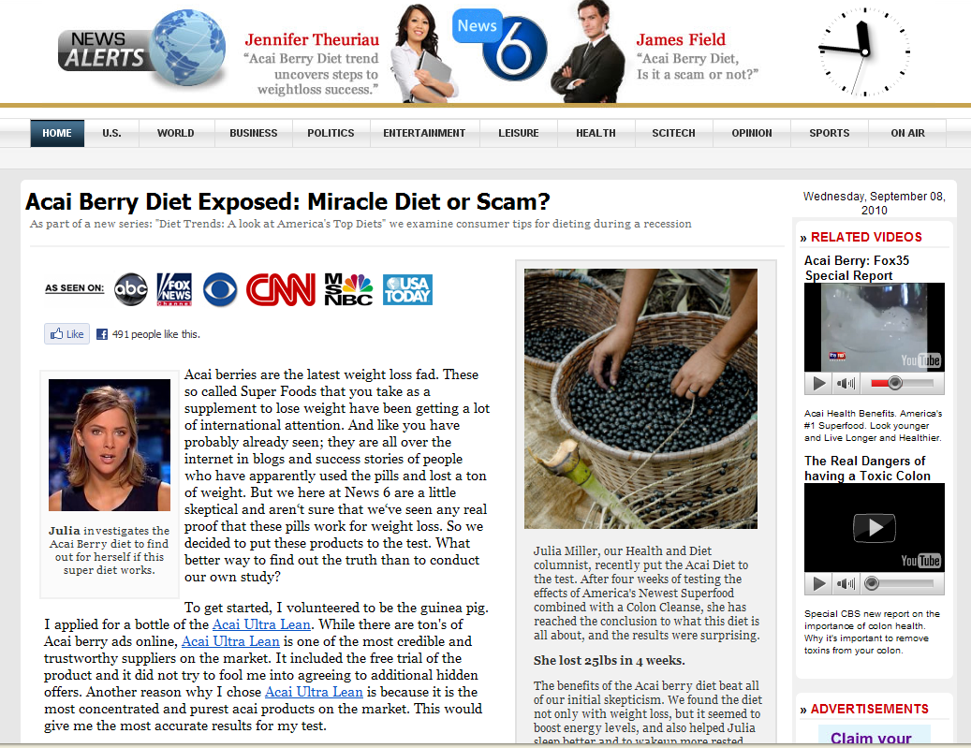
Taxonomy is Challenged On the Web
Which Neighborhood is it?
Notes:
Have you seen these Web Reports on Aca9 (Ah-Sigh-Yee) Berry Diets?
Ask: What neighborhood are you in?
Consumer organizations like the Better Business Bureau and Consumer Reports observe that many Acai Berry juice pages like this include fraudulent claims of an Oprah Winfrey endorsement. In addition, news-like web reports like this, designed to look like they come from independent news organizations, often use near-identical language and claims (Lost 2 Dress Sizes, etc.)
Reading this introduction and conclusion from one such “Investigation,” what are your clues?
(Lecturer read excerpt) “With all the media coverage, you probably already know that the acai berry has become one of the most popular and controversial health supplements in the world…(and it goes on for pages)
“CONCLUSION: Now that we have went through most of the key points of the controversy, it is time to weigh in on the score and make a conclusion. If you stay away from free trials and don't expect them to melt off 30 pounds of fat without exercise, the acai berry is 100% legitimate.”
Alongside one Acai web News Report we scrutinized last week were dozens of advertisements for Acai Berry products and the “reporter” discloses that he gets paid every time a reader clicks on one of the web ads alongside the “report.”

Slide 33
The First Rule of News Literacy
Know
Your
Neighborhood
It’s Easy to Get Lost
Notes:
This is Rule #1 in News Literacy: “Know which neighborhood you are in.”
It’s easy to get lost with so much information out there, plus there are people looking to benefit or profit from misleading you. Prof. Hornik likes to make a comparison to poker: “When you sit down to play, if you don’t know who the fish is…you’re the fish.”

Slide 34
The Blurring of the Lines:
News vs. Entertainment
Notes:
POINT: Be aware that the neat and tidy lines of the Grid can get blurred, sometimes on purpose and with intent to deceive…
It is easy to get fooled, as the acai berry ads and video news release demonstrated.
Let’s look at some examples of where the lines are blurred
POINT: Let’s start by thinking about entertainment shows that look like news and news shows that look like entertainment shows.

Slide 35

The Blurring of the Lines:
News vs. Entertainment
ABC’s ‘The Path to 9-11’
Notes:
THE BLURRING OF THE LINES: ENTERTAINMENT OR NEWS?
ASK: WHAT IS A DOCUMENTARY?
WHAT IS DOCUDRAMA?
Docudramas: Many people take what they see in these as being factually true, no different than a news report because of the word documentary. (Which has been blown to smithereens by young documentary makers who fictionalize like mad)
A phrase like ”Based on facts” gives wide latitude with the truth.
In can be engrossing, but it is not necessarily strictly factual. For instance…
LECTURER: CLICK NOW TO LAUNCH VIDEO (31 seconds of lead-in to “Path to 9-11”)

Slide 36
Path_to_9-11.wmv
Notes:
NEWS FELLOW: LINK (INSERT) VIDEO TO THIS SLIDE AND SELECT “START AUTOMATICALLY”

Slide 37
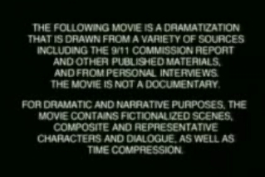
The Blurring of the Lines:
News vs. Entertainment
ABC’s Disclaimer for ‘The Path to 9/11’
Notes:
Are these movies the same as news reports?
Their primary goal is to entertain, not give a strictly factual or informative account of what happened.
Look for “Inspired by a true story.”
That’s a tipoff it is not news, it is entertainment.

Slide 38
Un-Blurring the Lines:
News vs. Entertainment
‘Based on Fact’
‘Inspired By a True Story’
If it has actors, if it has the word ‘drama’ in its description, if it is produced by the entertainment division – it’s not news, it’s entertainment.
Notes:
Point: Unblur the lines by using your grid…your taxonomy
If it has actors in it and the word drama in its description it is entertainment, not news.
Watch for the disclaimers, i.e. “based on facts” or “docu-drama”
If it is produced by the entertainment division of a television network or cable company, it is not news.
In the Information Neighborhoods, there’s news and then there’s everything else.

Slide 39

The Blurring of the Lines:
Where does entertainment news fit?
Is TMZ News?
Notes:
THE BLURRING OF THE LINES: INFOTAINMENT (News vs. Publicity)
Is TMZ journalism?
LECTURER: CLICK NOW TO LAUNCH VIDEO OF “JERSEY SHORE” STAR “SNOOKI” GETTING OUT OF JAIL(49 Seconds)

Slide 40
snooki.wmv
Notes:
NEWS FELLOW: LINK (INSERT) VIDEO TO THIS SLIDE AND SELECT “START AUTOMATICALLY”
ASK: IS IT NEWS THAT SNOOKI WENT TO JAIL? WHY? USE YOUR TAXONOMY
PROMPT WITH:
IS TMZ INDEPENDENT?
HOW DOES TMZ OBTAIN VIDEO? WHAT KIND OF DEALS DOES IT MAKE FOR INFORMATION
IS TMZ ACCOUNTABLE FOR ERRORS?
DOES TMZ VERIFY BEFORE BROADCASTING?
ASK: WHERE DOES TMZ FIT?

Slide 41

The Blurring of the Lines:
News vs. Promotion
Is a cover story selected
for its news value?
Or…
Is it a way of
promoting a film?
Notes:
What about People Magazine?
It’s the most successful magazine in history, has high standards for verification and credibility.
Many readers consider it a news magazine, but it is largely driven by the entertainment industry.
When hard-to-reach celebrities suddenly make themselves available right before the release of a new movie or new album of music…Where does that fit on the Taxonomy of News Neighborhoods.

Slide 42

The Blurring of the Lines:
“Exclusives”
When a famous person chooses one outlet to tell a high-demand story, what happens to verification and independence?
Notes:
UNBLURRING: Is there a journalistic rationale for this story?
… other than to promote or enhance the subject of the story?
In this case, Tiger Woods’ ex-wife Elin Nordgren, right after the divorce was final, was given the questions in advance and sent back written answers (Because her English isn’t natural yet, People Magazine noted)
It’s a QnA story, with no independent comments or verification other than a quote from Tiger saying he and Elin are committed to working to prevent the divorce from harming their children.
There is betting already over sales of this copy: did it outsell the pictures of Brangelina’s kids, of Sandra Bullock’s cover?
What are the pressures on independence when a famous face on the cover can guarantee 2 million magazines will be sold? We’ll return to that question in 2 weeks…

Slide 43
Un-Blurring the Lines:
News or Advertising?
How to Spot VNRs:
- Look for Sign Offs
- Look for credentials of experts – are they Accountable and Independent?
- Look for multiple sources supplying evidence
- Look for verified information
Notes:
UnBlurring VNRS (each HowTo clicks up)
Promotion can look a lot like news…
Revisiting the Video News Release.
UNBLURRING THE LINES IN VIDEO REPORTS (say “VIA” holding up 3fingers)
V…Is the information verified?
I…Whose payroll is the Expert on? Is he or she independent?
A…Look for Sign Offs (accountability) Who will answer if the information is false.
Will one company or product benefit from the report? (Particular problem in local television reporting on medical news. Major sponsor hospital is the default source)

Slide 44
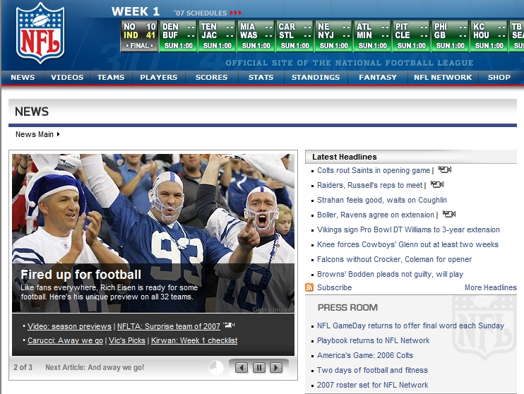
The Blurring of the Lines:
News or Promotion?
The NFL’s Preferred Form of Football News
Notes:
On the Internet it is especially difficult to know what neighborhood you are in.
For instance:You go to the NFL’s website and it has more information than any other source and usually before other outlets. That sounds like you are getting news.
But the NFL Network is managed by the NFL to benefit the NFL. The material on that site is prepared by people on the NFL’s payroll. When the NFL says something is so, do NFL Networks go to outside sources for verification?
V.
I.
A.
What’s it stand for?

Slide 45
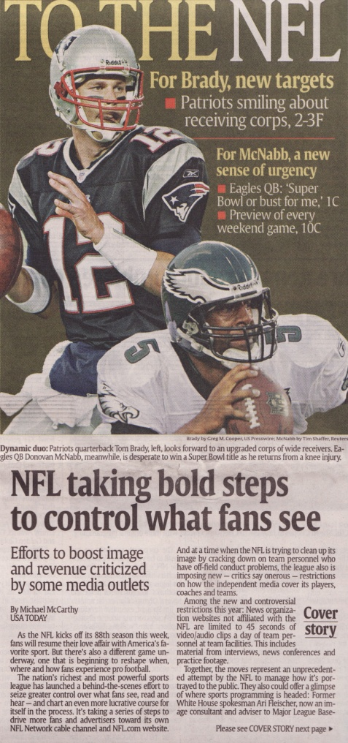
The Blurring of the Lines:
News or Promotion?
“The nation’s richest and most powerful sports league has launched a behind-the-scenes effort to seize greater control over what fans see, read, and hear . . .”
Notes:
Here’s a USA Today report on the NFL Network’s decision to limit non-NFL Network broadcasters from using more than 45 seconds per day of video/audio clips and keep more control over what fans hear and see about NFL Football.
It’s a trivial example of the battle for control of information.
Why isn’t NFL Network News?
Use The Taxonomy…

Slide 46
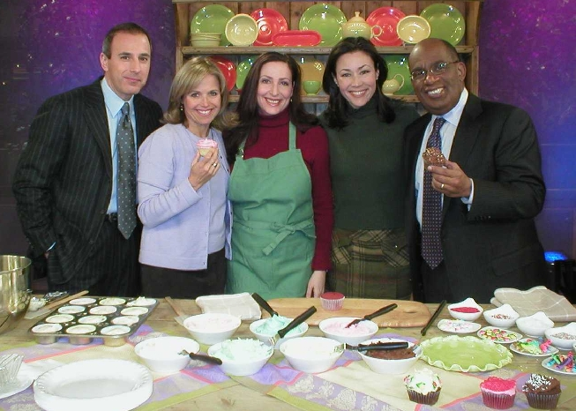
The Blurring of the Lines:
News vs. Promotion
Is This Today Show Segment News?
Notes:
When best-selling author Dan Brown was coming out with a new novel in 2009, NBC’s “Today Show” aired a weeklong series of daily clues to the thriller’s plot.
LECTURER: CLICK NOW TO LAUNCH VIDEO FROM TODAY SHOW COUNTDOWN to BOOK RELEASE (41 Seconds)

Slide 47
Today Dan Brown.wmv
Notes:
NEWS FELLOW: LINK (INSERT) VIDEO TO THIS SLIDE AND SELECT “START AUTOMATICALLY”
(SKIPPABLE SLIDE)
ASK: IS IT NEWS THAT Dan Brown has a book out?
What about these reports? News or Promotion?

Slide 48
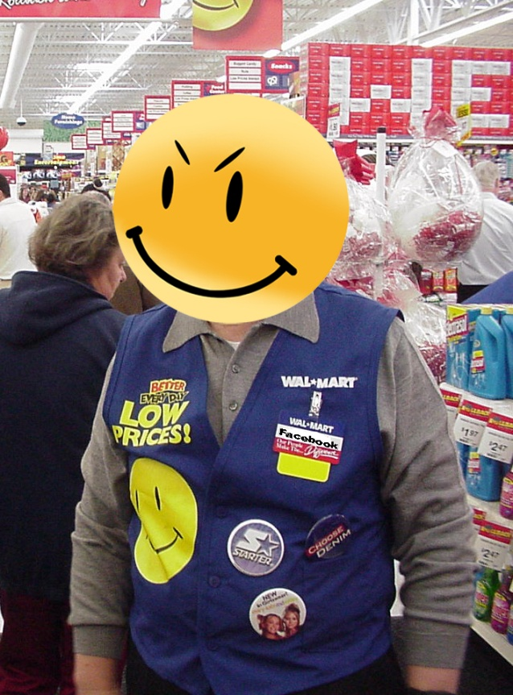
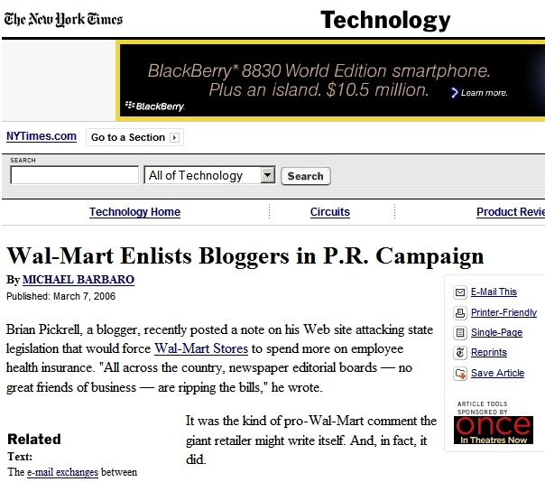
The Blurring of the Lines:
News vs. Promotion
“. . .some bloggers have posted information from Wal-Mart, at times word for word, without revealing where it came from.”
Notes:
On the web, how do you know what’s News and what’s promotion.
Wal-Mart paid bloggers to post comments that are designed to give the company a better image.
But they are not identified as being paid by Wal-Mart.

Slide 49


Un-Blurring the Lines Online
Taxonomy helps sort News from Promotion
Reliable bloggers give their name, credentials and affiliations
Notes:
Was this revealed? No. What are some of the steps you can take as a news consumer to be aware of what neighborhood you are in?
Look for accountability.
Demand names, credentials and affiliations.
SPJ sez:
Distinguish news from advertising and shun hybrids that blur the lines between the two.
As of December 1, the Federal Trade Commission required bloggers, and prominent Tweeters and Facebookers to reveal any arrangements under which they are paid for posting specific content. If you receive gifts, money or any other type of compensation from a product manufacturer or service provider you have to disclose it. Ditto if you post criticisms of your employer’s competitors.
ASK: Why should this be Public Policy?

Slide 50

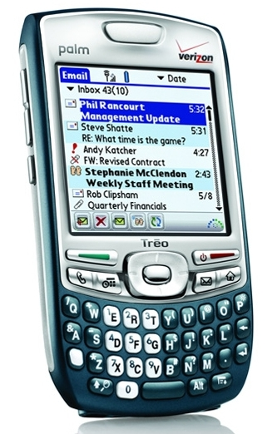


Un-Blurring Consumer News
News vs. Promotion (PR)
• Is There a Journalistic Rationale for the Story?
• Look for the phrases “press release” or “PR.”
Notes:
PRODUCT RELEASES
POINT: This one is Pure press release in that it has little news value, it’s clearly labeled a press release and there is no independent information included. It’s a one-sided tout of a product.

Slide 51
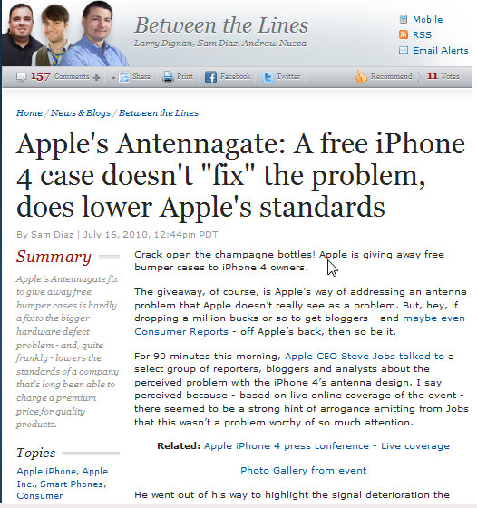
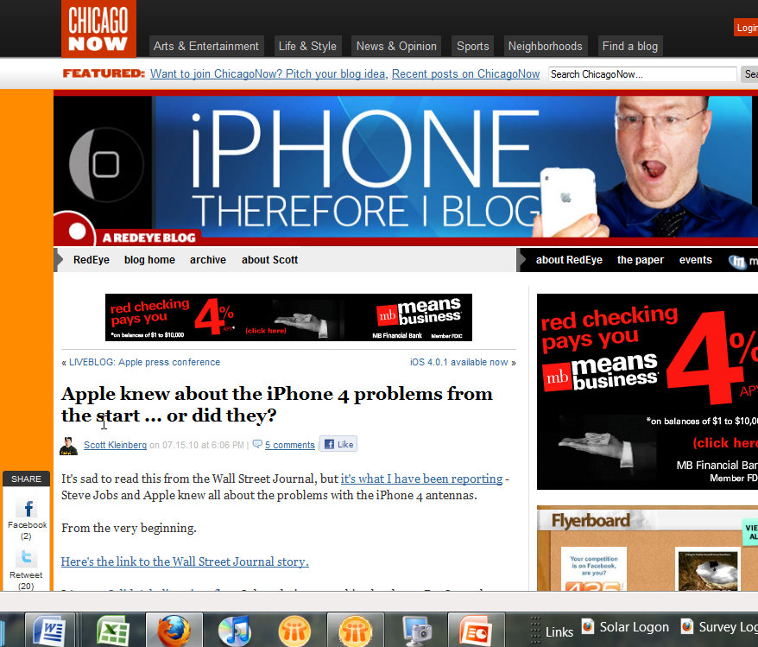
Bloggers vs. Consumer Reports
Why did bloggers like this have little impact?
Notes:
NEWS FELLOW: LINK (INSERT) VIDEO TO THIS SLIDE AND SELECT “START AUTOMATICALLY”
LECTURER: CLICK NOW TO LAUNCH VIDEO (TIME CODE)

Slide 52
Bloggers vs. Consumer Reports
Iphone4.wmv
Independence, Accountability, Verification
Notes:
NEWS FELLOW: LINK (INSERT) VIDEO TO THIS SLIDE AND SELECT “START AUTOMATICALLY”
Bloggers had been all over the iPhone’s antenna problem. But when Consumer reports gave it a negative rating and called on Apple to compensate iPhone buyers, Apple suddenly said it would give free protective cases to iPhone buyers.

Slide 53
Un-Blurring the Lines
News vs. Promotion (Publicity)
Who paid to organize the event?•
Are you getting independent information from multiple sources, or only self-interested information?
• Look for the phrase “press release”
Notes:
Using a Press Release,
Apple invites the News Media to the announcement of a new product: The iPad.
Using the Taxonomy…what is this:
Publicity?Advertising?

Slide 54
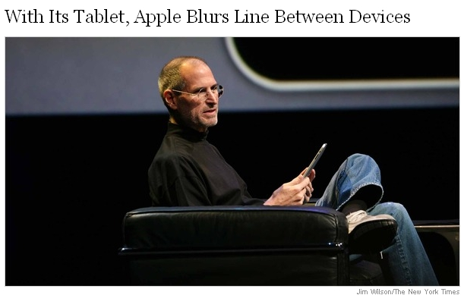
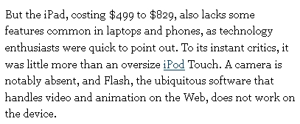
Un-Blurring the Lines
News vs. Promotion
• Is There a Journalistic Rationale for the Story?
• Are You Getting Independent, verified, Information?
• Look for a byline or sign-off
Notes:
After the event, The New York Times publishes a story about the release of Apple’s iPad
The story helps publicize iPad, but…it also includes comments from people who don’t work for Apple, as well as the reporter’s research on sales, markets, etc.
ASK: Which neighborhood are you in?
Why does it matter?

Slide 55

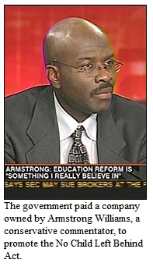
The Blurring of the Lines:
News vs. Propaganda
http://hnn.us/articles/20418.html
Columnist Armstrong Williams is Paid $240,000 to Promote a Bush Administration
Education Policy
Notes:
THE BLURRING OF THE LINES: PROPAGANDA VS. NEWS:
Armstrong Williams, a newspaper columnist and the host of, a monthly primetime television special syndicated to several TV and radio cable channels was revealed to have accepted $240,000 from the Bush Administration to write nice things about No Child Left Behind, an education reform program .
Congressional research service: “5 U.S.C. 3107 prohibits the use of appropriated funds to hire publicity experts. Appropriations law “publicity and propaganda” clauses restrict the use of funds for puffery of an agency, purely partisan communications, and covert propaganda.”
ASK: What neighborhood and why?

Slide 56

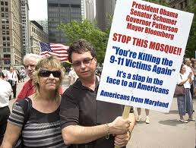
Un-Blurring the Lines
Propaganda vs. News
• Is the message one-sided?
• Does it manipulate emotions?
• Is it coming from an independent messenger?
Notes:
UNBLURRING THE LINES
What’s the neighborhood. Stay calm and use the taxonomy:
Ask: Is the message one sided?
Does it seek to manipulate emotions?
Is it coming from an independent messenger?
Is there a political campaign connected to it?
Ask: Why isn’t this Promotion or Advertising?

Slide 57
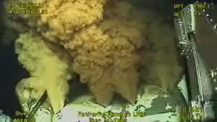
One Story, Several Neighborhoods:
Gulf Oil Spill
Which Neighborhood?
Notes:
The reason we’re pounding that word, Taxonomy, into your heads is this: you know from Lecture 1 the dimensions of the information Tsunami that washes over you every day. It’s tempting to ignore all of it…But you need reliable information to make decisions, take action and make judgments for your family, career and community. So let’s look at information about the Gulf Oil Spill in the major Information Neighborhoods.
This live underwater video of the oil gushing into the gulf was, for a time this summer, one of the most popular items on the Internet. BP’s live feed was viewed about 300,000 times per day and more than a million people have watched it via “spill cam” on various websites.
LECTURER: CLICK NOW TO LAUNCH APOilSpillClip.wmv VIDEO
(1:05 and interruptible after just a few seconds)

Slide 58
Neighborhoods Case Study:
Gulf Oil Spill
APOilSpillClip.wmv
Which Neighborhood?
Notes:
NEWS FELLOW: LINK (INSERT) VIDEO TO THIS SLIDE AND SELECT “START AUTOMATICALLY”
All those millions of viewers…were they getting news?

Slide 59
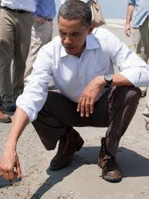
One Story, Several Neighborhoods
The Gulf Oil Spill
Which neighborhood ?
Notes:
SLIDE: From the U.S. White House Website
POINT: WHITE HOUSE, STUNG BY CRITICISM THAT THE PRESIDENT WASN’T DOING MUCH, ADOPTS P.R. TACTICS WITH A FEEL-GOOD EVENT, THANKING THE COAST GUARD FOR ITS RESCUE EFFORTS AFTER THE EXPLOSION AND MONITORING AND MANAGEMENT OF “THE LAREGEST ENVIRONMENTAL CLEANUP EFFORT IN HISTORY.”
LECTURER: CLICK NOW TO LAUNCH VIDEO (2:05 and interruptible)
It’s official White House video of an Obama event near a clean-up site

Slide 60
One Story, Several Neighborhoods
The Gulf Oil Spill
ObamaOil.wmv
Which Neighborhood?
Notes:
NEWS FELLOW: LINK (INSERT) VIDEO TO THIS SLIDE AND SELECT “START AUTOMATICALLY”
Ask: WHICH NEIGHBORHOOD?
Why? Be specific

Slide 61
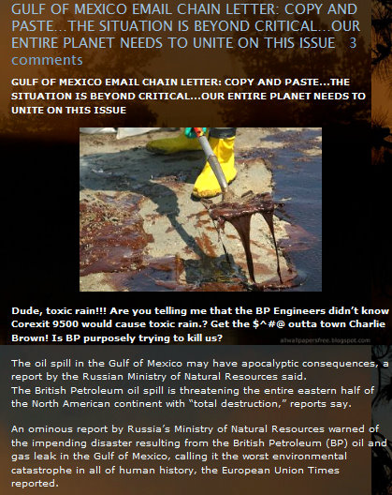
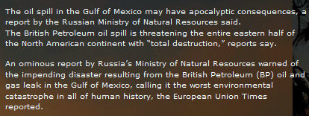
One Story, Several Neighborhoods
The Gulf Oil Spill
Which Neighborhood?
Notes:
ANIMATION: 2ND CLICK BRINGS UP “WHICH NEIGHBORHDOOD?”
In this chain letter, you are urged to pass along the following:
“The British Petroleum oil spill is threatening the entire eastern half of the North American continent with “total destruction,” reports say.”
Ask: WHICH NEIGHBORHOOD?
Why? Be specific

Slide 62
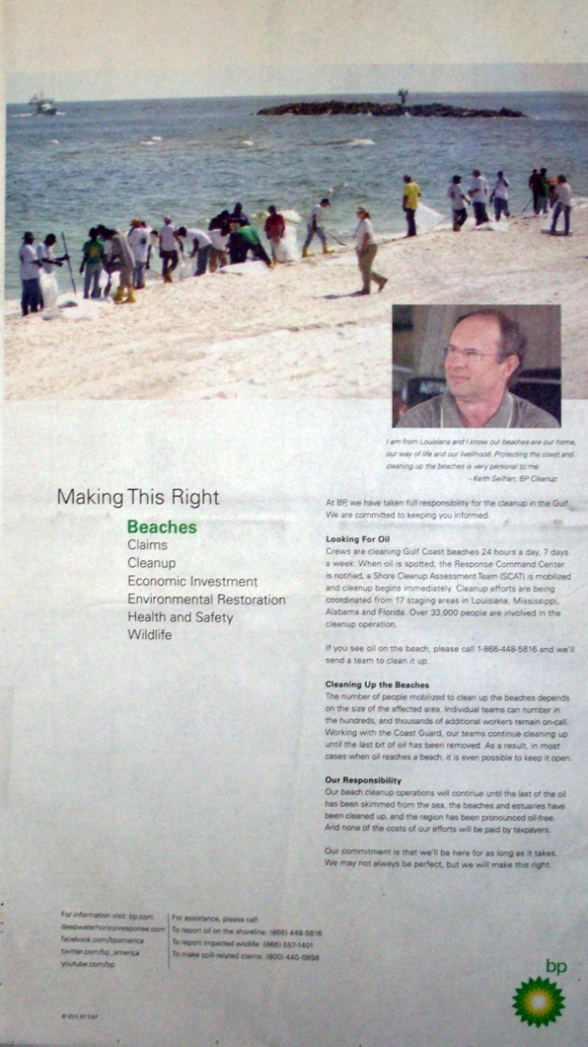
One Story, Several Neighborhoods
The Gulf Oil Spill
Which neighborhood?
Notes:
ANIMATION: 2ND CLICK BRINGS UP “WHICH NEIGHBORHDOOD?”
A sunny day…a white beach…an offshore breeze…a native Louisianan reassuring his neighbors.
Ask: What’s the Goal, Method, Practitioner and Outcome
(increase BP’s appeal to consumers, Paid Ad, Built by an ad agency, to rescue stock price and/or sales of BP products)

Slide 63
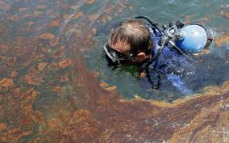
One Story, Several Neighborhoods:
The Gulf Oil Spill
Notes:
LECTURER: CLICK NOW TO LAUNCH OilScuba.wmv VIDEO (2:04)
It’s an AP report on underwater guck

Slide 64
One Story, Several Neighborhoods
The Gulf Oil Spill
Oilscuba.wmv
Which Neighborhood?
Notes:
NEWS FELLOW: LINK (INSERT) VIDEO TO THIS SLIDE AND SELECT “START AUTOMATICALLY”
All Three Methods are in place: V. I. A.
This reporter demonstrates an important News Literacy concept we’ll revisit at greater length later in the semester.
This reporter verified his facts in person.
He dove into the oily water himself to see what the local diver was talking about when he described strange “Snot Balls” underwater.
The reporter went and personally looked and touched. That’s the most powerful verification we know of and we call it “Opening. The. Freezer.”
Don’t worry. We’ll explain when we get there…”Open. The Freezer.” Remember that.

Slide 65
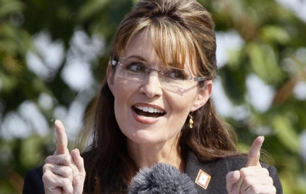
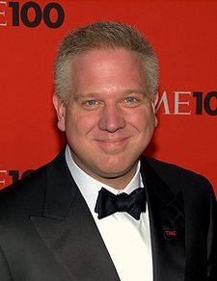
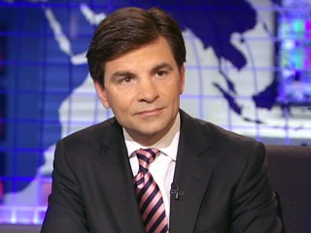
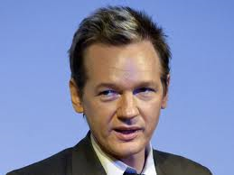
Who is a Journalist? (V.I.A.)
Notes:
We’ve just talked about what makes journalism different.
Now let’s address the “Practitioner” category of our Taxonomy of Information Neighborhoods.
Who is, and who is not, a journalist?
And how can we tell?

Slide 66
Who is a Journalist?
Is Sarah Palin a Journalist?
Notes:
She went to journalism school
She used to do local sports on an Alaskan TV station before she became Mayor of Wasilla, Alaska, then Governor of Alaska, then vice presidential nominee of the Republican Party. Now thought to be running for President, Palin endorses conservative candidates, raises political contributions and in January was hired by Fox News Channel to serve as a political commentator and part-time TV host. Born in 1965,
Palin, 45 (in 2010), "will provide political commentary and analysis'' for Fox News's political and business news programs and will host "periodic episodes of FNC's 'Real American Stories,' a series exploring inspirational real-life tales,'' a company statement said.
Verifies the material she broadcasts?
Independent of affiliations?
Accountable to whom?
Is she a journalist? Why does it matter?

Slide 67
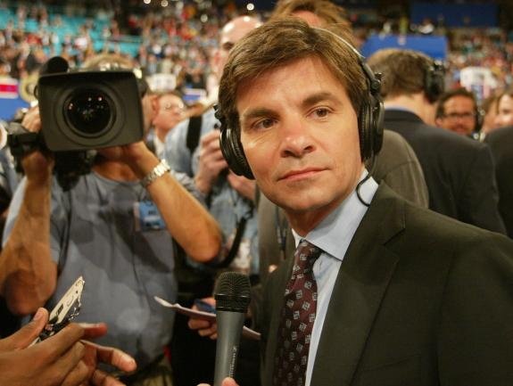
Who is a Journalist?
Is George Stephanopoulos
a Journalist?
Notes:
George Stephanopoulos (born 1961) is the chief political correspondent for ABC and a co-anchor of ABC News's morning news program, Good Morning America (GMA). He is the primary substitute anchor for ABC News's flagship news program, World News with Diane Sawyer. Prior to joining ABC News, he was a senior political adviser to the 1992 U.S. presidential campaign of Bill Clinton and later became the White House Communications Director for President Clinton. Before that, Stephanopoulos worked for a series of Democratic notables including Congressman Ed Feighan from Ohio, the Michael Dukakis 1988 U.S. presidential campaign and Dick Gephardt, U.S. House of Representatives Majority Leader. He graduated with a degree in political science from Columbia, where he was a radio sportscaster.
Verifies the material he broadcasts?
Independent of affiliations? (ASK: Once a politician, always a partisan?)
Accountable to whom?
Is he a journalist? Why does it matter?

Slide 68
Who is a Journalist?
Is WikiLeaks Founder
Julian Assange
a Journalist?
Notes:
Julian Paul Assange born 1971 is the Editor in chief and spokesperson for WikiLeaks, the whistleblower website. Assange, an Australian, was a physics and mathematics student, a hacker and a computer programmer, before taking on his current role. Wikileaks was founded in 2006. Like all others working for the site, Assange says he is an unpaid volunteer. Assange was the winner of the 2009 Amnesty International Media Award (New Media), awarded for exposing extrajudicial assassinations in Kenya. Assange says that Wikileaks has released more classified documents than the rest of the world press combined: "That's not something I say as a way of saying how successful we are – rather, that shows you the parlous state of the rest of the media. How is it that a team of five people has managed to release to the public more suppressed information, at that level, than the rest of the world press combined? It's disgraceful.”
Verifies the material he broadcasts?
Independent of affiliations?
Accountable to whom?
Is he a journalist? Why does it matter?

Slide 69
Who is a Journalist?
Is conservative broadcaster and author
Glenn Beck
a Journalist?
Notes:
Glenn Lee Beck (born February 10, 1964) hosts the Glenn Beck Program, a nationally syndicated conservative talk-radio show, The Glenn Beck Show on Fox News Channel, and author of six New York Times best-selling books, five of which debuted at #1. Beck’s Fox program has captured as many as 3 million viewers at its peak. Currently said to be less than half that. Supporters call him a defender of the Constitution and defender of traditional conservative values.
Critics say he is a dangerous peddler of conspiracy theories whose rhetoric may spur his listeners to violent action.
Verifies the material he broadcasts?
Independent of affiliations?
Accountable to whom?
Is he a journalist? Why does it matter?

Slide 70
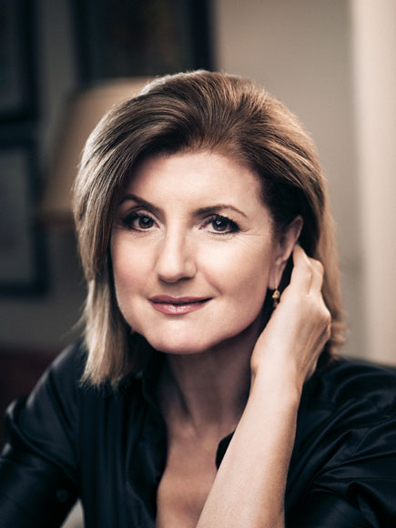
Who is a Journalist?
Is Huffington Post Co-founder Arianna Huffington
a Journalist?
Notes:
Arianna Huffington (born 1950) is a Greek-American author (12 books on topics from Picasso to American politics) who co-founded the progressive news website The Huffington Post. A popular conservative commentator and syndicated columnist in the mid-1990s, she championed Newt Gingrich’s Contract With America and ran “Resignation,” a website devoted to demanding Bill Clinton’s resignation from the Presidency.
she is the ex-wife of former Republican California congressman Michael Huffington. In 2003, she ran as an independent candidate for Governor in California.
Launched in 2005 as an alternative to conservative websites like the Drudge Report, Huffington Post offers coverage of politics, media, business, entertainment, living, style, the green movement, world news, and comedy, and has news, blogs, and original content.
Verifies material before publication?
Independent of affiliations?
Accountable to whom?
Is she a journalist? Why does it matter?

Slide 71
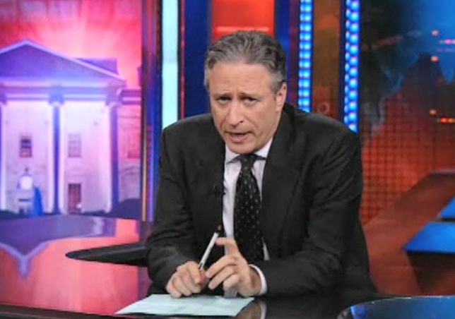
The Daily Show
Segment on “Don’t Ask, Don’t Tell”
Notes:
So…what about this? Is it or isn’t it?
LECTURER: CLICK NOW TO LAUNCH Gays in the Military Daily Show segment VIDEO (3:08)

Slide 72
daily show gays military.wmv
Notes:
NEWS FELLOW: LINK (INSERT) VIDEO TO THIS SLIDE AND SELECT “START AUTOMATICALLY”

Slide 73
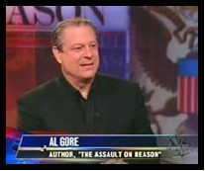
Is Jon Stewart a Journalist?
The Daily Show Hosts Al Gore
Notes:
daily show gays military
Like a news show…Jon Stewart has newsmaker guests who talk about news
ASK: Why isn’t this a News Show?
LECTURER: CLICK NOW TO LAUNCH Gore’s egregious up-sucking VIDEO (3:33)

Slide 74
Daily_Show_Gore
Notes:
NEWS FELLOW: LINK (INSERT) VIDEO TO THIS SLIDE AND SELECT “START AUTOMATICALLY”

Slide 75
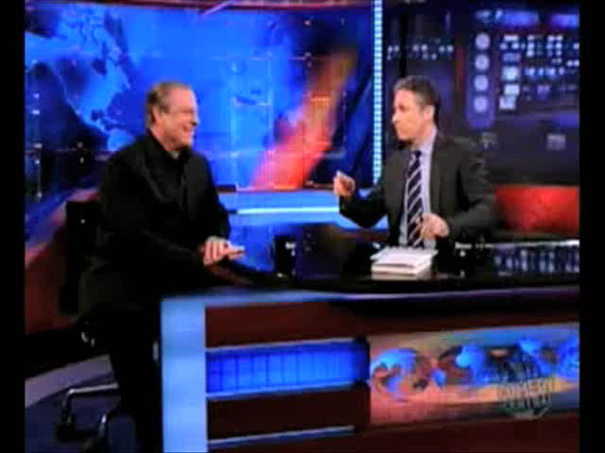
Notes:
SLIDE: AL GORE ON THE DAILY SHOW
POINT: Gore plugs the Daily Show as the best place to cut through the noise
LECTURER: CLICK NOW TO LAUNCH VIDEO (TIME CODE)

Slide 76
The Daily Show: Newscast or Not?
Notes:
Re-ask: Is Jon Stewart a Journalist?
Is the Daily Show Journalism?

Slide 77
So Who is a Journalist?
• Primary Mission is to
Inform the Public
• Employs Journalistic
Methods and Values
Notes:
The Bedrock commitment of a journalist is to Seek Truth and Report it.
You will see many examples this semester of people who wish to wear the mantle of journalism, but refuse to submit to the collar that restricts journalists from some parts of life everyone else takes for granted, like political activism, public expressions of opinions, etc.
Here are the key components of the code of ethics that binds journalists:
Journalists seek the truth and should be honest, fair and courageous in gathering, reporting and interpreting information.

Slide 78
So Who is a Journalist?
• Makes a conscious effort to maintain independence
• Accountable: Stands behind work
• Subjects work to verification
Notes:
Journalists should be free of obligation to any interest other than the public’s right to know.
Journalists are accountable to their readers, listeners, viewers and each other.
Journalism is a discipline of verification, not the mere recording of one point of view or another.

Slide 79
What Methods Make Journalism Different?
Verification
Independence
Accountability
(Mnemonic device: “Via”)
Notes:
ANIMATION: EACH CLICK BRINGS UP THE NEXT WORD. LAST CLICK BRING UP MNEMONIC
Here’s one way to remember it while you’re reading the Times this week: “VIA”
--Verification: evidence that establishes or confirms the accuracy or truth of something.
--Independence: freedom from the control, influence, or support of interested parties.
--Accountability: Responsible or answerable for your work.

Slide 80
Assignments
News Quiz starts this week in recitation.
Taxonomy of Information Neighborhoods: Make one blank printout to bring to recitation. Make a second copy that you fill in for submission at recitation.
Is You Tube News? Watch the 3 videos as assigned and write a short paper explaining where they fit in the grid.
Jon Stewart and the News: Read the selection of stories found in My Assignments folder for this week. Be prepared for quiz and discussion
Notes:
--Verification: evidence that establishes or confirms the accuracy or truth of something.
--Independence: freedom from the control, influence, or support of interested parties.
--Accountability: Responsible or answerable for your work.

