Slide 1
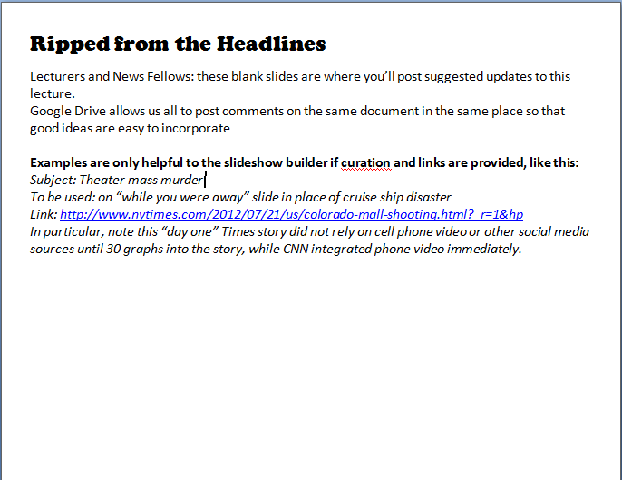

Slide 2
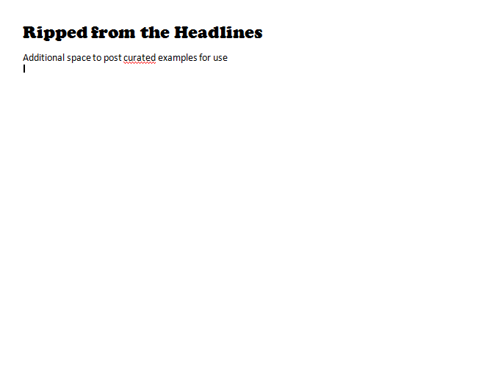

Slide 3


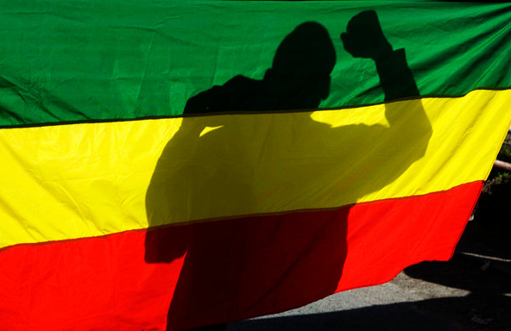
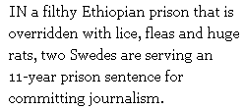

Notes:
http://www.nytimes.com/2012/01/29/opinion/sunday/kristof-whats-he-got-to-hide.html?_r=1
Click brings up pull quotes

Slide 4
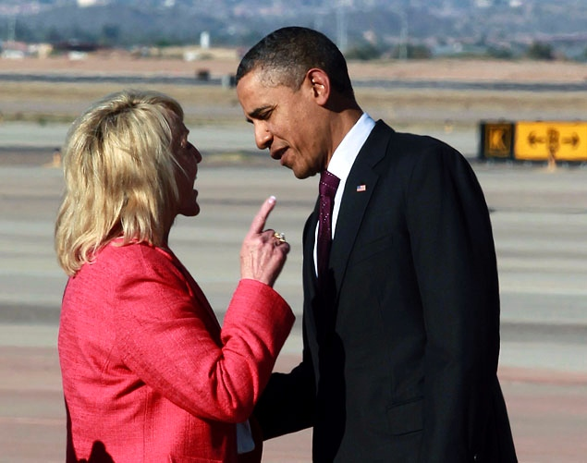
Notes:
http://www.cbsnews.com/8301-503544_162-57367529-503544/jan-brewer-releases-private-letter-she-gave-obama/
http://www.cbsnews.com/8301-250_162-57367220/obama-brewer-chat-not-a-big-deal/

Slide 5
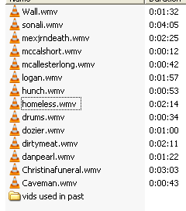
LECTURERS’ ALERT
22 MINUTES OF VIDEO
Note: Examples from last semester moved to end if you prefer them to the new examples.

Slide 6
“He that increaseth knowledge
increaseth sorrow.”
- Ecclesiastes i.18
“Knowledge is power.”
-Francis Bacon, 1561-1626
English polymath & pioneer of the Scientific Method
“Knowledge is only potential power.”
-Napoleon Bonaparte, 1769 – 5 May 1821
French Emperor & cynic

Slide 7
The Power of Information: Three Themes
There is a universal need
to receive and share
Why do people kill
– or risk death –
over information?
The battle to control information
is also universal
Notes:
No need to write this down yet.
Just settle these ideas into your head so you’re ready as we move through them.
But first, let’s do the housekeeping…

Slide 8
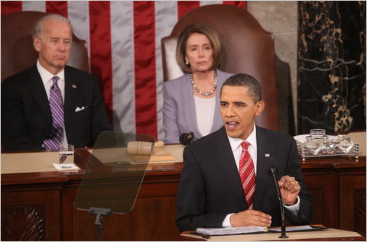
State of the Union
Notes:
We assigned you to watch the Presidents annual report to Congress on the State of the Union… and then immediately begin your Blackout. No commentary from pundits. No fact-checking by reporters. No rebuttal. Just the Supreme Commander telling you how well he’s doing and how bad the other side is.
ASK: Any reflections on how that felt?
Imagine you live in North Korea. Your radio, by law, can only be tuned to the state-controlled frequency.
The Beloved Leader’s son, the new beloved leader, gives a speech and that’s it.
There’s no rebuttal from the opposition party. There’s no opposition party.
What kind of information would you most want?
We’ll be talking about that dynamic today.

Slide 9
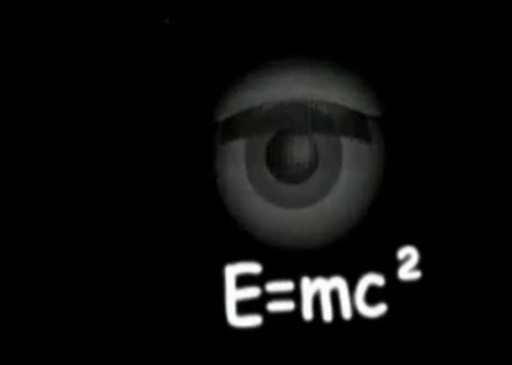

Notes:
(Animation all automatic. Twilight Zone images fade in and out ending with News Literacy Blackout Zone.)
I wanted to pause for a moment and ask you for any reflections from your News Blackout. Did anyone feel a NEED for information, when they couldn’t have it any more?
ASK: What surprised you about the News Blackout?
Was anyone sure they would NOT miss the news, and find they did miss it?
Was anyone sure they’d miss their daily dose of news, and then not miss it?
Any interesting reactions to the deficit?

Slide 10
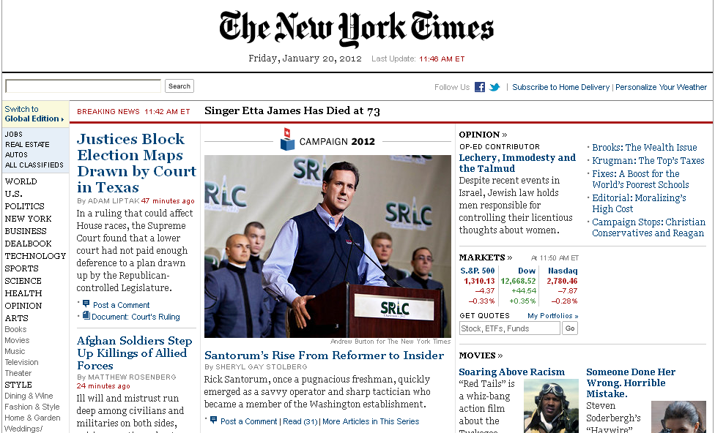
The News Blackout is Over -Change Your Homepage
Notes:
Change your homepage and read the news daily. The news is your third “textbook.”
Weekly News Quizzes begin next week and your recitation instructor will tell you how to participate in recitation.

Slide 11
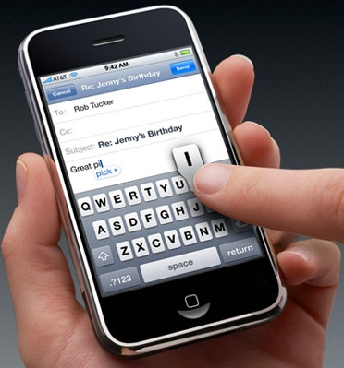
Classroom Etiquette
∙ No Cellphones
∙ No Smartphones
∙ No Texting
∙ No Talking
∙ No Sleeping
∙ Be on Time
Violators will be asked to leave class
Notes:
A quick review of attendance policies and etiquette
Reminder: Check Blackboard daily

Slide 12
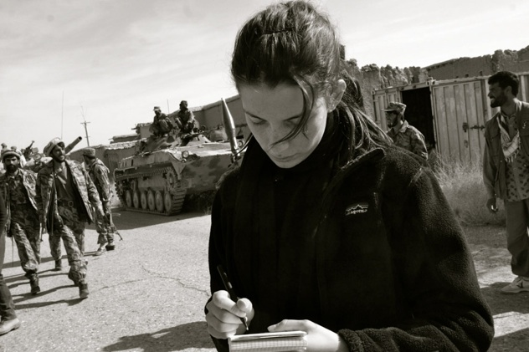
“My Life As…”
Ilana Ozernoy
Foreign correspondent
7:30 p.m. February 14th
Notes:
Every semester, News Literacy students are invited to earn extra credit by attending the School of Journalism’s public lecture series featuring top journalists from around the world. Past visitors have included Watergate investigator Bob Woodward, CNN’s Soledad O’Brien, and photojournalists and reporters who have worked in every hotspot around the world.
Students are required to prove attendance at the event to earn extra credit. We’ll explain that later this week.
In student evaluations of News Literacy, the “My Life As” events are often described as one of the best and most unique parts of the course.
Ilana Ozernoy took up reporting in 2001, when she returned to Moscow fifteen years after her family fled Russia as political refugees.
Weeks after 9/11, she traveled to the Afghan outback to cover the U.S.-led battle against the Taliban. She followed the Northern Alliance as the rebel army pushed towards Kabul, writing for The Boston Globe and U.S. News & World Report.
In 2002, Ozernoy traveled to the Uganda-Sudan border to write about the child soldiers of the Lord’s Resistance Army. In 2003, she covered the invasion of Iraq for U.S. News & World Report, and established and ran the magazine’s Baghdad bureau until February of 2005.

Slide 13
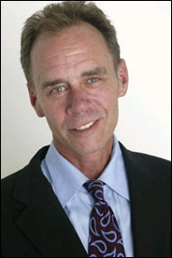
“My Life As…”
March 5th
David Carr
New York Times Journalist
Notes:
One of the top-rated documentaries of 2011 was “Page One: Inside the New York Times and the Future of Journalism.”
Carr, a former cocaine addict whose long, strange trip from rock bottom to a post at the Times is worthy of its own documentary is described by critics as the star of the documentary: “the colorful, foulmouthed truth-teller amid his more strait-laced colleagues… Carr has an air of wise, almost shamanistic detachment that makes him seem above the daily fray…Watching Carr report a story…is like watching James Levine conduct an opera. With a can of Coke Zero at one elbow and a Plantronics headset on his head, he grills sources with dogged energy and a fierce skepticism that's a joy to watch.”

Slide 14
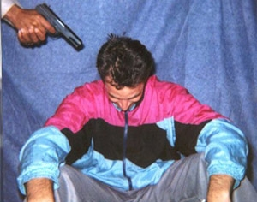
The Power of Information
Notes:
PRE-VIDEO SLIDE. THE NEXT SLIDE WILL LAUNCH AN EXCERPT OF PEARL’S HOSTAGE VIDEO (1 MINUTE: NO VIOLENCE)
This is Wall Street Journal South Asia Bureau Chief Daniel Pearl.
“Danny” as his friends called him, was born in Princeton, New Jersey, and grew up in Los Angeles, the son of a computer science professor. He graduated from Stanford University in 1985, where he co-founded a student newspaper. He got an internship at the Indianapolis Star and spent a winter in Idaho, busing tables to pay for his ski pass. After a trip through Russia, China, and Europe, he joined the Berkshire Eagle, a legendary small-town paper in western MA.
He moved up, to the San Francisco Business Times and then to Wall Street Journal by 1990. Promotions followed: Atlanta; Washington, DC; London; and then South Asia Bureau Chief in Mumbai, India.
January 23, 2002, he was in Pakistan to investigate links between Richard Reid (the "shoe bomber") and Al-Qaeda.
It seemed like a lucky break when he got a call telling him where to rendezvous for an interview with Sheikh Mubarak Ali Gilani in Karachi.
A militant group calling itself The National Movement for the Restoration of Pakistani Sovereignty kidnapped him near the Metropole Hotel. Using used a Hotmail address, they declared him a CIA operative and listed the usual demands: release prisoners, change policy, withdraw troops…or else.
Here’s the video they posted. (LECTURER: CLICK NOW TO LAUNCH HOSTAGE VIDEO)

Slide 15
The Power of Information
Danpearl.wmv
Notes:
NEWS FELLOW: LINK VIDEO TO THIS SLIDE AND SELECT “START AUTOMATICALLY”
AFTER VIDEO:
There was no response to public pleas from Pearl's editor, nor from his wife Mariane, who was six months pregnant with their first child.
Nine days after Danny Pearl was kidnapped, his captors released a video of themselves cutting his head off.
On May 16, 2002 (about 4 months after the kidnapping) Danny’s severed head and decomposed body were found cut into ten pieces, and buried in a shallow grave at Gadap, about 30 miles north of Karachi. In the grave was the jacket of the tracksuit Pearl was wearing in this photo, taken by his kidnappers when they grabbed him.
His son, Adam Daniel Pearl, had already been born.

Slide 16
The Power of Information: Today’s Themes
There is a universal need
to receive and share information
People kill
– and risk death –
over information
The battle to control information
is also universal - and changing with technology
Notes:
First paragraph fades in automatically. Next click brings up Second paragraph. Next click brings in third paragraph.
Here are the three main themes of today’s lecture.

Slide 17
Approximately three times every month,
a journalist is killed.
Seven out of ten are murdered, many on the orders of government officials.
Few cases are ever solved.
Notes:
Facts, collected by CPJ, that sometimes surprise students.
Right now, the most dangerous place in the world to be a journalist is in the areas of Mexico controlled by the drug cartels.
In Russia, government and business interests are suspected in the deaths and disappearances of dozens of journalists.
And in China, jailings and beatings are the norm.
It’s a widespread phenomenon

Slide 18
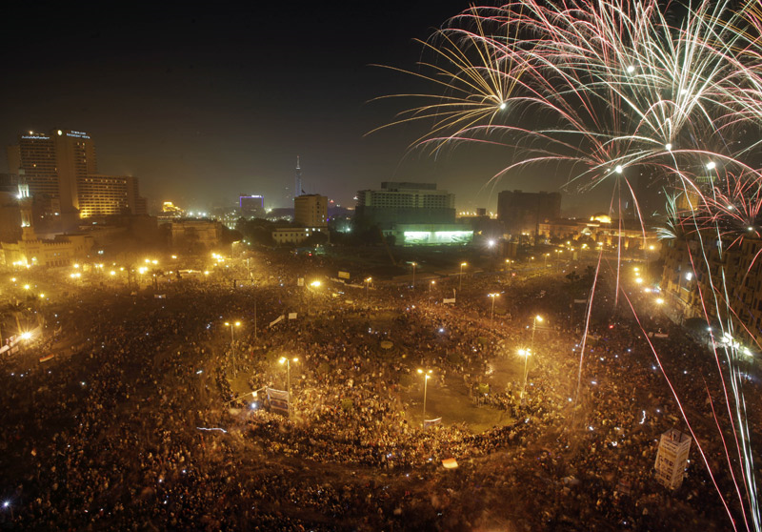
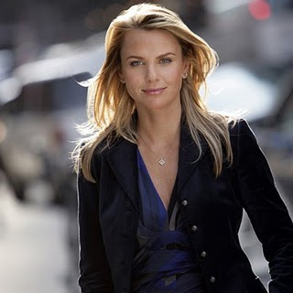
The Power of Information
Attacked During Tahrir Square
Victory Celebration
Notes:
Perhaps the highest-profile recent attack on a journalist was the rape of CBS correspondent Lara Logan.
A week after having been arrested by Egyptian police and interrogated while handcuffed into stress positions for reporting on the protests in Cairo, Lara Logan returned to Egypt to interview Wael Gohnim, the Google executive who played a key role in publicizing the atrocities of Egyptian secret police.
She arrived as Tahrir Square erupted in victory and decided to take her camera crew into the square for footage.
In the crush of the mob, she was separated from her crew. She was surrounded and reports her clothes were torn off and she suffered a brutal and sustained sexual assault and beating before being saved by a group of women and an estimated 20 Egyptian soldiers.
She reconnected with her CBS team, returned to her hotel and returned to the United States on the first flight the next morning where she was hospitalized four days.
Here is an excerpt from her interview on 60 Minutes:

Slide 19
The Power of Information
Logan.wmv
Notes:
NEWS FELLOW: LINK VIDEO TO THIS SLIDE AND SELECT “START AUTOMATICALLY”

Slide 20
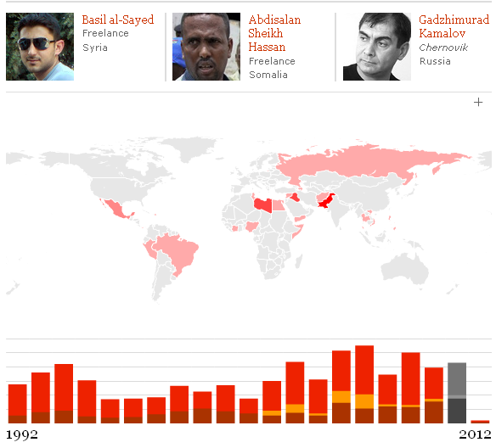
CPJ documented 46 Journalists killed in 2011
Notes:
As you can see, the number of deaths comes and goes very year.
But, the average is about 3 journalists per month, killed for committing journalism.

Slide 21
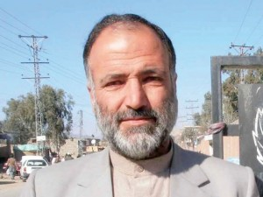
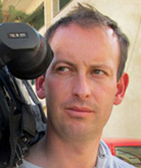
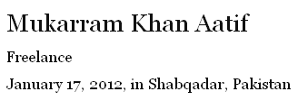
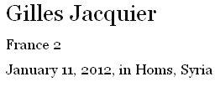

CPJ has documented 3 Journalists killed already in 2012 (as of 1/25)
Notes:
(Lecturers: you’ll want to go to the CPJ website just before lecture for updates. The number rises all the time)
Gilles Jacquier, 43, was killed January 11 by hostile fire while covering a pro-regime rally in Homs, Syria. He worked for the French public broadcaster France2. Seven others died in the attack. Witnesses said the group was struck by either a mortar or a rocket-propelled grenade.
Mukarram Khan Aatif, a freelancer reporter, was killed January 17 outside a mosque in Shabqadar, about 15 milesnorth of Peshawar, according to news reports. A correspondent for the private TV station Dunya News, Aatif also worked for Deewa Radio, a Pashto-language service of the U.S. government-funded Voice of America.
On January 20, Enenche Akogwu, a video cameraman and reporter for Channels TV in Nigeria, was shot by unidentified gunmen as he interviewed witnesses of terrorist attacks in the city of Kano
http://www.cpj.org/killed/2012/

Slide 22
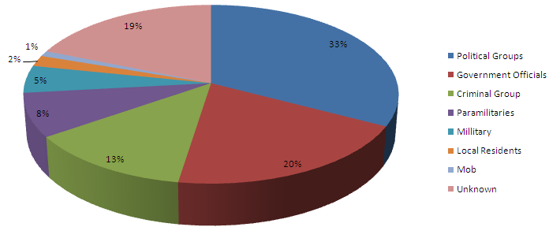
Who is Doing the Killing?
Suspected Perpetrators in Murder Cases
88% are carried out with complete impunity
35% are threatened before being murdered
19% are taken captive before being murdered
Source: The Committee to Protect Journalists
Notes:
POINT: CPJ attempts to distinguish motives from mistakes and to determine who is responsible when journalists are killed for committing journalism. These numbers are from 2010, but the proportions are fairly consistent: Government forces, political groups and criminals are the main killers of journalists, and likely account for a significant number of the “unknown” assailants.

Slide 23

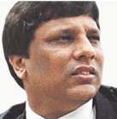
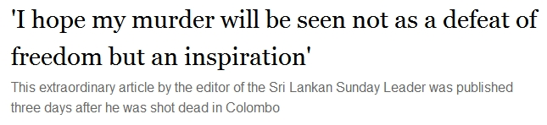
Journalists Targeted: One Story
Notes:
Click brings up headline and clips from article
During anti-Government protests in January of 2009, Sri Lankan officials stepped up their assaults on journalists. Lasantha Wickrematunge, editor of The Sunday Leader, had been detained and threatened but was still pushing investigative stories about the government. January 8, 2009 as he drove to work, he was killed by gunmen on motorbikes, the fourth journalist killed in a short period in Sri Lanka. (CLICK BRINGS UP HEADLINE AND PULL QUOTE)
Staff of the Sunday Leader discovered that, expecting to be killed, he had already written his own obituary.
Read excerpt aloud:
“No other profession calls on its practitioners to lay down their lives for their art save the armed forces and, in Sri Lanka, journalism. In the course of the past few years, the independent media have increasingly come under attack. Electronic and print media institutions have been burnt, bombed, sealed and coerced. Countless journalists have been harassed, threatened and killed. It has been my honour to belong to all those categories and now especially the last.
I hope my assassination will be seen not as a defeat of freedom but an inspiration for those who survive to step up their efforts. Indeed, I hope that it will help to galvanize forces that will usher in a new era of human liberty in our beloved motherland. I also hope it will open the eyes of your President to the fact that however many are slaughtered in the name of patriotism, the human spirit will endure and flourish.
People often ask me why I take such risks and tell me it is a matter of time before I am bumped off. Of course I know that: it is inevitable. But if we do not speak out now, there will be no one left to speak for those who cannot, whether they be ethnic minorities, the disadvantaged or the persecuted.”

Slide 24
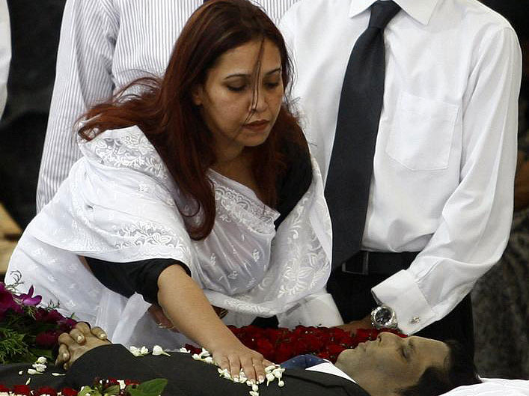
Sonali Wickrematunge
Notes:
His wife, Sonali, is also a journalist. She edited the midweek edition of the paper and had been with him the day of the shooting as they were shadowed through the city by men in black fatigues on motorbikes.
When the body was brought to their home and relatives and friends were paying their respects, as is traditional in Sri Lanka, she was in a back room, checking page layouts, editing copy and preparing the midweek edition for publication.
In the fall of 2011, she spoke to students at Stony Brook about what happened.
Here’s a clip of that:

Slide 25
Sonali.wmv
Notes:
LINK VIDEO TO THIS SLIDE AND SET TO “START AUTOMATICALLY”

Slide 26
The Power of Information: Three Themes
There is a universal need
to receive and share
Why do people kill
– or risk death –
over information?
The battle to control information
is also universal
Notes:
What is it about information that makes it so vital, so dangerous?
Our work today is to think about these three questions as a foundation for your study of News Literacy.

Slide 27
Why is there a universal need to share and receive news?
Notes:
Why IS there a universal need to share and receive news?
ASK: How many of you share news as you read it…linking Facebook posts or blogging or “LIKE” ing items posted by others, re-posting Tumblr items….
What is it about us that we all seem to need to receive and share information?

Slide 28
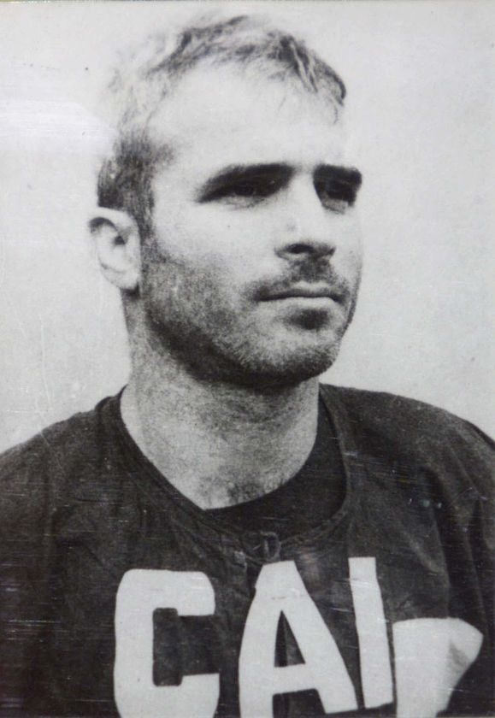
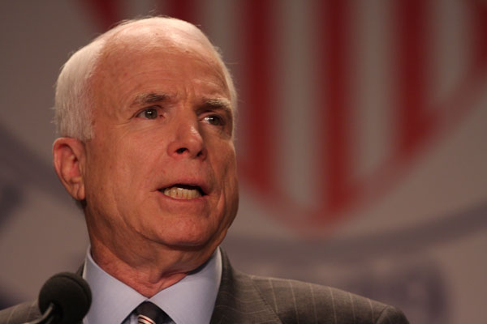
The Power of Information
During five and a half years as a prisoner of war…
“The thing I missed most was information…free uncensored, undistorted, abundant information.”
Notes:
Animation is automatic: Headline, photos and “During five and a half…”
The 2nd CLICK: Brings up the quote in yellow.
In October 1967, while on a bombing mission over Hanoi, John McCain he was shot down, seriously injured, and captured by the North Vietnamese. He was a Prisoner Of War until 1973, during which time he was tortured , but refused his captor’s offer to move him up the release list, sending him home early. His war wounds left him with lifelong physical limitations.
What is it he says he missed the most while in prison?
DO 2ND CLICK NOW

Slide 29
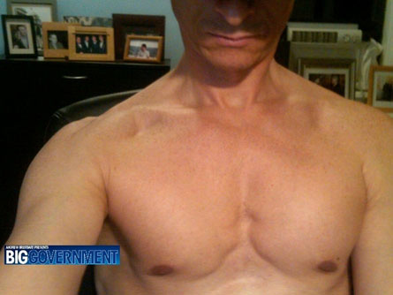
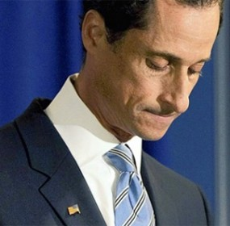
I’ve Got a Secret…
But Can’t Keep It
Notes:
Click makes shirtless shot slide over, and sad wiener fades in
Maybe some of it is that we humans find it hard to keep a secret… Even when it could wreck our life.
ASK: Who is this? (Rep. Anthony Wiener)
What was the secret?
He was sexting strangers.
Then one of those strangers, a 26-year-old single mother from Texas, told the secret.
What were the consequences of “sharing” this information?
(The rumor circulated, conservative blogger/activist Andrew Breitbart found and spread the word and the rest is history)

Slide 30
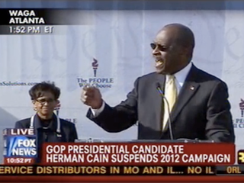
Secrets are Powerful Stuff
Notes:
In November, while radio host Herman Cain was seeking the Republican presidential nomination, Sharon Bialek, a Chicago-area single mom, hired a high-powered lawyer and came forward with an explicit description of a 1997 incident in which she says Cain tried to pressure her to have sex with him.
He denied it, but the accumulation of similar stories, plus the revelation that his employer had paid to settle a harassment suit, drove him from the race.
http://www.washingtonpost.com/politics/who-is-ginger-white/2011/11/29/gIQAMPD49N_story.html

Slide 31
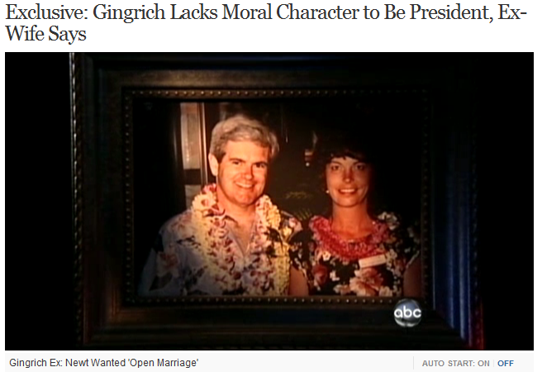
Information in the Hands of the Less Powerful
Notes:
Maybe some of it is that we humans find it hard to keep a secret, when embarrassing ourselves a little bit can punish someone we’re mad at.
Presidential candidate Newt Gingrich, campaigning in the South Carolina primary suddenly on Jan. 19 had to face this headline:
His second wife, a conservative Republican, said he lacks the moral character to be President.
She alleged that when she found out he had carried on a six-year affair with an aide in his congressional office, Gingrich asked the wife for an open marriage so that he could keep the mistress and the marriage.

Slide 32

News is Part of Our “DNA”
Alert Us
Connect Us
Divert Us
Notes:
Hunger for News is part of our “DNA” (metaphorically speaking)
Every society studied by anthropologists - no matter how primitive - prized a system for exchanging news.
What is this Need to Know? Think about your day on campus. The most common question is… “What’s New? What up?”
For purposes of this course we observe that humans seem to need three kinds of news: Alerts, Diverts, Connects. Hang on to those ideas, They’re useful in the writing assignments for this course

Slide 33
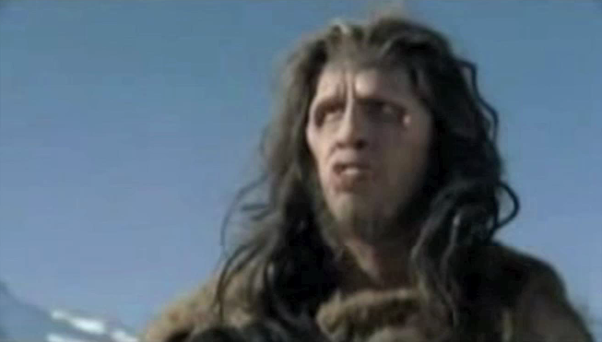
It Alerts Us…
Even a Caveman Needs to Know…
Notes:
PRE-VIDEO SLIDE. THE NEXT SLIDE WILL LAUNCH THE FUNNY FED-EX AD (38 seconds)
Without information systems that alerted them to danger, humans wouldn’t have survived. This highly scientific reconstruction shows how humans need information that alerts them to new opportunities and alerts them to danger.
(LECTURER: CLICK NOW TO LAUNCH VIDEO)

Slide 34
Caveman.wmv
Notes:
NEWS FELLOW: LINK VIDEO TO THIS SLIDE AND SELECT “START AUTOMATICALLY”

Slide 35


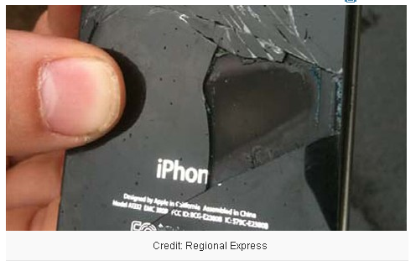
Notes:
Animation: Click once to bring up the headline.
Okay, so let’s think about serious alerts we rely on.
Anyone carry an iPhone, iPad or iPod?
CLICK
In November (2011) a passenger on an Australian regional airline flight noticed their iPhone4 was hot, glowing red and billowing dense smoke. The plane was flying from Lismore to Sydney and was in the midst of landing when the incident occured.
A flight attendant put out the fire and officials are investigating what happened. Exploding Apple products are rare, but explosions have happened in the past, mostly related to the devices’ lithium ion batteries overheating.The European Union launched an investigation in 2009 after multiple instances of iPhones and iPod Touches exploding or catching fire midflight were reported in the U.K., Holland, France and Sweden.
http://abcnews.go.com/blogs/technology/2011/11/iphone-4-explodes-midflight-on-australian-airline/

Slide 36
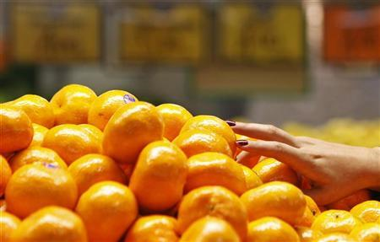
Who had juice today?
Notes:
On January 11, we got reports that a U.S. juice producer had detected low levels of carbendazim in orange juice concentrate imported from Brazil, the top grower accounting for more than 10 percent of the U.S. supply.
Whoa…What is carbendazim and if the U.S. bans it, do you want to be drinking it?
Now…The pesticide is banned in U.S. citrus but it is used on orange trees in Brazil to fight mold. The FDA said low levels of carbendazim were not dangerous and the agency had no plans for a recall, but it would stop any shipments of orange juice at the border that tested positive for the fungicide.
What if you’re McDonald’s?
What if you’re a commodities trader?
You want to know about an alert like that, right?
Orange juice futures jumped almost 11 percent to an all-time high on the news, which was announced by the FDA in a letter to the Juice Products Association on Monday. The orange juice market is particularly prone to volatility because of its tiny size compared to oil and other major commodities.
http://online.wsj.com/article/SB10001424052970204124204577154813627399478.html
http://www.reuters.com/article/2012/01/11/us-fda-orangejuice-idUSTRE80A1K720120111
http://www.nj.com/business/index.ssf/2012/01/port_newark_scour_brazilian_or.html

Slide 37

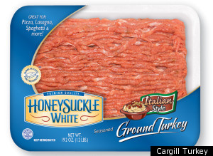
It Alerts Us…
Notes:
ANIMATION. FIRST CARGILL LOGO, THEN THE TURKEY MEAT.
Ask: Do you like turkey burgers?
Here’s a report that alerts you to news you can use.

Slide 38
Dirtymeat.wmv
Notes:
NEWS FELLOW: LINK VIDEO TO THIS SLIDE AND SELECT “START AUTOMATICALLY”
Background from August and September of 2011
CNN: “Cargill Meat Solutions Corporation announced last month an immediate voluntary recall of approximately 36 million pounds of ground turkey meat because it may be contaminated with salmonella bacteria.
Cargill's plant in Springdale, Arkansas, processed the suspect fresh and frozen ground turkey products between February 20 and August 2, the company.
Federal health authorities said Tuesday that an outbreak of multi-drug-resistant Salmonella Heidelberg that has killed one person and sickened 76 others in 26 states appears to have been traced to ground turkey products.”

Slide 39
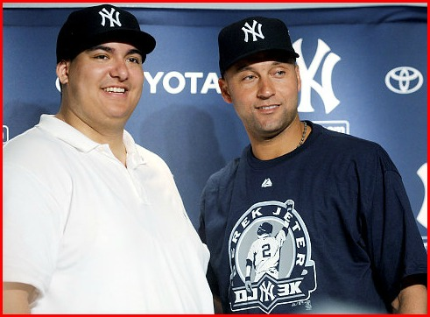
It Diverts Us…
Notes:
Don’t be embarassed to admit you’re an ESPN addict, a People Magazine reader…or a Page Six Devotee. The fact is, news is often a form of entertainment, whether we’re laughing at the antics of the rich and famous or chuckling over some debate in the U.S. Senate.
People were entertained for weeks by the story of Christian Lopez, a 23-year-old cellphone salesman from Highland Mills, N.Y., who caught and decided to return Jeter’s 3,000th hit ball. The Yankees gave him memorabilia and tickets, which he then had to pay taxes on.
http://espn.go.com/new-york/mlb/story/_/id/6765849/companies-line-help-new-york-yankees-fan-christian-lopez

Slide 40
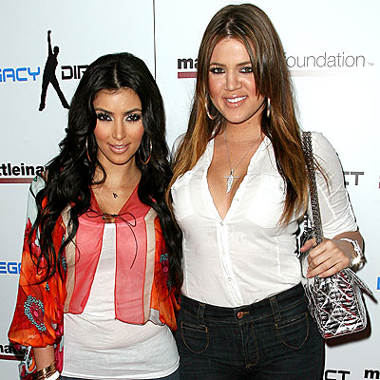
Khloe Kardashian
Notes:
There’s a recurrent skit on Saturday Night Live in which the Kardashian sisters introduce themselves as “The smart one, the hot one and the other one” Last month, rumors that Khloe Kardashian is not related to the other two got a lot of coverage in the news.
Given the reaction to the 72-day marriage of her sister Kim, Kardashian Bashin’ has become a mini industry, feeding our desire to be diverted by other people’s troubles.
http://www.radaronline.com/exclusives/2012/01/khloe-not-kardashian-dad-final-confession-robert-kardashian-star
http://www.dailymail.co.uk/tvshowbiz/article-2085230/Khloe-Kardashian-TWO-fathers-ex-wives-claim-expressed-doubts-paternity.htmlhttp://www.topnews.in/light/files/Kim_Khloe.jpg
http://www.usmagazine.com/celebrity-news/news/kim-kardashian-oj-simpson-is-not-khloes-father-2012181

Slide 41
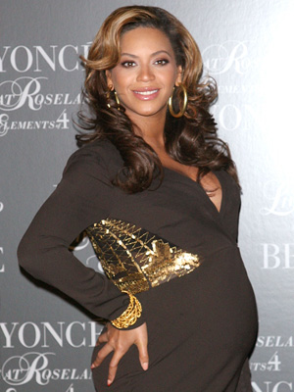
Beyonce’s Baby
Notes:
No less than CBS News and the Associated Press have devoted reporters to this story:
New York health officials are investigating complaints that patients in Lenox Hill Hospital’s neonatal unit were mistreated while mega-star Beyonce’s daughter Blue Ivy Carter was born.
It seems the singer’s security team may have over-ridden hospital security and blocked parents from seeing their children in the neonatal intensive care unit.
http://www.dailymail.co.uk/tvshowbiz/article-2085799/Beyonce-baby-First-pictures-emerge-VIP-hospital-suite-Blue-Ivy-Carter-born.html
http://www.huffingtonpost.com/news/blue-ivy-carter/

Slide 42
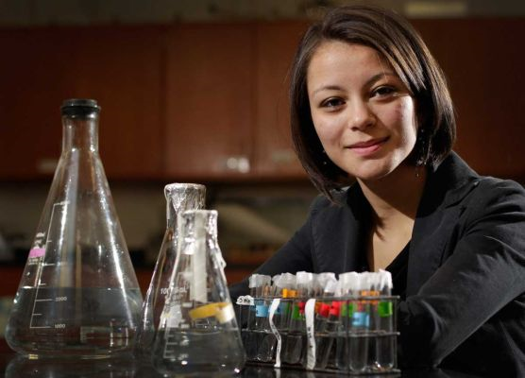
It Connects Us…
Homeless Intel Semi-finalist
Notes:
As did stories told around the campfire or in the darkness of grass huts at the dawn of human history, some news stories connect us. The telling and re-telling of them. The discussion of them…That’s deep in our DNA.
Here’s an example:
When the Intel national science competition announced its semifinalists, one of them was Samantha Garvey, who has been living in a Long Island homeless shelter.
These are the stories that make you say, “Awwwwww….”
Garvey, an aspiring marine biologist, was one of 300 national semifinalists in the Intel national science competition. The story of that achievement brought in television appearances and even a scholarship for college.
Garvey, by the way, did not make it to the final round of the Intel prize.
http://latimesblogs.latimes.com/nationnow/2012/01/homeless-long-island-whiz-kid-gets-ticket-to-obamas-state-of-the-union.html
http://www.washingtonpost.com/local/education/homeless-ny-science-whiz-to-receive-50k-college-scholarship-on-ellen-degeneres-tv-show/2012/01/19/gIQAgokYAQ_story.html
http://www.myfoxny.com/dpp/news/homeless-teen-finalist-in-intel-scien
ce-contest-samantha-garvey-20120113 - video

Slide 43
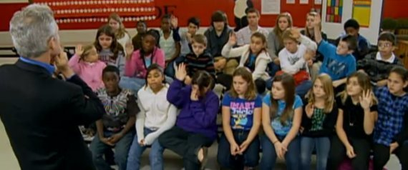
News that connects us
Millions Raised for Homeless Florida Teens
Notes:
After CBS aired a set of reports on children growing up homeless during the mortgage crisis in Florida, donations flowed in.
Here’s why.
(Lecturer, run the video on the next slide)
http://www.huffingtonpost.com/2011/03/07/homeless-children-homeless-students_n_832415.html
http://www.cbsnews.com/stories/2011/03/06/60minutes/main20038927.shtml
http://www.cbsnews.com/video/watch/?id=7389750n

Slide 44
Homeless.wmv
Notes:
NEWS FELLOW: LINK VIDEO TO THIS SLIDE AND SELECT “START AUTOMATICALLY”

Slide 45
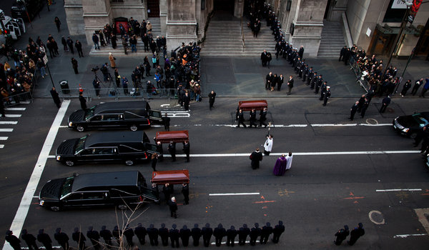
The death of a “girl tribe”
The Badger Family fire Christmas Day
Notes:
Sad stories are the one.
Madonna Badger’s three daughters and her parents all perished in a Christmas Day fire at their Connecticut home.
Here’s how the story of the funeral was told:
“NEW YORK -- Lily, her firstborn, was her "angel," her "life." Sarah was her "little whippersnapper, loved and lovable and full of love." While her twin, Grace, "fearless," often asked her mother if she was going to die before her.
Madonna Badger told her daughter it was "never going to happen."
"But it did, and I wonder why," she said during a eulogy to her "girl tribe" in New York City on Thursday. "Why my children?"
The three young girls died along with Badger's parents during a Christmas morning fire at their Connecticut home. More than 500 mourners joined the grieving mother at St. Thomas Church in Manhattan for a somber funeral.
"My girls are in my heart," Badger said. "They're right here. And that's where they live now.“
http://abcnews.go.com/US/connecticut-christmas-fire-grandfather-died-save-granddaughter/story?id=15239065#.TxmYtGVuR5U - has video
http://www.nytimes.com/2012/01/06/nyregion/unbearable-grief-as-three-sisters-killed-in-christmas-day-fire-are-mourned.html?_r=1

Slide 46
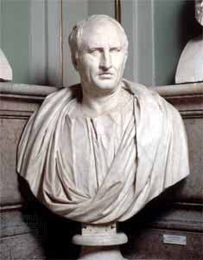
And It’s Nothing New…
A lot of “Tittle-tattle…Gladiator pairs…trials…burglary”
Notes:
The Roman Emperor Cicero ordered news about Rome sent to him when he was away. He griped that the news in these letters was a lot of tittle-tattle and gossip: which gladiator was paired off with which…who was on trial for what scandalous or embarassing crime…what leak about the Emperor was making the rounds.
Don’t be embarassed if TMZ is part of your daily news diet. It is human to seek information that diverts or entertains us and that has always included a fair amount of tabloid news and sports reports.
PAUSE FOR TRANSITION.
These patterns , seeking information that alerts us, that connects us, that diverts us…make us human, which is why in News Literacy we assert that the need for information is in our DNA.
But information-seeking and information-spreading have a lot to do with power… which makes it dangerous.

Slide 47
The Power of Information: Three Themes
There is a universal need
to receive and share
Why do people kill
– or risk death –
over information?
The battle to control information
is also universal
Notes:
In Uganda, police have systematically shut down 11 radio stations in the last year, battling dissenters.
Mother Jones magazine reports that the Syrian government’s crackdown on protesters includes sophisticated technology to prevent Syrians from accessing social media, video-sharing, and other websites.
The three journalists killed since the beginning of the semester: Some were in the wrong place, but at least one was clearly targetted for death because he was gathering and circulating information.
Why would a government or other entities kill over a little information?
And why would a journalist risk death to get information out and into the public’s hands?

Slide 48
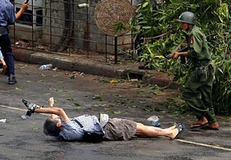
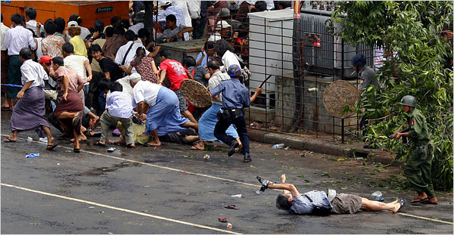
Real Blood
Why do Journalists risk their lives?
Notes:
(LECTURERS: BE READY TO CLICK AGAIN TO ZOOM IN ON THE PHOTOG AND THE SOLDIER)
Japanese television aired video of the last seconds of 50-year-old news videographer Kenji Nagai’s life during the Buddhist Monk-led protests against Burma’s dictatorship.
Nagai, who was on the edge of a crowd of panic-stricken demonstrators, is shoved violently to the ground by a soldier. The crowd flees, leaving behind Nagai – dressed casually in shorts and flip-flops – on his back in the street. In his right hand is a video camera, held high to protect it from the fall.
(LECTURER: CLICK NOW FOR THE CROPPED VERSION)
A loud crack can be heard on the video as a soldier points his rifle at Nagai, shooting him at point-blank range.
His elderly mother told reporters that she begged her son not to go to Burma, but Nagai had simply told her that it was his job to go to places nobody else wanted to.

Slide 49
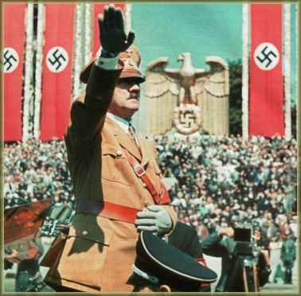
Information Can Be a Weapon of Mass Murder
Notes:
The control of information and the use of propaganda - a concept we will discuss at greater length later - can lead to terrible results.
In Germany in the 1930s, where the Nazi Party bought weak newspapers before it came to power and cranked out propaganda. Once in power, they licensed newspapers and dictated content.
For the sake of their license, even non-partisan papers agreed to print Nazi propaganda free and to take no ads from Jews. As insurance, dozens of German advertisers cynically bought space in Nazi organs.
Thus controlled, Germany’s newspapers did little to challenge Hitler.
What do autocrats fear?

Slide 50
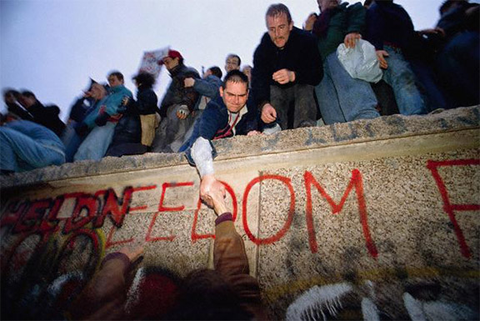
The Power of Information to Topple Oppressors
1989: The Berlin Wall Comes Down
Notes:
PRE-VIDEO SLIDE. THE NEXT SLIDE WILL LAUNCH THE ABC PIECE ON THE FALL OF THE WALL (1:32 video)
POINT: The Berlin Wall, was built in 1961 because more than 2.6 million of 17 million East Germans escaped to West Berlin or West Germany from 1949 to 1961 and the Communist system could not afford the embarassment…or the loss of talent.
The wall fell in 1989, not through force of military might, but because of the power of information.
As much as they tried, the communist governments of East Germany and other Eastern Bloc states could not prevent information about a better way of life in the west from penetrating their societies, via television, radio and other means. (Radio Free Europe clip?)
Once the borders were opened, information spread quickly across Eastern Europe, sparking mass border crossings and…Shopping.
…………….(LECTURER: CLICK NOW TO LAUNCH VIDEO)

Slide 51
Wall.wmv
Notes:
NEWS FELLOW: LINK VIDEO TO THIS SLIDE AND SELECT “START AUTOMATICALLY”

Slide 52
The Power of Information: Three Themes
There is a universal need
to receive and share
Why do people kill
– or risk death –
over information?
The battle to control information
is also universal – and changing with technology.
Notes:
Text animates automatically
Whether conducted with rocks and sticks in Tahrir Square or with network switches, the battle to control information is universal and the effect of digital technology is unclear. Do mobile web-based devices put more power in the hands of individuals, or give government more power over individuals’ lives?

Slide 53
From The Beginning
Information Was Power
Drums.wmv
Notes:
NEWS FELLOW: LINK video TO THIS SLIDE AND SELECT “START AUTOMATICALLY” – (Drums.wmv 30 SECONDS) THIS VIDEO DOES NOT PLAY FULL SCREEN. THERE IS NO VIDEO, JUST AUDIO. (FYI: Drum telegraphy is based on speech patterns. )
Let’s step back and put this in perspective
(Lecturer: As drumming winds down…) Drums were one of the earliest forms of remote communication and their use sometimes rebalanced the power equation. European expeditions to West Africa were surprised: tribes they encountered already knew when they were coming and what they were up to.
Regardless of the method, of transmission, Saber es Poder. (Knowledge is Power) and the powerful try to clamp a lid on knowledge they don’t want to get out.

Slide 54
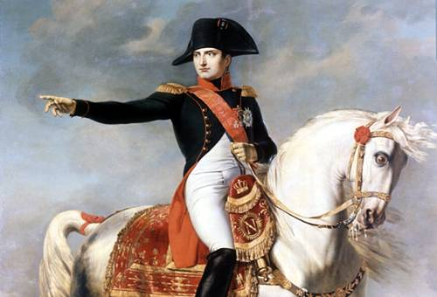
Even (especially) Emperors
Need to Control Information
“I fear three newspapers more than
a hundred thousand bayonets.”
Notes:
The Emperor Napoleon, the military genius who emerged from the French Revolution, won battle after battle against stronger armies, established French influence across Europe and worked to spread the ideals of the Revolution, most notably through the Napoleonic Code of legal procedure…Yet he feared the un-muzzled power of newspapers.
Here’s what he knew: that you control the public by controlling their access to information.
Yes, he said knowledge is only potential power. But without it, there is no potential for power.

Slide 55
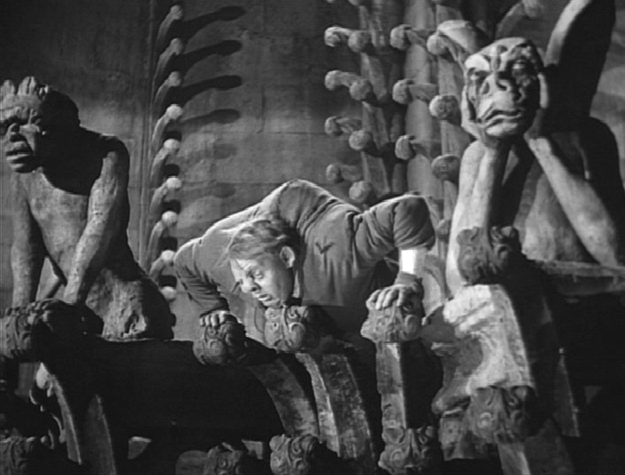
Victor Hugo’s Symbol of Change
Notes:
In Lecture 1, we talked about the power of information from Gutenberg’s press to Zuckerberg’s Facebook.
In Victor Hugo’s novel, “The Hunchback of Notre Dame,” published in 1831, the printing press symbolizes the huge changes sweeping Europe in the late 15th century.
In this scene, King Louis and Frollo, the Archdeacon of Notre Dame Cathedral examine a printing press and debate the influence it will have.

Slide 56
hunch.wmv
Notes:
NEWS FELLOW: LINK VIDEO TO THIS SLIDE AND SELECT “START AUTOMATICALLY”
Hunchback clip
(Framing the story, the scene opens with the bells of Notre Dame, King Louis inquires who the bell ringer is, then turns to examine the press. The printer sez he is printing books for The People, who will learn to read. Frollo asserts that the printing press and the books it produces will destroy the intellectual authority of the church.)

Slide 57
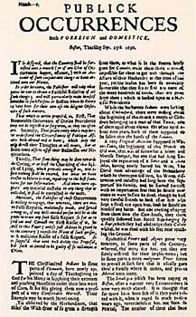
North America’s First Newspaper
1690: Publick Occurrences Both Forreign and Domestick
Notes:
The battle over control of information followed us here from Europe.
The first news sheet in North America debuted in 1690… and produced just one edition.
Publick Occurrences Both Forreign and Domestick, was published in Boston by Benjamin Harris. The English authorities, in "high Resentment" that Harris dared to report that English military forces had allied themselves with "miserable" savages, put him out of business four days later.
Same battle. New battlefield.

Slide 58
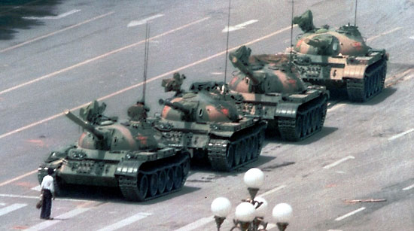
The most famous photo of the Tiananmen Square Rebellion?
Not in China
Notes:
Governments seek to control their history, as well as news coverage.
June 4th 1989, est. 3000 dead during pro-democracy protests. Gov’t kicked out foreign press after a few days. This photo showed a lone protester facing down the government’s tanks dispatched to clear protesters out of Tianenmen Square.
China kept this out of history books and off Baidu (Google-like search site) for years and only recently can it be found in official histories.
(LECTURERS: Some Chinese students object to our simplification of this example, be ready for questions.)

Slide 59
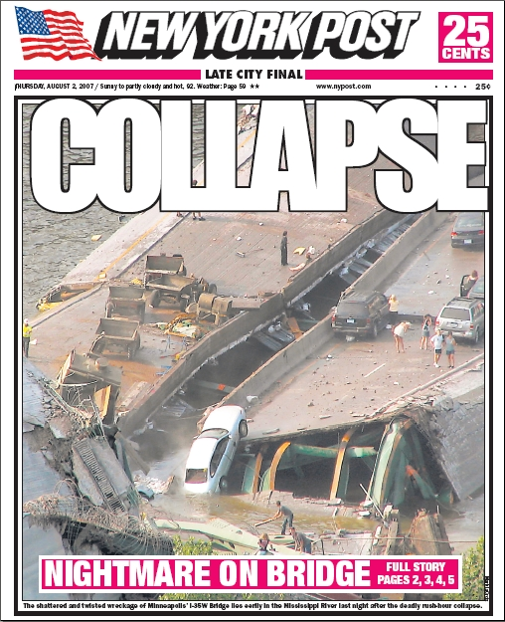


Cultural Differences:
Whose Business is a Bridge Failure?
Does informing the public help or hinder solutions?
Notes:
Two cultures’ views of the battle: Does news coverage help fix societal problems or make them worse?
On Aug. 1, 2007 during evening rush hour, the I-35W Mississippi River bridge in Minneapolis collapsed, killing 13 people and injuring 145. On the evening of the collapse, CNN, MSNBC and Fox News went live and stayed live through the overnight, along with local stations. In the days that followed, most of America’s top anchors broadcast live from the scene: Shepard Smith and Greta Van Susteren(FOX), Katie Couric (CBS), Charlie Gibson(ABC), Brian Williams and Matt Lauer (NBC) Soledad Obrien and Anderson Cooper (CNN), Contessa Brewer (MSNBC)
Ten days later in Southern China, Communist authorities banned most state media from reporting on the collapse of a bridge under construction near Fenghuang, which killed at least 47 people. Local officials punched and chased reporters from the scene.
We’ll look in future weeks at this fundamental difference between China’s emphasis on stability and America’s focus on openness. With globalization, those values increasingly clash.

Slide 60

Cultural Differences:
Whose Business is a Bridge Failure?
Does informing the public help or hinder solutions?
Notes:
We are beginning, though, to see signs that kind of censorship is no longer possible in China.
A collision between two trains on July 23rd, 2011 near the coastal city of Wenzhou killed at least 35 people brought online criticism of the the railway bureaucracy and official media.
Twitter-like services, the Wei-Bos, provided information the official media tried to cover up.
From the scene, Weibo accounts provided insights while censors forced official media to play it down while railway officials literally tried to bury the train.
http://behindthewall.msnbc.msn.com/_news/2011/07/25/7157046-deadly-train-crash-in-china-provokes-outrage

Slide 61

The Battle Isn’t Ancient History
Notes:
The Battle continues today.
This map shows countries judged to have a free press in green, partly free in yellow and not free in blue. You’ll note correlations to the places CPJ reports reporters are being beaten, kidnapped, jailed or killed.
http://www.newseum.org/exhibits-and-theaters/permanent-exhibits/world-news/press-freedom-map.html

Slide 62

Who Are the Front-Line Casualties
of The Battle to Control Information?
Notes:
PRE-VIDEO SLIDE. THE NEXT SLIDE WILL LAUNCH this broadcast about what does not get reported in Mexico (2:25)
In the last 10 years, CPJ research shows, more than 30 editors and reporters have been killed, at least 12 in direct reprisal for their work. Drug-related violence now makes Mexico one of the world's most dangerous countries for the press, according to CPJ research. Six journalists have been killed this year alone, at least one in direct reprisal for their work.
Powerful drug cartels, which grew by exporting narcotics to the United States, have extended their reach to street sales, extortion, and kidnapping. Rival groups fighting for urban markets murder one another’s members, and bribe or kill police officers and public officials.
…………….(LECTURER: CLICK NOW TO LAUNCH VIDEO)

Slide 63
Drug Cartels Decide What IsNews
…and What Is Not
Mexjrndeath.wmv
Notes:
NEWS FELLOW: LINK VIDEO TO THIS SLIDE AND SELECT “START AUTOMATICALLY”
In Ciudad Juárez, a Cartel battleground, there were nearly 2,000 drug and cartel-related murders in 2009, according to officials and news reports. Almost all of the murders went unpunished and journalists extensively censor their own stories, CPJ reports.
“We have learned the lesson: To survive, we publish the minimum,” says Alfredo Quijano, editor-in-chief of Norte de Ciudad Juárez. “We don’t investigate. Most of what we know stays in the reporter’s notebook.”

Slide 64


The Battle Rages Here, Too
Notes:
Images animate automatically
Pro football player Daniel “Pat” Tillman turned down a $3.6million 3-year contract with the Arizona Cardinals in June 2002 in the aftermath of the September 11, 2011 attacks. Instead, he joined the U.S. Army Rangers and served multiple combat tours before he died in the mountains of Afghanistan. Lt. General Stanley McChrystal, who knew the circumstances of Tillman’s death, nonetheless approved a Silver Star citation for Tillman…Later it was learned that the U.S. Government, eager for a popular and handsome war hero, covered up the fact that Tillman had been killed by friendly fire. A documentary, “The Tillman Story” was released in August and is still in theaters.
(McChrystal, whom the Tillman family criticized for his role in the cover-up, was forced to resign his post as commander of U.S. forces in Afghanistan a year ago after he and senior officers under his command were quoted in Rolling Stone criticizing the decisions and officials of the Executive Branch, a freedom members of the U.S. military do not have while in uniform.)

Slide 65

Dying for Journalism in the US
Oakland Post Editor
Chauncey Bailey Killed Aug. 2, 2007
Notes:
Late in his career, Chauncey Bailey, Jr. he took on the job of editor-in-chief of The Oakland Post, a small community newspaper. While investigating Yusuf Bey IV, the CEO of Your Black Muslim Bakery, Bailey was shot, assassination style in the street on August 2, 2007.
To continue Bailey's work and answer questions regarding his death, more than two dozen reporters, photographers and editors from print, broadcast and electronic media, and journalism students teamed up to investigate and solve the crime. The Bailey Project’s work resulted in the successful prosecution just this summerof Bey and of the young man sent to kill Bailey.

Slide 66


Journalists Under Attack-
A Happy Ending
Newsday’s Matthew McAllester and Moises Saman
Freed After 15 Days of Captivity in Iraq
Notes:
At the beginning of the first Gulf War, two Newsday journalists , Matt McAllester and Moises Saman, were imprisoned by Saddam Hussein’s forces and not released from Abu Ghraib prison until 15 days had passed. From then-editor Howie Schneider’s archive, read the following notes he took from their phone call about why they were willing to stay for the invasion and risk their lives, why they were returning to Iraq to continue reporting.
After Matt reached Jordan he called the office. There was, of course, wild jubilation on both ends of the phone. Later that day I was able to reach him. I asked him if he had any regrets now about staying behind in Bagdad after many other reporters had decided to leave. Matt had stubbornly held out to remain behind. Here’s what he said to me on the phone: “Howie, I had to be there. I had a moral obligation to report from where the bombs were falling.”
Subsequently, Matt wrote a piece for Newsday recounting his experience in captivity. He recalled listening from his cell as another prisoner was beaten and tortured. Then he wrote: “Journalists are meant to bear witness, that’s rather the point of our job. We watch and record, tell other people what we have seen, perhaps in the hope that an account, a witnessing, could eke away at the badness.”

Slide 67

Notes:
NEWS FELLOW: LINK VIDEO TO THIS SLIDE AND SELECT “START AUTOMATICALLY”
McAllester in his own words, during a talk he gave at Stony Brook.

Slide 68
Mcallester
Notes:
NEWS FELLOW: LINK VIDEO TO THIS SLIDE AND SELECT “START AUTOMATICALLY”
Off-campus courses, here is the link to a You Tube clip of McAllester speaking at Stony Brook: http://youtu.be/ohRwq26z5jg

Slide 69

The Power of Information
Seven minutes with Kim Dozier: http://youtu.be/sTBbQGmoZ7I
Notes:
NEWS FELLOW: LINK VIDEO TO THIS SLIDE AND SELECT “START AUTOMATICALLY”
This is Kimberly Dozier, a CBS News reporter who nearly died on Memorial Day 2006 while reporting on U.S. troops in Baghdad. The 500-pound car-bomb killed the leader of the patrol she was reporting on, plus an Iraqi translator and two members of her news crew.
Sometimes in this course we send you to our YouTube channel to watch videos in addition to textbook selections.
You’ll find a seven-minute excerpt of her speech at Stony Brook at http://youtu.be/sTBbQGmoZ7I. Take notes and come to recitation ready to discuss.

Slide 70
The Power of Information
Dozier.wmv
Notes:
NEWS FELLOW: LINK VIDEO TO THIS SLIDE AND SELECT “START AUTOMATICALLY”
Run a short bit as a teaser to the longer piece
(Off-campus courses: here’s the link to Dozier’s talk at Stony Brook: http://youtu.be/sTBbQGmoZ7I)

Slide 71
Your Assignments…
1. Read the Google vs. China articles in the Virtual Course Reader on Blackboard. In a short essay, you will play the role of CEO of Google, deciding whether to follow China’s censorship policies, or withdraw from one of the largest markets in the world.
Due at your next recitation.
2. Videos: Using links posted on Blackboard, watch three short videos of journalists talking about the relationship between secrecy and power and why they challenge power with information. Be ready to discuss in recitation.
3. Watch “60 Minutes” segment on Sunday, September 11. (It’s about first responders studied by Stony Brook scientists) See Blackboard for the assignment prompt.

Slide 72
1 minute quiz:
1. What day is the 1st “My Life As” lecture of the semester?
2. Who said “I fear three newspapers more than a hundred thousand bayonets.”
3. Comments & suggestions. For example
What material in today’s lecture
needs more/better explanation? What
Works or does not work about this lecture?

Slide 73

hus endeth the Lesson…

Slide 74

News Matters
You Write a sentence here, connecting the news to a course concept.
YOUR REC. #
Submitted by:YOUR NAME GOES HERE
Professor : MY NAME GOES HERE
Notes:
Here’s a weekly tradition in News Literacy.
Students reading the news ever day see stories that illustrate some point from the course.
They may earn extra credit by building a slide that is accepted for use in lecture.
We’ll explain that system next week.
For now, here are some examples of what the finished product looks like.

Slide 75
Insert News Matters slides here
Notes:
NEWS FELLOWS NEED TO CUSTOMIZE THIS SLIDE TO EACH LECTURE’S ASSIGNMENT REGIMEN,

Slide 76

The Power of Information
Notes:
.

Slide 77


Notes:
Animations: Slide opens with cartoon about shutting off the internet, next click brings up Arbor Networks data on the shut-down in Egypt.
In Egypt last winter, when President Hosni Mubarak was trying to quell the revolution in the streets of Cairo, security forces realized one way to hobble anti-government forces was to shut down access to the internet, which is how reports on government atrocities were spread and also how protest organizers reached their supporters.
Shortly after police shot a protester in the street, internet service into and out of Egypt was locked down, as shown in this graph of Net traffic.

Slide 78

The Power of Information
Notes:
THE VIDEO OPENS WITH THE SHOOTING OF THE PROTESTERS, NEXT, THE GRAPH SHOWING THE DRAMATIC SHUTDOWN OF INTERNET SERVICE IN EGYPT. IT ENDS WITH THE INTERVIEW WITH ASSAD SAWEY, BBC (ARABIC SERVICE) REPORTER WHO GOES BACK ON THE AIR DESPITE HIS INJURY. BEST PORTION OF HIS INTERVIEW IS 1:49 THROUGH END.
On Jan. 27, the Associated Press posted the raw footage of a killing during a protest in Egypt. No provenance, date, location are available from AP, YouTube or elsewhere, although it has been used repeatedly by the networks and by CNN. The clip shows a helicopter flying above and people running when suddenly a shot is heard, and a man falls to the ground. Another man rushes to him and tries to pick up his limp body. AP posted the clip as part of an overall post of raw video of protest scenes in Egypt presumed to be from Jan. 26 and 27.
In anticipation of big protests planned for Friday, internet service and mobile phone service were dramatically cut on Thursday the 27th. The chart and headline in our montage describe it.
According to a report by Ryan Singel at Wired there isn't anything like a big red "stop the internet" button. Checking with ISPs and techies, Singel reports there are a variety of different internet providers in Egypt, but it's still possible to shut them all down with just a few phone calls. You can see in the chart that it drops in steps and then there’s a huge dropoff.
Only one, Noor, was still operating during the blackout.http://www.allvoices.com/contributed-news/8024551-man-shooted-in-cairo-protestsee-new-video
http://online.wsj.com/video/digits-egypt-technology-shutdown/44B74AB0-A734-44FF-B1DF-1ECE38C53BD6.html
http://mashable.com/2011/01/27/egypt-protests/
http://www.zdnet.com/blog/igeneration/egypt-shuts-down-internet-amid-further-protests-facebook-web-traffic-drops/7915
THIS IS THE SET-UP SLIDE TO A 3-minute VIDEO THAT STARTS WITH A SINGLE CLICK.
Elements:
CAIRO PROTESTER BEING SHOT
VISUALIZATION of INTERNET SERVICE CUT-OFFS
ENDS WITH BBC REPORTER EXPLAINING WHY HE GOES INTO HARM’S WAY.

Slide 79



Information Can Prevent Mass Murder
Newsday’s Roy Gutman exposes Bosnian atrocities
Notes:
(Lecturers: animation automatically brings up suicide, then prison camp internee, then Gutman)
POINT: During Bosnia’s civil war (1992-1995) the Serbs started systematically using mass rape of civilians as a weapon in so-called “Ethnic Cleansing.” Estimates ranged from 20,000 to 50,000 victims. The U.N. investigation found Serbs took steps to maximize shame and humiliation to not only the victim but also the victim's community. (UN report (S/25274)
Impregnated by Serbian fighters, the women were forced to carry the child of their rapist. In this way, the Serbs intended to wipe out Muslim bloodlines. Roy Gutman of Newsday was the first reporter into prison camps like Srebrenica. His reporting sparked worldwide outrage that pushed the U.S. and other nations to intervene.

Slide 80

President Clinton on the Day
His Impeachment Trial Began
Notes:
If knowledge is power, then is power predicated on secrecy?
If knowledge is power, then what is ignorance?
Knowledge makes WHO more powerful?
(News Consumers are more powerful than non-consumers)
This is Clinton on the day he was impeached by the House of Representatives, December 19, 1998

Slide 81


I’ve Got a Secret
But Can’t Keep It
Notes:
Maybe some of it is that we humans find it hard to keep a secret… Even when it could wreck our life.
ASK: Who is this? (Monica Lewinsky, Linda Tripp)
What was the secret?
What were the consequences of “sharing” this information?
(Monica told her friend Linda Tripp. Tripp told her to keep the famous dress, recorded their conversations and turned the tapes over to independent counsel Kenneth Starr, who led the impeachment effort.)

Slide 82



Notes:
http://nymag.com/news/features/danny-chen-2012-1/
http://www.huffingtonpost.com/2012/01/06/danny-chens-family-says-t_n_1190563.html
http://www.dnainfo.com/20111221/lower-east-side-east-village/army-charges-eight-chinatown-soldier-danny-chens-death#ixzz1kIeBOpR5

Slide 83



Notes:
http://www.washingtonpost.com/national/georgia-judge-orders-obama-to-appear-in-court-for-hearing-on-attempt-to-keep-him-off-ballot/2012/01/20/gIQAsayeEQ_story.html?tid=pm_national_pop
Date comes in on click

Slide 84

Syrian cartoonist Ali Farzat
Notes:
It’s hard to imagine, but humor, if it’s political and on a news website or in a newspaper, can get you killed.

Slide 85


Masked gunmen severely beat Syria’s best-known political cartoonist on Thursday, breaking his hand and leaving him to bleed on the side of a road in Damascus, activists said.
The attack came days after the artist,
Ali Farzat, published a cartoon showing President Bashar al-Assad hitching
a ride out of town with Col. Muammar el-Qaddafi of Libya, who was toppled from power this week.
Notes:
Animation:
NY times and headline fade in. Click for picture. Click for led text.
Ali Farzat is known in Syria for political cartoons like this one, showing an overfed Syrian general feeding medals to a starving soldier.
On August 25, as protests against President Bashar al-Assad grew more fierce, masked gunmen attacked
Farzat, focusing particularly on his hands and leaving him to bleed on the side of a road in Damascus, activists said.
The attack came days after the artist, Ali Farzat, published a cartoon showing President Bashar Al-Assad hitching a ride out of town with Col. Muammar el-Qaddafi of Libya, who was toppled from power this week.
http://www.nytimes.com/2011/08/26/world/middleeast/26syria.html?_r=1&emc=eta1

Slide 86

It Connects Us…
“Human Interest” or Campfire Stories
Notes:
As did stories told around the campfire or in the darkness of grass huts at the dawn of human history, news stories connect us. The telling and re-telling of them. The discussion of them…That’s deep in our DNA.
Here’s an example:
The youngest victim of the Tucson shooting was Christina Green, a 9-year-old who was the only girl on her Little League team, sang in her church choir, served on the student council, got straight As and volunteered at a children’s charity.
She went to meet her congressman at the supermarket, where a gunman shot Representative Gabrielle Giffords, leaving her in critical condition, and killed six people, including Christina.
Christina was born on Sept. 11, 2001 and her mother says, “ She was very bright, very mature, off the charts. She was the brightest thing that happened that day.”
At the hospital, her mother said, “We waited for a while, and then the surgeon and people from the I.C.U. unit came in and police officers and other people, and they told us the bad news,” she said. “She had a bullet hole to the chest, and they tried to save her, but she just couldn’t make it. It was really, really bad.”
Christina’s family donated some of her organs and one has already saved a child’s life in Boston.

Slide 87
Christinafuneral.wmv
Notes:
NEWS FELLOW: LINK VIDEO TO THIS SLIDE AND SELECT “START AUTOMATICALLY”
This launches Obama at the Tucson Memorial service. It’s 3 minutes, but if you want to cut it in half, the obvious spot is when he emphatically says “We Must” make politics as good as Christina dreamed it could be, etc.

Slide 88

The Battle Isn’t Ancient History
Notes:
(Lecturers: We are hunting an updated map, as this is now two years old)
The Battle continues today.
This map shows countries judged to have a free press in green, partly free in yellow and not free in blue. You’ll note correlations to the places CPJ reports reporters are being beaten, kidnapped, jailed or killed.
http://www.freedomhouse.org/template.cfm?page=251&year=2010

Slide 89

A Secret Internet?
The Obama administration is leading a global effort to deploy “shadow” Internet and mobile phone systems that dissidents can use to undermine repressive governments that seek to silence them by censoring or shutting down telecommunications networks.
Notes:
Recognizing this, one way the U.S. government hopes to foster rebellons in repressive countries is by developing technology that will allow people to set up a shadow internet out of reach of government censors. Because social media and digital technology played important roles in the revolutions across the Middle East this year, we have added information technology to the weapons we use in our foreign policy.
http://www.nytimes.com/2011/06/12/world/12internet.html?pagewanted=all

