Slide 1
Last week’s Quick Quiz results
“Four hostile newspapers are more to be feared than a thousand bayonets,” said Napoleon Bonaparte, military genius and Emperor of France.
On September 29, 1690, British Colonial authorities in Boston shut down the first multi-page newspaper in the Americas, which was called “Publick Occurrences Both Forreign and Domestick.”
Student Questions and Comments:

Slide 2
The Quick Quiz
1.
2.
3. Write a question we can answer to clarify today’s lesson…or a comment that will help us improve our work.
Write your name and Recitation Instructor name on your Quiz
Hand your QUICK QUIZ to your recitation instructor as you leave, and practice saying her or his name. (i.e. “Hi, Professor Schmedlapp”)
Notes:
Every lecture, we’ll stop and give you a quick quiz, just three questions.
This helps cement key lessons in your memory.
Plus, it helps us see if we explained things well.
And the third question is a chance for you to improve your own course.
We’ll start lectures with a selection of your comments and suggestions.

Slide 3
Lecturer Alerts
This lecture is intended to be continued in a subsequent class section. The atmosphere envisioned is a seminar, with students (having read the examples ahead of time) working their way through Workbook examples with their teacher. The point is to begin developing their ability to deconstruct in real time.

Slide 4
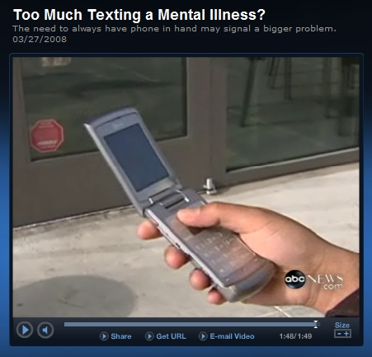
‘Deconstructing’ the news
Is Too Much Texting A Mental Illness?
How to assess the reliability of the news
Notes:
(LECTURERS: More than is usually the case, you’ll want to rehearse this with an eye on the time. This lecture is designed to be continued in our recitations. We like to conclude with the series of slides on the Pregnant man and then a deconstruction of the Texting report that opens the hour. Also, make arrangements to turn lecture hall lights back on at those times when students are reading.)
You’ll want to have your Deconstruction Workbook out and ready today, as we’ll be working from it.
ASK: I know what I think…but as a lecturer who is offended that students tear themselves away from my fascinating class to tend their cellphone, I may be victim to effects of cognitive dissonance…
But what do you think?
-Is too much texting a mental illness?
-Do you text excessively?
-How about your friends or family members?
-Do they have a texting mental illness?
(Show the video. It launches from next slide)

Slide 5
Texting.wmv
Notes:
NEWSFELLOW: NEWS FELLOW: LINK (INSERT) VIDEO TO THIS SLIDE AND SELECT “START AUTOMATICALLY” run-time 1:50
(After it runs)
ASK: What do you think of this?
How do you react? With disbelief or skepticism?
What more do you need to know?
Can you make a reasoned assessment of its reliability?
We are now at the nitty-gritty of News Literacy, taking news reports apart and examining the reliability of the information. We call it Deconstruction.
Using the Deconstruction Workbook you brought to class today, we will examine a series of stories piece-by-piece.
Does the headline match the story? Does the lead (summary paragraph) spell out the main points?
We’ll look at the difference between verification, assertion and inference.
How’s the evidence in each story? Is it direct or arm's-length? Does the reporter “Open the Freezer?
Does the reporter place this tiny report in its appropriate context so that you’re neither lost in the forest nor hugging a lone anomalous tree?
Does the reporter provide transparency…admitting what the reporter doesn’t know and why not and how the reporter found out the key points?
We will almost certainly not have time to do all the examples in the workbook. You’ll keep working on these in recitation.

Slide 6
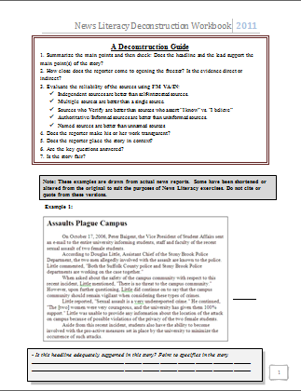

Deconstruction: “Application of News Literacy concepts to the analysis of component parts of a news report in order to dispassionately judge its reliability.”
Notes:
SLIDE: DECONSTRUCTING THE NEWS.
This week, we learn and practice a step-by-step process for pulling apart news stories of all kinds to assess their reliability.
Remember, that’s the point of this course: not to make you a cynical smart-aleck, but to prepare you to lead your family, your workplace and your community by skillfully finding reliable information…information that is actionable.
The Deconstruction Work book includes a series of stories that illustrate the value of this deconstruction process.
We will almost certainly not have time to do all the examples in Lecture, so this process will continue in recitation.
Past students say this lesson sticks with them long after the final exam…annoys them…makes them read slower…deconstruct TV stories out loud instead of zoning out…to which we say YES!
A word to the wise: most of your grade on the final will rest on your ability to deconstruct with precision and sophistication, using all of the concepts, skills and vocabulary learned this semester.
Note the stories are not all perfect examples; they are the result of daily journalism like you will consume for the rest of your life.
In the next three slides I’m going to introduce to you the method by which you break a story down into its parts in order to judge its reliability.
We call this deconstruction.

Slide 7
Deconstructing to judge reliability
Deconstruction
Step 1: Summarize the main points, comparing headline to lead
Deconstruction
Step 2. Did the reporter open the freezer? Is the evidence direct or indirect?
Deconstruction
Step 3: Evaluate the sources, using IMVA/IN
Deconstruction
Step 4: Does the reporter make his/her work transparent?
Deconstruction
Step 5: Does the reporter place the facts, the story, in context?
Deconstruction
Step 6: Are the key questions answered? (Who-What-When-Where-Why-How)
Deconstruction
Step 7: Is the story fair or balanced? Which should it be? What about fair play and fair language?
Notes:
ANIMATION: EACH CLICK WIPES OUT THE LAST STEP, BRINGS UP THE NEXT
You can’t do all seven steps of the deconstruction process on every story you read in your life.
But when the topic really matters to you and you’re getting ready to make decision or take action…you better be sure you’re working from reliable information.
Here’s how:
1. Summarize the main points of the story.
Do the headline and lede support the main point(s) of the story?
2. Assess the evidence supporting the main points of the story. Is Direct? arm's-length? How close did the reporter come to opening the freezer?
3. Are the sources reliable? (Are you reacting to them, or analyzing them?)
4. Does the reporter make his or her work transparent? How does the reporter know what is being reported?
5. Does the reporter place the story in context?
6. Are the key questions answered? (And what is left out.)
7. Is the story balanced? Should it be? Is it fair to the evidence and to key stakeholders?
When the information matters because you’re going to make a decision, take action or share it with others…these questions matter.

Slide 8
Deconstructing to judge reliability
Step 1: Summarize the main points, comparing headline to lead
Step 2. Did the reporter open the freezer? Is the evidence direct or indirect?
Step 3: Evaluate the sources, using IMVA/IN
Step 4: Does the reporter make his/her work transparent?
Step 5: Does the reporter place the facts, the story, in context?
Step 6: Are the key questions answered? (Who-What-When-Where-Why-How)
Step 7: Is the story fair or balanced? Which should it be? What about fair play and fair language?
Notes:
(NO ANIMATION ALL STEPS IN ONE SPOT)

Slide 9
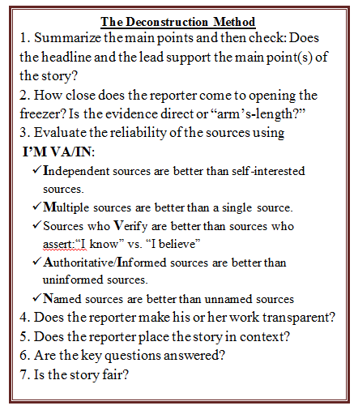
And The Whole Point Is….
What can a news consumer
Do with this information
Is it actionable?
Notes:
Again, the point of this process is not to make you an insufferable smart-alek.
It is to help you find reliable information to:
- Make a decision
Take action
Make a judgment
Share (responsibly) with others

Slide 10
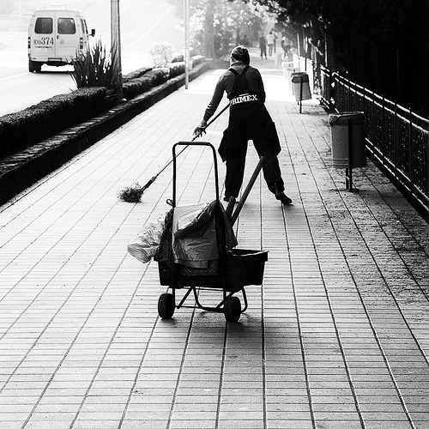
Housekeeping, Announcements & Notes

Slide 11
Last week’s Quick Quiz
#1. CBS is an OUTLET, not a SOURCE.
#2. The “M” in IMVA/IN stands for MULTIPLE. AS IN MULTIPLE SOURCES ARE BETTER THAN A SINGLE SOURCE. THINK CORROBORATION, NOT MAJORITY RULE.
Your questions and comments …

Slide 12




Reminder: Bring Deconstruction Workbook to Recitation, too
Notes:
Students need not only to bring this today, but also to the next class session

Slide 13
After this lecture, students will be able to:
Begin to apply key lessons of News Literacy in real time to find or identify reliable information.
Use the IMVAIN test of source reliability on the fly.
Distinguish, on the fly, between direct and indirect evidence and even spot-check if conclusions are logical or not.
Begin to correctly use the terms “Transparency” and “Context” to judge the professionalism of news reporting.
Use the Deconstruction Workbook as a means to rehearse detailed and sophisticated judgment of news reports.
These are the capstone skills of this course, encompassing all 6 outcomes promised by the syllabus.
Notes:
This slide intended for instructors as a focusing tool, but can be shared with students to prime them. Each lecture will include a slide like this with specific lecture outcomes that refer to course outcomes.
Here is what the syllabus declares students will be able to do if they successfully complete the course:
Analyze key elements of news reports - weighing evidence, evaluating sources, noting context and transparency - to judge reliability.
Distinguish between journalism, opinion journalism and un-supported bloviation.
Identify and distinguish between news media bias and audience bias.
Blend personal scholarship and course materials to write forcefully about journalism standards and practices, fairness and bias, First Amendment issues and their individual Fourth Estate rights and responsibilities.
Use examples from each day’s news to demonstrate critical thinking about civic engagement.
Place the impact of social media and digital technologies in their historical context.

Slide 14
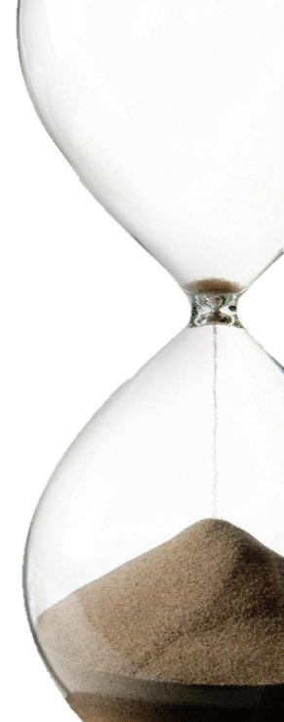
Countdown
To Test #2
Held in Recitation, WEEK OF NOV. 17
Emphasizes Lectures 7-11,
(Fairness & Bias through Deconstructing TV News)
Same format: 10 questions, 100 points possible.
Notes:
Lecturer should know the date of the Test #2 recitations in her/his lecture.

Slide 15





Context & Transparency
Two Ideas Students Struggle With
Notes:
ANIMATION: Slide opens with Red Box “The News”.
With each click another of the types of context appears.
A set of facts about some event that happened today takes on much more meaning, accuracy even, when the writer gives you context, such as the HISTORY that led to the event, COMPARISON to similar events, CONNECTION between these players and outside parties, and responsible PREDICTIONS of what comes next.
With all context, today’s isolated event makes more sense.

Slide 16

Key Definitions
Context: Facts that surround an event or elements of a news story and provide meaning or significance
Notes:
Before we go step-by-step through deconstruction, I want to walk you through two concepts that bedevil undergraduates: Context & Transparency.
Here’s a simple definition.
Let’s look at some more examples.

Slide 17
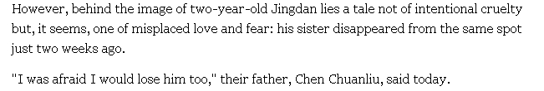
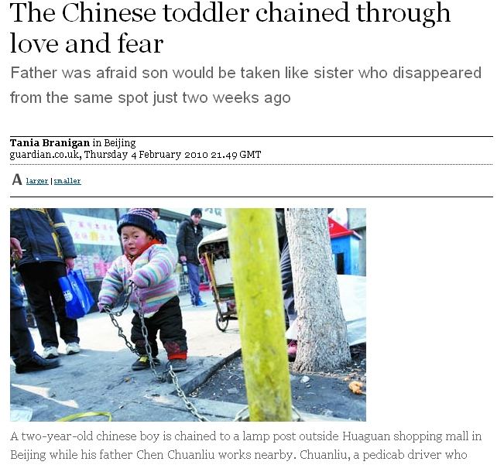
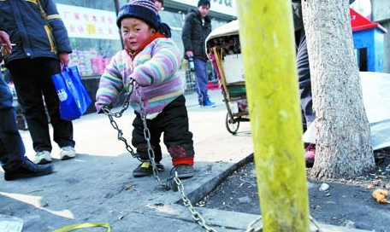
Deconstructing the News
The power of Context
Notes:
Animation: Click1=Photo, Click2= Headline, Click3= Excerpt
Click - You see a photo of a toddler chained to a tree. What do you think?
Click
Now what do you think?
Click:Reporter Tania Branigan in Beijing interviews the father, who says his daughter was abducted, so while he must work, he chains up the boy, Jingdan.
that change how you see the photo? That is context, what you might call “The Rest of the Story.”
As a news consumer, if you don’t look for context, you can miss the story.
http://www.dailymail.co.uk/news/article-1248252/Chinese-boy-chained-lamp-post-dad.html

Slide 18



Context
“Trends in College Pricing” and “Trends in Student Aid” reports is that fast-rising tuition costs have been accompanied by a huge increase in financial aid, which helped keep down the actual amount students and families pay.
When you look at how much students are actually paying, on average, it is lower, after adjusting for inflation, than five years earlier.”
As their state financing dwindled, four-year public universities increased their published tuition and fees almost 8 percent this year, to an average of $7,605… When room and board are included, the average in-state student at a public university now pays $16,140 a year.
Notes:
(Animation: First headline, then scary data graph about costs rising, then graphs that show aid grew faster than costs for a net reduction in payouts by students. Text is included so you can read aloud.)
The headline starts your ulcer: college costs are rising. That college costs are rising is the kernel of news, a story that alerts…with multiple drivers: Change, Relevance, Proximity, Importance…
(click) But if you were a scientist studying the impact of that fact, you’d think about all the variables…Like t this fact about aid increasing. That’s the context.
(click)…Which makes possible this analysis: Payouts have dropped for students.
Wow…Does context ever matter. If you had the fees data alone, it would be a very different story than this.
Full story on P.25 of Decon Workbook

Slide 19
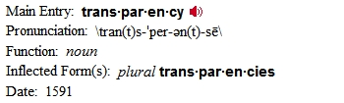
Key Definitions
Transparency: The reporter specifies in the story what he or she does not know, and why it could not be learned; how they know what they do know; when the reporter pulls the curtain aside.
Notes:
And now transparency. This is a word that has a lot of different connotations, depending on what you’re talking about.
For the purposes of this course, there are two meanings to transparency.
1. Specifying in a story what you do not know or could not learn. For example: “It could not be learned… He or she could not be reached for comment.”
2. Specifying how the reporter got the information. For example: “In an interview at his front door, the suspect said…According to documents obtained by Channel 6 News…”

Slide 20


TRANSPARENCY
A Source Who Saw Her Boss And Fears Retribution
A Source Who Saw Her Boss And Fears Retribution
A Source Who Saw Her Boss
Who Saw
A Source
Notes:
ANIMATION: This sequence is intended to show how transparency makes a source more trustworthy.
Click 1= A Source; Click2=A Source who Saw; Click 3= A source who saw her boss; Click4=A Source Who Saw Her Boss and Fears Retribution.
TRANSPARENCY, is what we call it when the reporter lets you see why she made certain decisions so that you may judge her work. In this case, an anonymous source is pretty fuzzy until you know it is a witness, a female, an employee and that she fears retribution.(click-click-click-click)
Ironically, transparency makes things LESS fuzzy. Transparency is a journalist making it possible for you to see how she knows what she knows or why we don’t know all that we wish we did know.

Slide 21


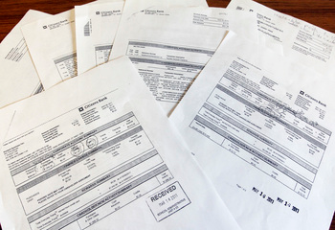
TRANSPARENCY
“…lax oversight of the district’s credit card, (was) among a series of financial irregularities outlined in a critical audit of the Wilton-Lyndeborough School District.”
Notes:
ANIMATION: On Click, Transparency header appears. Each additional click raises the blinds on the credit card statements that provided the details used in the repot.
LECTURER: HERE’S ANOTHER VISUAL ATTEMPT AT SAME EXPLANATION
TRANSPARENCY is what we call it when the reporter lets you see the provenance of crucial information.
In this case, the serious charge of misuse of a government credit card is supported with copies of the credit card bills, showing the dubious meals and travel.
Ironically, transparency makes things LESS fuzzy. Transparency is a journalist making it possible for you to see how she knows what she knows or why we don’t know all that we wish we did know.

Slide 22
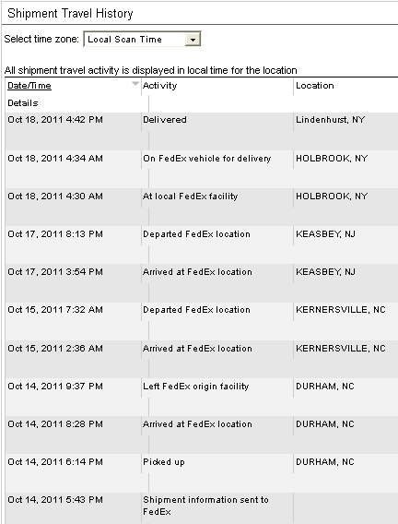

Deconstructing the News
Transparency is Openness about Methods
· “Could not be reached”
· “Requested anonymity because she feared losing her job”
· “A reporter attempted to contact the family at home, but no one came to the door.”
· “The information could not be independently verified.”
Notes:
Transparency has lots of analogies in your every day life:
At the on-campus grill, the cooks make your omelets and cheeseburgers as you watch. Letting you see the process is supposed to make you feel better about the food.
Fed Ex lets you log onto its website to see each stage in your package’s progress from you to your Grandmother.
Tracking the shipment lets you see the steps they took to deliver it.
That’s what we mean by transparency in journalism: The journalist letting you see the steps taken to assemble the story.
CLICK HERE TO SHOW QUOTES
Here is a list of common statements by which journalists make their work transparent…open to the public:
--Could not be reached
--Requested anonymity because she feared for her job.
--A reporter tried to contact the family at their home, but no one came to the door.
-The information could not be independently verified.
We’ll circle back to this concept.

Slide 23
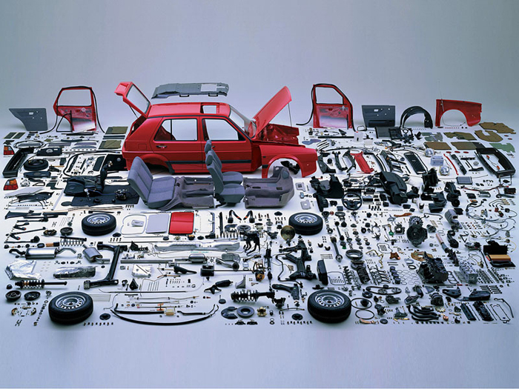
Deconstruction
Step 1: Summarize the main points, comparing headline to lead
Deconstruction
1) Summarize the main points of the story
Notes:
Let’s start working our way through the Deconstruction workbook, step by step.
STEP 1: SUMMARIZE THE STORY
If your car is a Toyota , you want it to have a Toyota engine, Toyota brakes and Toyota steering wheel, not a shiny but mismatched part from a Chevy schoolbus.
Same goes for a reliable news report. If the Headline and Lead are not matched to the story, you should be concerned.
SO, Summarize for yourself the main points. This will get you out of automatic reading mode and into critical thinking mode.
A well-made, reliable story will have a headline and “lead” that match the facts.
One useful definition: The Lead is often the first paragraph and should generally give the main point of the story . Sometimes the lead is delayed because the reporter uses an anecdote to set the scene or hook the reader. Even then, there is usually still one paragraph, a bit further into the story, which gives you a summary of the main points. A hyped-up headline or lead is a warning sign: this report is more interested in gathering an audience than delivering reliable information.

Slide 24
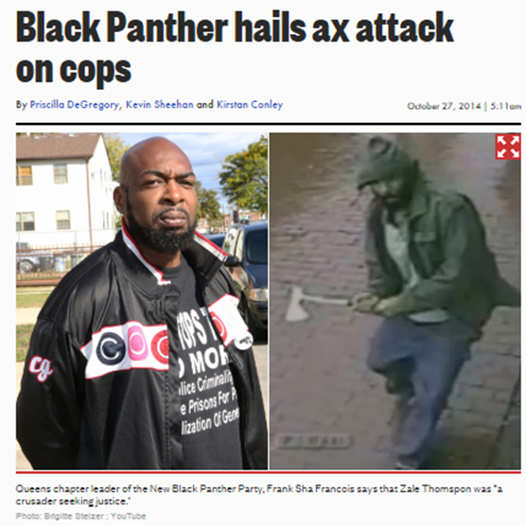
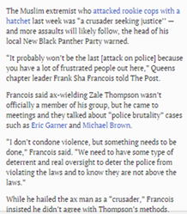
Deconstruction
Step 1: Summarize the main points, comparing headline to lead
Deconstructing the News
How Reliable is the Headline?
Is the Headline Supported By the Story?
Notes:
ANIMATION: SLIDE OPENS WITH SCARY HEADLINE. CLICK TO BRING UP STORY TEXT. MUCH LESS SCARY.
The headline makes it sound like he celebrates the attack.
CLICK
Yet when you read the story, he is making a fairly common warning: that U.S. foreign intervention sometimes breeds enemies.
Do you trust an outlet that writes grabby headlines that are not supported?

Slide 25
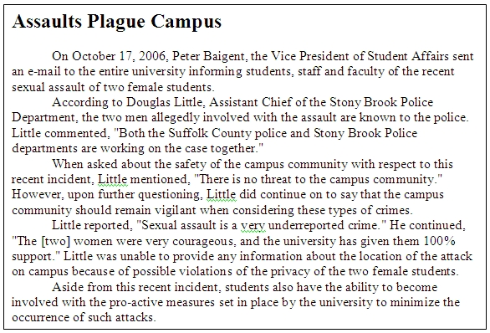
Deconstruction
Step 1: Summarize the main points, comparing headline to lead
Is the Headline Supported By the Story?
Notes:
(Animation: Click a 2nd time to bring up pull quote)
Turn to page 1 in the workbook
Assaults Plague campus.
The words intended to make you stop and read a story are the Headline, the stuff in big letters, and the “lead,” a summary sentence that tells you what the story is about .
ASK: Does this headline accurately summarize the story?
(It does not. Discuss why it does not. )
Stony Brook enrollment is approximately 22,000. What rate of crime per 1,000 students would constitute a plague?
ASK: Is the campus “plagued?”
Is this reliable information?

Slide 26
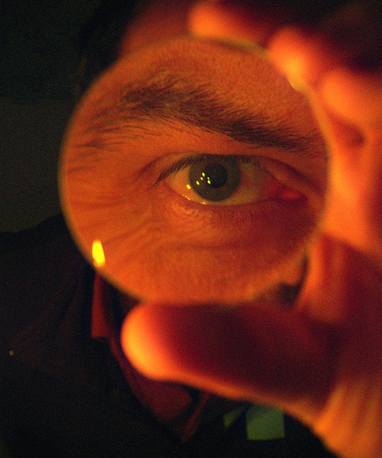
Deconstruction
Step 2. Did the reporter open the freezer? Is the evidence direct or indirect?
Assess the evidence supporting the main points of the story.
Notes:
In the lecture on Truth and Verification, we talked about the importance of judging the quality of the evidence for yourself.
Is it direct or indirect?
Are assertions going about naked, with no evidence to give them dignity?
When it comes to really serious reports that affect a person’s freedom, the outcome of an election, the future of a business, you want to pay attention to the evidence a journalist has collected. Does it support the conclusions that are suggested?

Slide 27
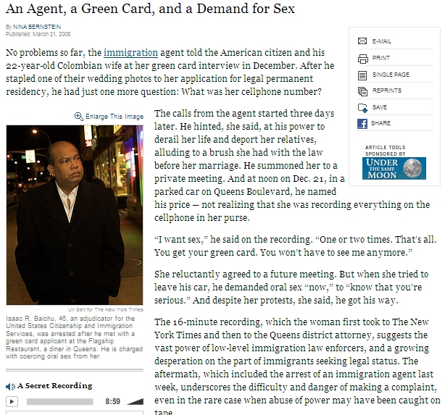
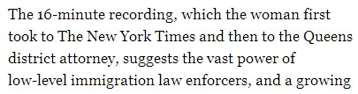
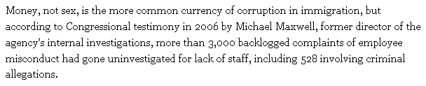
Deconstruction
Step 2. Did the reporter open the freezer? Is the evidence direct or indirect?
Evidence: Did the reporter open the freezer?
Notes:
(Animation: First click brings up graph about the audio recording. 2nd click, indirect evidence in the form of background information that describes other examples of this kind of behavior by INS agents.)
Workbook Page 24
In this example from the workbook, a serious charge is made against an Immigration agent.
(Don’t click yet, but each click brings up another)
ASK: Where is the evidence? What kind is it?
ASK: How close did the reporter come to opening the freezer
Let students bring this out:
1. On the tape, the 16-minute recording.
2. Confirmed in congressional testimony by a named official, Michael Maxwell.
3. Statistics re: complaints back up point 3,000 pending misconduct complaints.
http://www.nytimes.com/2008/03/21/nyregion/21immigrant.html

Slide 28
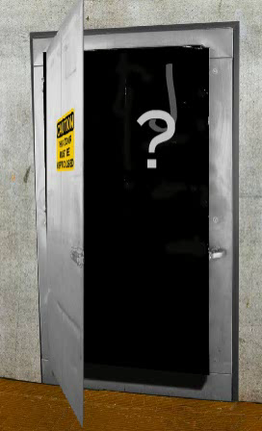
Deconstruction
Step 2. Did the reporter open the freezer? Is the evidence direct or indirect?
How close did the reporter come to opening the freezer? If not, did a reliable source open it?
Notes:
(Animation: Mildly creepy…Question mark on a meat-hook swings out)
DID THE REPORTER OPEN THE FREEZER?
You recall the story of the New Orleans reporter who flinched from examining the freezer in the Convention Center that was supposed to be full of murder victims… and got the story wrong.
This course asks the question…How close does the reporter come to “opening the freezer? “ as a way to think about whether the story is based on direct or arm's-length evidence.
Just because a story relies on arm's-length evidence does not mean it is a weak story.
Often, that is the only evidence available.
But the news consumer should remember to stop and think when the story rests on eyewitnesses, when it rests on second-hand information.

Slide 29
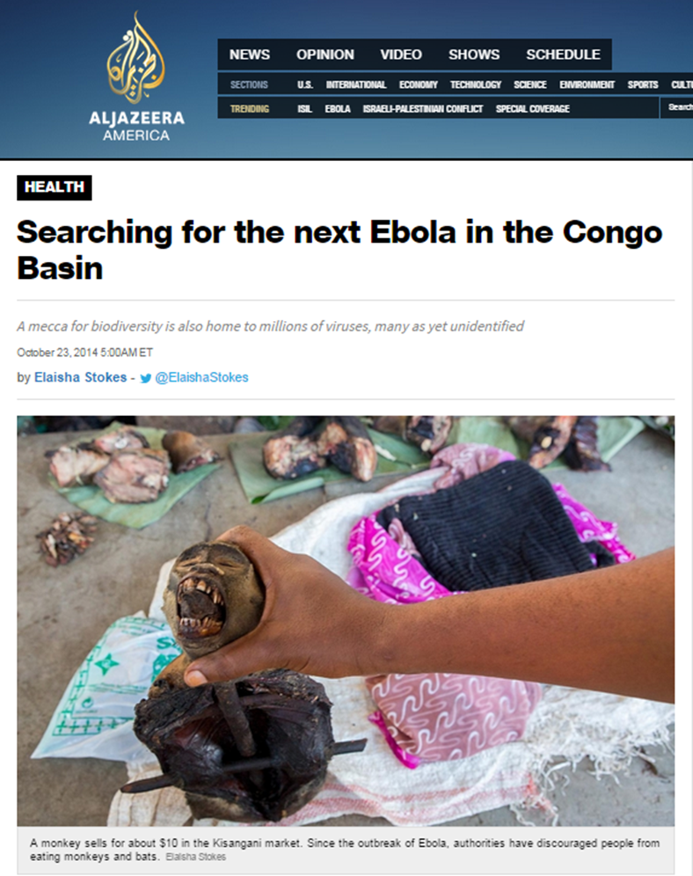
Deconstruction
Step 2. Did the reporter open the freezer? Is the evidence direct or indirect?
Notes:
Workbook Page 3
In this example from the workbook, the reporter describes the sale of so-called “bush-meat” the wild animals indigenous to the region, which may also carry communicable diseases and viruses.
How did the reporter open the freezer? (The opening tour of the marketplace is a good example of opening the freezer. The reporter went and saw.)

Slide 30

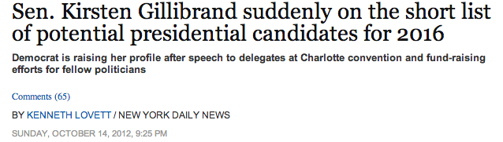
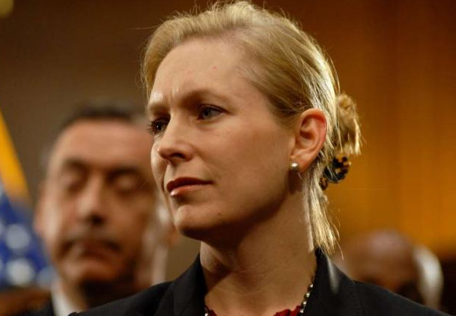
What’s the Evidence That Sen. Gillibrand Will Run for President?
Deconstruction
Step 2. Did the reporter open the freezer? Is the evidence direct or indirect?
Direct Evidence?
Indirect Evidence?
Inference?
Notes:
NOT IN WORKBOOK
In this example from the Daily News, there’s no direct evidence at all.
She has raised money for other candidates.
She spoke at the Democratic Convention
She says she’s not running and wants Sec. of State Hillary Clinton to run.
A political science professor says he has heard her name mentioned (hearsay)
The reporter infers from these pieces of evidence that she is gearing up.
He does not mention that this is also a common pattern for Senators from safe districts: raise unnecessary campaign funds and then curry favor by giving it to candidates who face a tough race.
Which leads to the next part of evidence analysis: has the evidence been used to support a valid inference?
http://www.nydailynews.com/news/politics/gillibrand-short-list-2016-presidential-contenders-article-1.1183451

Slide 31


Test Inferences for Soundness
Evidence: Information that proves or disproves something
Inference: Taking information that is accepted as true and then drawing a conclusion
that may or may not be valid
Notes:
Evidence is information that proves or disproves something
Inference is an assertion that suggests a conclusion or relationship. To be sound, the assumptions must be accurate AND the connections must be carefully made. Otherwise…you’re on thin ice.
Aka: Correlation does not equal causation.
Aka: Post Hoc, Ergo Propter Hoc: Latin for "after this, therefore because (on account) of this" commonly referred to as a logical fallacy .

Slide 32


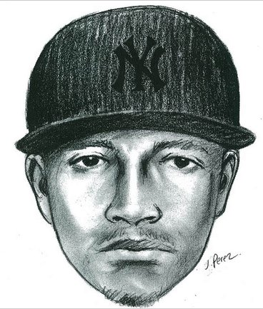
Deconstruction
Step 2. Did the reporter open the freezer? Is the evidence direct or indirect?
Checking Inferences
Notes:
Now let’s read Workbook Page 7
ASK: What kind of evidence does the reporter collect? (Direct or arm's-length)
With that evidence:
Can you conclude Yankees hat cause criminal behavior?
Can you conclude all criminals wear Yankees hats?
Can you conclude dumb criminals, the ones who get caught, wear Yankees hats?
What phrase have you learned about this common trap people fall into when they assume they have all the right facts? (Correlation does not equal causation…flawed inference.)
I think you could call that a context problem, by the way. If you don’t have the whole picture, you may draw a faulty inference.
And if you conclude from this that all inference is flawed…you’re ignoring the fact that most criminal investigation and scientific endeavor relies at least in part on Inductive reasoning built on sturdy three-part inferences like this: All Men are Mortal; Socrates is a Man; Socrates is Mortal.
http://www.nytimes.com/2010/09/16/nyregion/16caps.html

Slide 33



Deconstruction
Step 2. Did the reporter open the freezer? Is the evidence direct or indirect?
Is The Inference Sturdy?
Notes:
Now let’s look at Workbook Page 9: Pulling all-nighters can lower GPA.
(Click brings up quote with data)
“Certainly the evidence is out there showing that short sleep duration absolutely interferes with concentration….” says one source…and then there’s this study (CLICK NOW)
But does that mean all-nighters equate to lower grades?
Is that the only conclusion you can make from the evidence that was collected?
OR…are lower-GPA students more likely to pull all nighters.
Or…what are other possible conclusions?
Solid evidence is one thing.
Inductive reasoning, however, is dangerous if you don’t understand Fallacy: which is the study of common thinking errors such as confusing correlation for causation.
http://www.usatoday.com/tech/science/discoveries/2007-12-14-all-nighters-gpa_N.htm

Slide 34
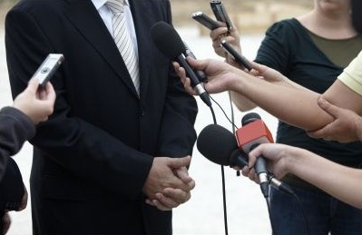
Deconstruction
Step 3: Evaluate the sources, using IMVA/IN
Notes:
Because most stories rely on interviews, news consumers looking for reliable information need to evaluate sources.
TO REITERATE A KEY POINT…In the past, some students have mistakenly applied an all-or-nothing standard. Any source who failed just one of the sourcing guidelines was ruled unreliable.
It’s rarely that clear, which is why we have given you five rules for weighing sources.
Remember how important that word “BETTER” is. It’s not absolute. It’s relative.
If someone’s an eye-witness, odds are good they are also a participant. That doesn’t mean they’re unreliable, but it does suggest you proceed carefully.
If someone’s authoritative about a company, they’re likely an employee, investor or competitor and therefore self-interested. But if the information they provide is verifiable, they may be a reliable source.
The point is, you’re smart enough to take all this into account and make a nuanced judgment of reliability.

Slide 35
Deconstruction
Step 3: Evaluate the sources, using IMVA/IN
1) Independent Sources Are Better Than Self-Interested Sources
2) Multiple Sources Are Better Than Single Sources
3) Sources Who Verify Are Better Than Sources Who Assert
4) Authoritative/Informed Sources Are Better Than Uninformed Sources
5) Named Sources Are Better Than Unnamed Sources
(Mnemonic Device: I’M VAIN)
Notes:
(ANIMATION: Each bullet point comes in (quickly) on the click. Instead of fading in, they fly in, just to keep the students awake. )
Just a reminder.
Here’s how we evaluate sources in News Literacy.

Slide 36


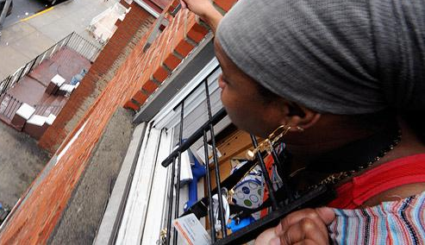
Deconstruction
Step 3: Evaluate the sources, using IMVA/IN
Independence vs. Self-Interest
Notes:
ANIMATION: CLICK1 = UNDERLINES PAUL BROWNE AND HIS AFFILIATION
CLICK2 = UNDERLINES CITIZEN GRAY
On March 9th, 16 year old Kimani Gray was shot by police in Brooklyn. Riots erupted at a vigil for the teen, after a witness and several family members and friends say Kimani was unarmed. Paul J. Browne, chief spokesperson for the police department, however, says Gray produced a revolver. The police department has released photos of the revolver found at the scene.
How do you rate each source on the basis of Independence?
Browne’s self-interest is that he is paid by the NYPD.
We don’t know Ms. Gray’s self-interest

Slide 37
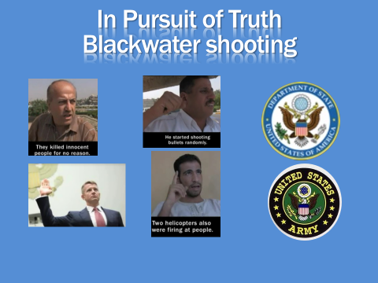
Deconstruction
Step 3: Evaluate the sources, using IMVA/IN
Multiple
aka Corroboration
Notes:
ANIMATION: CLICK1= BRINGS UP SLIDE FROM SOURCES LECTURE, MULTIPLE SOURCES IN NYT VIDEO
Just a reminder from the Sources lecture, the strength of the New York Times story on the Blackwater shooting case was that it used so many different sources, with so many different perspectives on what happened.
That’s what the M in IMVAIN pushes you to ask is “Who Else Sez So?”

Slide 38
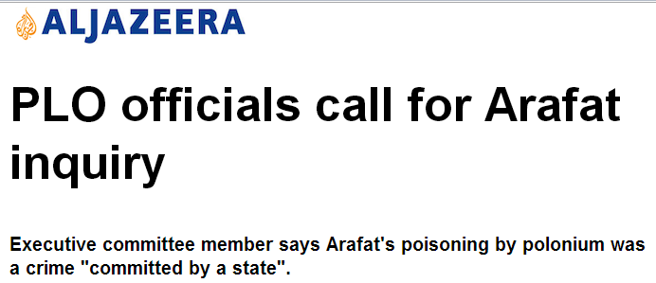
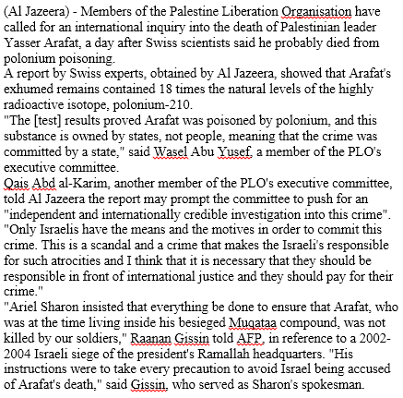
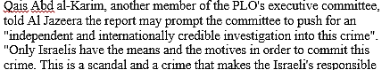
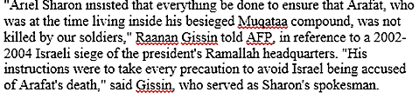
Deconstruction
Step 3: Evaluate the sources, using IMVA/IN
Verifying or Asserting?
Notes:
ANIMATION: CLICK1= YUSEF SAYING POLONIUM IS ONLY OWNED BY STATES
CLICK2= AL-KARIM SAYING IT HAS TO BE ISRAEL
CLICK3= GISSIN SAYS THE POLICY WAS THE OPPOSITE: PROTECT ARAFAT
In November of 2004, PLO Leader Yasser Arafat died of unknown causes. His mysterious death has been the cause of speculation that has now risen in response to a new report.
On November 6, an Al Jazeera report surfaced that quotes a Swiss expert saying the exhumed body of Yasser Arafat contained high levels of Polonium-210, a radioactive isotope that is a powerful poison. (Though not a sneaky one, as it leaves behind an unmistakable radiation signature.)
Let’s think about these three sources quoted in Al Jazeera’s report.
Are they asserting or do they verify, and how does that (and their other traits) affect your rating of their reliability?
Does Yusef verify his statement that Polonium is never owned by individuals?
Does al-Karim verify his statement that only Israel has the means and motives?
Does Gissin verify his statement that Israel’s security forces were under strict orders to avoid killing Arafat?
(Your correspondent would say no. All three make very specific statements, but provide no evidentiary basis. Upon some further research, note that there are quasi-industrial, non-state, uses of Polonium, that Russia is the major producer and that the Lancet article on Arafat’s remains may or may not be challenged by a Russian report.)
http://www.aljazeera.com/news/middleeast/2013/11/plo-calls-international-arafat-inquiry-2013117133621879133.html

Slide 39
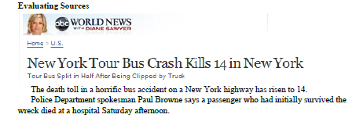
Deconstruction
Step 3: Evaluate the sources, using IMVA/IN
How Reliable Are Mr. Williams’ Friends?
(Bookard and Jackson)
What Do You Base That On?
Notes:
PAGE 10 IN WORKBOOK
Read the web version of ABC’s story about the bus crash that killed 14 people.
Write down your ratings of Shamel Bookard and Ashanti Jackson.
ASK:
Rate their reliability.
On What basis (push for I.M.V.A/I.N.)

Slide 40
Trustworthy Anonymous Sources
Are Offered to You With:
Transparency
Characterization
Corroboration
Notes:
Anonymous sources present a number of challenges.
It’s tempting to discount everything they say. They’re not accountable for what they say and it’s nearly impossible for a reader to judge if a nameless person is authoritative.
On the other hand, whistleblowers have exposed a great deal of dangerous, illegal or embarrassing behavior by government officials, corporate leaders and religious leaders.
So, other than trusting the reporter’s judgment, what can you do?
Ask yourself these questions.
- Why is the person anonymous?
-Has the reporter offered information to demonstrate the person is informed?
-Is there any indication the person is self-interested?
-Does the source assert or verify?
-Is there any independent confirmation of what the source is saying? (Corroboration)

Slide 41


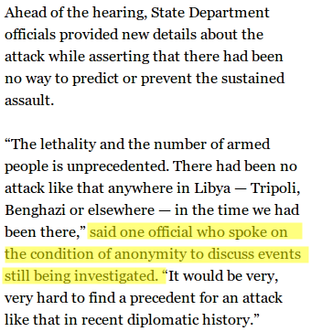
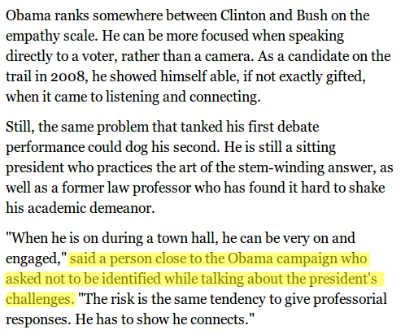
Anonymous Sources
Deconstruction
Step 3: Evaluate the sources, using IMVA/IN
Transparent enough?
Benghazi attack may cloud Clinton’s legacy
Characterized enough?
Town hall awaits Obama and Romney
Notes:
(NOTE: Example is not in Deconstruction Workbook)
These are two examples of anonymous or unnamed sources in the news.
The "good" example on the left is from a story in the Washington Post about the attack in Benghazi, Libya. A State Department official is giving information to the reporter on background because the event is still being investigated. The information may be self-serving, but at least you know why the source is not named.
The "bad" example on the right is from a story in the LA Times about how the two candidates are preparing for the town-hall style debate format. Can you get any more vague than "person close to the Obama campaign" ? Does that mean the drunk sitting on the curb near the campaign office, or a top official?
ASK: Is there a legitimate journalistic reason to withhold this source's name? Shouldn’t the Times say what it is?

Slide 42
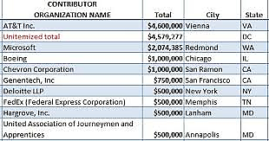
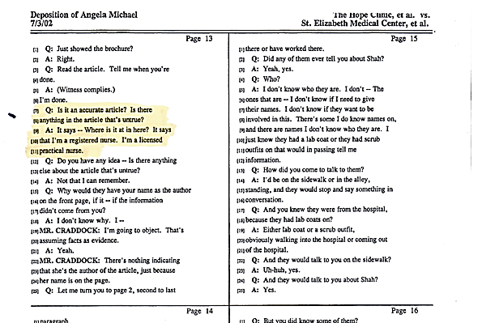
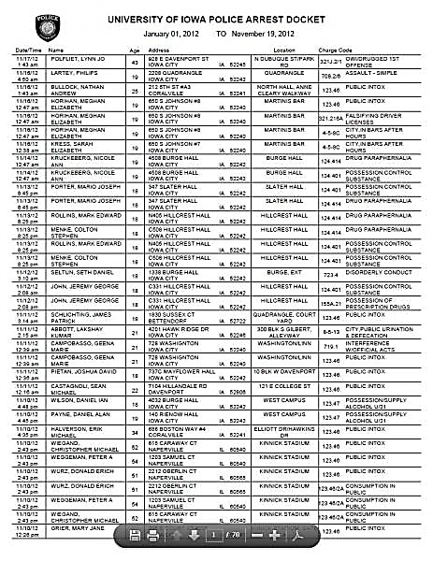
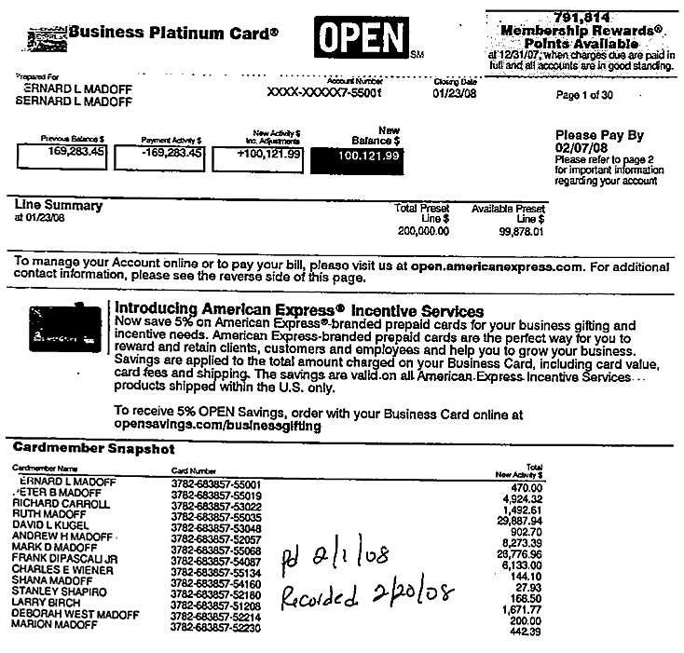
Deconstruction
Step 4: Does the reporter make his/her work transparent?
Notes:
Working through the Deconstruction steps, we’re now at #4: DOES THE REPORTER MAKE HIS OR HER WORK TRANSPARENT?
In the prior lecture we described the scientific method, which includes publication of research findings with detailed data, methodology, etc and encouraging other scientists to review it.
In journalism, one form of peer review is called transparency: telling how you know what you know and why you don’t know what you don’t know.
Think of it as a behind-the-scenes tour…the reporter showing you how the information was gathered…or why it was not available.. This allows you to judge their work, just like you’d judge the findings of a scientist. If someone else could go find the same material, the story is reliable.

Slide 43
Key Definitions
Transparency: The reporter specifies in the story what he or she does not know, and why it could not be learned; how they know what they do know; when the reporter pulls the curtain aside.
Notes:
Definition of transparent: Specifying in a story what you do not know or could not learn. For example: It could not be learned. He or she could not be reached for comment.

Slide 44
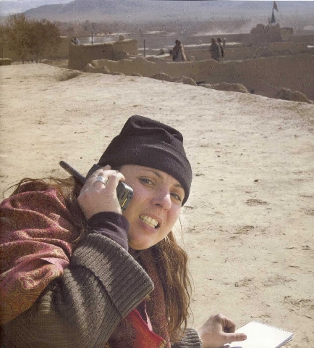
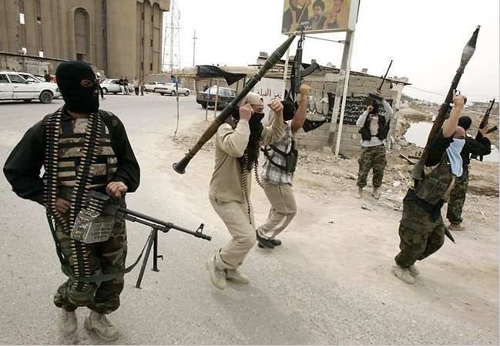
Deconstruction
Step 4: Does the reporter make his/her work transparent?
What is the example of transparency?
National Public Radio Reports from Basra
Notes:
STEP 5: DOES THE REPORTER MAKE HIS OR HER WORK TRANSPARENT?
Here is an NPR report from Basra, (Iraq)
Listen for examples of transparency
Example: NPR report from Basra. Listen for the statements of what it cannot verify or know with certainty.
(Next slide launches audio, a really good example of real-time transparency in which she says what she doesn’t know.)

Slide 45
Deconstruction
Step 4: Does the reporter make his/her work transparent?
Npr_basra.wmv
Notes:
NEWSFELLOW: NEWS FELLOW: LINK (INSERT) VIDEO TO THIS SLIDE AND SELECT “START AUTOMATICALLY”
Runtime 2:40

Slide 46
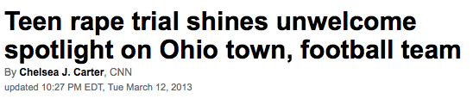

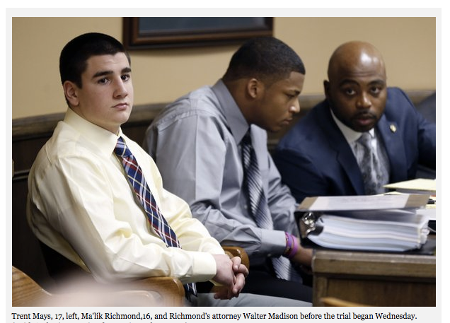
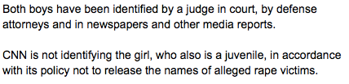
Deconstruction
Step 4: Does the reporter make his/her work transparent?
Notes:
Animation: The Transparency example is hidden until you click for it.
Workbook Page 15
Transparency is how a journalist shows you what he or she doesn’t know or can’t say. In this case, the CNN explains where and how the alleged perpetrators and victims were identified elsewhere, and why they were not being identified by CNN in this article.
http://www.cnn.com/2013/03/12/justice/ohio-steubenville-case/

Slide 47

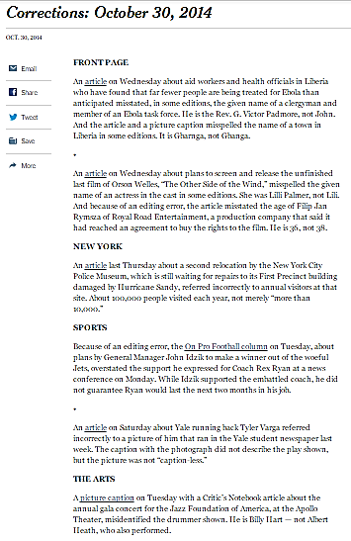

Deconstruction
Step 4: Does the reporter make his/her work transparent?
Corrections are Institutional Transparency
Notes:
STEP 5: DOES THE REPORTER MAKE HIS OR HER WORK TRANSPARENT?
Point of this is that corrections are institutional transparency: here’s what we got wrong.

Slide 48
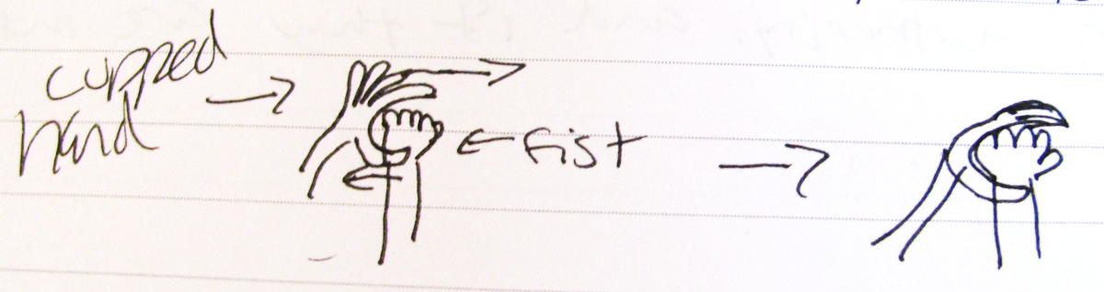
Deconstruction
Step 5: Does the reporter place the facts, the story, in context?
Notes:
Students have been known to remember how to think about context by flashing the News Literacy gang sign and even by drawing it on their exams…
It shows the context (hand shaped like a C – for Context) wrapped around the kernel of news (other hand ). It’s a way to remember the news is still the heart of the story, but it’s a stronger story with context supporting and explaining the news.

Slide 49
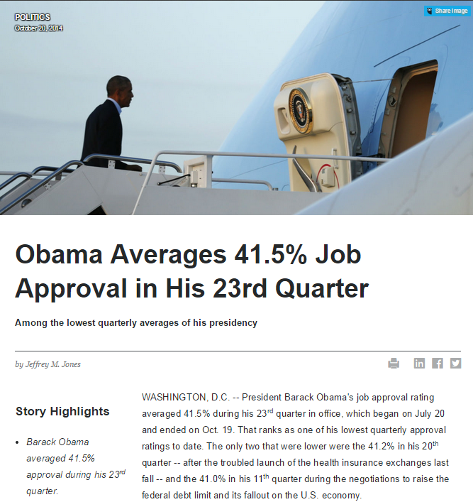
Deconstruction
Step 5: Does the reporter place the facts, the story, in context?
Notes:
WORKBOOK PAGE 16
What are the examples of context?
Basically, the whole story is context.
And that’s a good lesson about statistics and numbers. They are misleading, or at least non-useful, until context gives them meaning.
“…he hit 41% in the third quarter of 2011…After a relatively strong fourth year…middle of the pack for recent presidents…Three post-war presidents…Two presidents…The legislative battles…”
ASK:
How does context help makes this story reliable, fair, useful?

Slide 50

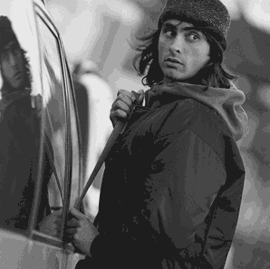
Deconstruction
Step 5: Does the reporter place the facts, the story, in context?
Nassau and Suffolk are two of New York’s 62 counties, but account for 10% of car thefts.
Notes:
(This example is better suited to Recitation, but it’s very effective if you decide to take time in lecture)
Circling back to the idea we introduced at the beginning of lecture: Context
Let’s see….Two counties is 3% of the 62…but %10 percent of the car thefts?
How many of you drive to school or have a car? Well, according to the Federal Bureau of Investigation's Uniform Crime Reports, a motor vehicle is stolen in the United States every 26.4 seconds. (Look at watch, wait 26 seconds, say “There goes one now!)
The FBI also calculates the odds of a vehicle being stolen were 1 in 207 in the latest study. So…how many cars in the lot west of here?
Furthermore, the odds are highest in urban areas like this Tri-state area....And I thought you should know that more than one in ten of the cars stolen in all 62 counties of New York State are stolen right here on Long Island…
How are you commuters feeling?... Can you remember if you locked your car?
If you leave, though, you'll miss this context...The car theft rate is the highest in the Western U.S., almost a full third higher than the US average. And the theft rate for the Northeast is about half the US average. And the car theft rate for Long Island? It's about one third the U.S. average. ...But, but, but...what about "more than one in ten of the cars stolen in all 62 counties of New York State are stolen right here on Long Island"?
That is true, but while Long Island accounts for about 15 percent of the state's population, it only sees about a tenth of the car thefts, so car theft is rare on Long Island, relative to almost anywhere in the country…

Slide 51
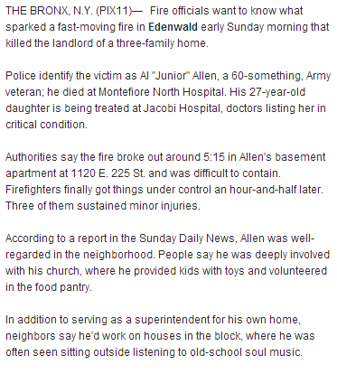
Deconstruction
Step 6: Are the key questions answered? (Who-What-When-Where-Why-How)
Who
What
When
Where
Why
?
hoW
Notes:
(Animation: 7 Clicks: Who, What, When Where and then Why and How are unanswered)
One way to stay focused is to ask…are the key questions all answered?
Who, What, When, Where, Why and How are certainly a starting point.
Pay attention to questions that tug at you as you are watching or reading.
Perhaps Most important…What’s missing?
Gaps should either be explained (transparency) or you need to pay attention to them in judging a story.

Slide 52
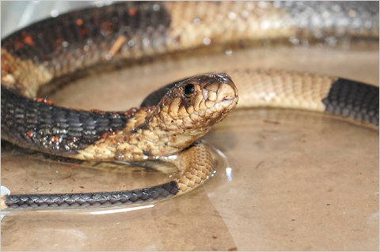
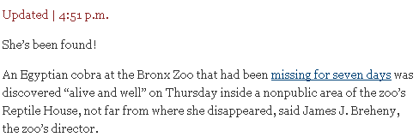
Deconstruction
Step 6: Are the key questions answered? (Who-What-When-Where-Why-How)
Notes:
Workbook Page 20
(Animation: Click will bring up the lead of the story)
ASK: Is there anything missing from this story?
ASK: What habit might that gap analysis reinforce? (checking to see questions are answered)
Follow the News, Check Multiple Outlets
http://cityroom.blogs.nytimes.com/2011/03/31/bronx-zoo-cobra-found-alive/

Slide 53

Deconstruction
Step 7: Is the story fair or balanced? Which should it be? What about fair play and fair language?
Notes:
Deconstruction workbook page 6
Balance vs. Fairness is a complicated question we covered at length in Lecture, so today we’ll just remind you that on the exam you’re going to be asked to tell the difference between a story that should be mathematically BALANCED in its treatment of all parties or FAIR to the evidence.
ASK: Which is which?
(Balanced when the truth is yet unknown or there is a real lack of consensus. Fair when the evidence is overwhelming, regardless of those who wish it were not so.)
Who or what is missing from this story?
A lot of things are missing.
While the reporter does provide documentary evidence, the statistics on differences in the gender of defendants, only one person, Brian Leverenz, is interviewed. No other point of view is presented and in that way, the girls of New Trier Township have gotten a bad reputation.

Slide 54
And The Whole Point Is….
What can a news consumer
Do with this information
Is it actionable?
Notes:
Again, the point of this process is not to make you an insufferable smart-alek.
It is to help you find reliable information to:
- Make a decision
Take action
Make a judgment
Share (responsibly) with others

Slide 55



Deconstructing the News
Case Study: The pregnant man story
Assess reliability by Evaluating Sources & Evidence
Notes:
This is NOT in the Workbook for Lecture any longer
: The Pregnant Man.
The original story was in The Advocate, a magazine we might not have known much about.
ASK: What would it take for you to believe this story?

Slide 56



Case Study: The pregnant man story
Do These Sources Help?
Notes:
Look at this March 27th story: it has more detail.
Story says he is expecting baby in July.
Several more sources are cited…Are they reliable?
ASK: Why or why not.
How would you check it further?
With medical records?
What evidence shows that this is or is not a hoax?
This report relies heavily on the Advocate’s story. Is that a reliable source?

Slide 57

Deconstructing the News
Case Study: The pregnant man story
Does This Sonogram Help?
Notes:
Now we’ve got a Sonogram.
Does the sonogram have weight?
What kind of evidence is it?

Slide 58


Deconstructing the News
Case Study: The pregnant man story
Do Baby Photos Help?
Notes:
How about the picture of him holding the baby?
What kind of evidence is that?
Is this an example of provisional truth?
What changed over time?
What kind of new evidence emerged?
(lecturer see BackgroundPak. Beatie has had three children now and 10 years of hormone treatment apparently did not prevent pregnancy. Beatie is a “top-only” transgendered person: Kept reproductive organs, but had breasts removed and took hormones for 10 years to get bear, male features, etc.)

Slide 59
Deconstructing methodically
The workbook method
How reliable?
Notes:
Now let’s go back to the example we started with, the clip from ABC News saying that there is an epidemic of texting and it’s an illness.
As you watch, keep a list of the evidence and of the sources.

Slide 60
Texting.wmv
Notes:
NEWSFELLOW: NEWS FELLOW: LINK (INSERT) VIDEO TO THIS SLIDE AND SELECT “START AUTOMATICALLY”

Slide 61





Deconstructing the News
Weigh sources and evidence
Notes:
(Animation: Slide opens with phone and mad texter. Each following clip brings up another source and then the final click is the study)
ASK: Evidence?
Sources?
(Three Vox Pop interviews.
Excerpts from a study.)
The apparent starting point is a study reported on in the American Journal of Psychiatry.
THAT would be an expert or informed source.

Slide 62
Deconstructing to judge reliability
Deconstruction
Step 1: Summarize the main points, comparing headline to lead
Deconstruction
Step 2. Did the reporter open the freezer? Is the evidence direct or indirect?
Deconstruction
Step 3: Evaluate the sources, using IMVA/IN
Deconstruction
Step 4: Does the reporter make his/her work transparent?
Deconstruction
Step 5: Does the reporter place the facts, the story, in context?
Deconstruction
Step 6: Are the key questions answered? (Who-What-When-Where-Why-How)
Deconstruction
Step 7: Is the story fair or balanced? Which should it be? What about fair play and fair language?
Notes:
ANIMATION: EACH CLICK WIPES OUT THE LAST STEP, BRINGS UP THE NEXT
You can’t do all seven steps of the deconstruction process on every story you read in your life.
But when the topic really matters to you and you’re getting ready to make decision or take action…you better be sure you’re working from reliable information.
Here’s how:
1. Summarize the main points of the story.
Do the headline and lede support the main point(s) of the story?
2. Assess the evidence supporting the main points of the story. Is Direct? arm's-length? How close did the reporter come to opening the freezer?
3. Are the sources reliable? (Are you reacting to them, or analyzing them?)
4. Does the reporter make his or her work transparent? How does the reporter know what is being reported?
5. Does the reporter place the story in context?
6. Are the key questions answered? (And what is left out.)
7. Is the story balanced? Should it be? Is it fair to the evidence and to key stakeholders?
When the information matters because you’re going to make a decision, take action or share it with others…these questions matter.

Slide 63
Deconstructing to judge reliability
Step 1: Summarize the main points, comparing headline to lead
Step 2. Did the reporter open the freezer? Is the evidence direct or indirect?
Step 3: Evaluate the sources, using IMVA/IN
Step 4: Does the reporter make his/her work transparent?
Step 5: Does the reporter place the facts, the story, in context?
Step 6: Are the key questions answered? (Who-What-When-Where-Why-How)
Step 7: Is the story fair or balanced? Which should it be? What about fair play and fair language?
Notes:
You can’t do all eight steps of the deconstruction process on every story you read in your life.
But when the topic really matters to you and you’re getting ready to make decision or take action…you better be sure you’re working from reliable information.
Here’s how:
1. Summarize the main points of the story.
Do the headline and lede support the main point(s) of the story?
2. Assess the evidence supporting the main points of the story. Is Direct? arm's-length? How close did the reporter come to opening the freezer?
3. Are the sources reliable? (Are you reacting to them, or analyzing them?)
4. Does the reporter make his or her work transparent? How does the reporter know what is being reported?
5. Does the reporter place the story in context?
6. Are the key questions answered? (And what is left out.)
7. Is the story balanced? Should it be? Is it fair to the evidence and to key stakeholders?
When the information matters because you’re going to make a decision, take action or share it with others…these questions matter.

Slide 64
And the Whole Point Is…
Is it actionable?
Can you reach a conclusion?
Can you take an action?
Can you make a judgment?
Should you re-post this information?
Notes:
Again…WHAT’S THE POINT? THE SEARCH FOR RELIABLE INFORMATION
Oh…and a good grade on the final, which is all deconstruction.

Slide 65
Assignments:
Bring Deconstruction Workbook to Recitation
Writing assignment: “Deconstructing the Washington Post’s report on Walter Reed Hospital”
Notes:
Note, they are to bring the Deconstruction Guide to Recitation, as well.

Slide 66
The Quick Quiz
When the reporter tells you where they got a certain statistic, describes unsuccessful efforts to reach someone for comment, or publishes a correction of an earlier factual error, those are all examples of ____________.
If a reporter tells you what your university’s tuition increase is this year and compares it to the national average, that is an example of _________
Confusions? Comments? Suggestions?
Notes:
Every lecture, we’ll stop and give you a quick quiz, just three questions.
This helps cement key lessons in your memory.
Plus, it helps us see if we explained things well.
And the third question is a chance for you to improve your own course.
We’ll start lectures with a selection of your comments and suggestions.

Slide 67

hus endeth the Lesson…
Notes:
All slides after this are optional or familiar slides from past years.

Slide 68

Deconstructing the News
The Main Points Aren’t Always in the First Paragraph
Notes:
(Animation: Don’t click yet)
Turn to example 3 In your workbook and read the story you find there. We’re going to use it several times, so read it well.
ASK: What is the main point of this story?
Where did you find it? (In the 5th and 6th paragraphs.)
This is an example of a delayed lead.
Sometimes a reporter uses an anecdote to begin the story but then you should find a summary paragraph (journalists call it the Nut of the Story or Nut Grpah) that tells you what the main points of the story are.

