Slide 1

PhD Dissertation Defense
Coupling Techniques for Dense Surface Registration:
A Continuous-Discrete Approach
Yun Zeng
Department of Computer Science
Stony Brook University
Notes:
Hello everyone, welcome, before committee member for evaluating my thesis

Slide 2
Outline
Introduction
Dense surface registration using high-order graph matching
Intrinsic dense 3D surface tracking
A generic surface deformation model
Conclusion

Slide 3
Outline
Introduction
Dense surface registration using high-order graph matching
Intrinsic dense 3D surface tracking
A generic surface deformation model
Conclusion

Slide 4
Outline
Introduction
Dense surface registration using high-order graph matching
Intrinsic dense 3D surface tracking
A generic surface deformation model
Conclusion

Slide 5
Outline
Introduction
Dense surface registration using high-order graph matching
Intrinsic dense 3D surface tracking
A generic surface deformation model
Conclusion

Slide 6
Outline
Introduction
Dense surface registration using high-order graph matching
Intrinsic dense 3D surface tracking
A generic surface deformation model
Conclusion

Slide 7
Outline
Introduction
Dense surface registration using high-order graph matching
Intrinsic dense 3D surface tracking
A generic surface deformation model
Conclusion

Slide 8
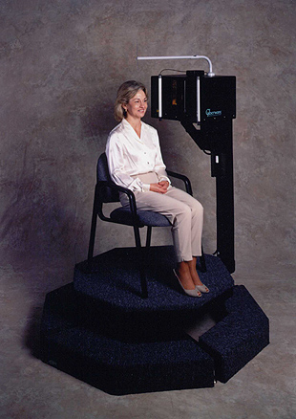
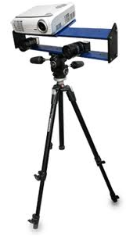
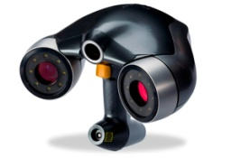

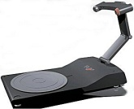

Motivation
Applications:
  3D shape retrieval, deformation transfer, object recognition, facial expression recognition, statistical shape modeling, shape change detection, etc.
3D Acquisition Techniques
?
Static/Expensive/Cumbersome
Dynamic/Cheap/Portable
Notes:
One of the motivations of studying the surface registration problem is from the rapid developments of 3D acquisition techniques.
During the past decade, the 3D acquisition devices has evolved from being cumbersome and expansive, to being portable and cheap.
Also the data captured from being static to being dynamic.
It would not be a surprise that one day you might find out that your smartphone is able to capture 3D data instead of 2D images.

Slide 9
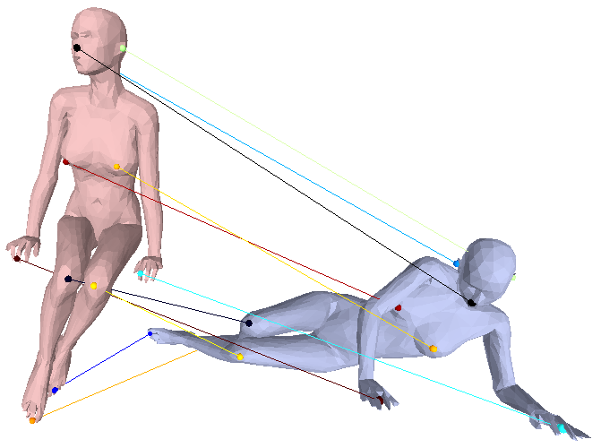
The Surface Registration Problem
Sparse Surface Registration
7
1
2
3
4
5
7
8
9
6
2
8
3
1
4
11
10
9
11
10
5
6
Notes:
There are two basic problems in surface registration.
One is the sparse surface registration problem, where you establish the correspondences for a sparsely sampled set of points.

Slide 10
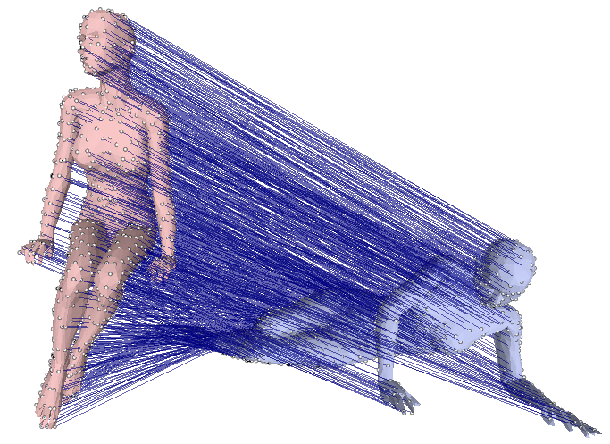
The Surface Registration Problem
Dense Surface Registration
Notes:
Another is the dense surface registration problem, where you find the correspondence for almost every point on the surface.

Slide 11
Surface Registration Problem
Challenges
  Large deformation – image based approaches do not directly apply
  Noisy input – regularization is needed
  Partial occlusions – inconsistent boundary should be handled
  Arbitrary deformation – most methods assume isometric deformation
Notes:
Although the surface registration problem has been one of the most studied problem in computer vision, there remains many challenges.

Slide 12


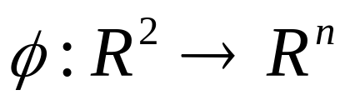
Previous Approaches
Intrinsic Space based Methods
u
v
o
Intrinsic Space
Embedding Space
Notes:
A promising approach for dealing with the surface registration with large deformations is the intrinsic space based method.
Intrinsic space based method allows us to study the surface in a lower dimensional space, regardless the environment it is embedded into and without leaving the surface.

Slide 13
Previous Approaches
Intrinsic Space based Methods
  Surface registration
S1
S2
f
p
f(p)
u
u'
f'
p'
f‘(p’)
v
v'
o
o

Slide 14
Previous Approaches
Intrinsic Space based Methods
  Isometric deformation – distance preserving
S1
S2
f
f(p)
f(q)
p
q
d1(p, q) = d2(f(p), f(q))

Slide 15
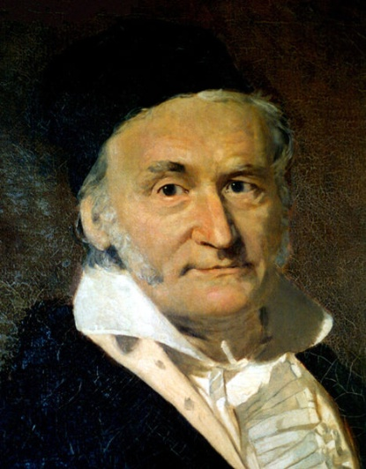

Previous Approaches
Intrinsic Space based Methods
  Isometric deformation – 2D case
No way!
p
q
?
u
Carl Friedrich Gauss
p'
q'
o
v

Slide 16
Previous Approaches
Geodesic distance based approaches
  Multidimensional Scaling [Bronstein et.al. NAS 06]
  Exponential Maps [Bronstein et.al. PAMI 07]
  Diffusion Geometry [Ovsjanikov et.al Eurographics 10]
  Affine Geometry [Bronstein et.al. CVPR 11]

Slide 17
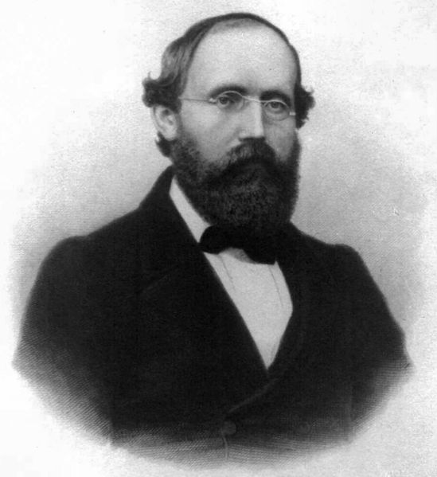


Previous Approaches
Intrinsic Space based Methods
  Conformal deformation
Uniformization theorem
p
u
Bernhard Riemann
p'
v
o

Slide 18

Previous Approaches
Intrinsic Space based Methods
  Isometric deformation and conformal mapping
f
S1
S2
Isometric deformation
Conformal mapping
Conformal mapping
u
u'
Conformal mapping
v
v'

Slide 19
Previous Approaches
Conformal mapping based approaches
  Harmonic Energy [Wang et.al. ICCV 05]
  Cauchy-Riemann Equation [Wang et. al. CVPR 06 ]
  Euclidean Ricci Flow [Gu et.al. ICCV07]
  Hyperbolic Ricci Flow [Zeng et.al. CVPR08]
  Holomorphic 1-Forms [Zeng et.al. ECCV08]
  Mobius voting [Lipman et.al. SIGGRAPH09]
  Blended map [Kim et.al. SIGGRAPH11]

Slide 20
Previous Approaches
Conformal mapping
  Pros
    Uniformization: CM always exists
    Flexibility: Mapping into any canonical domain
    Efficiency: closed-form with low degrees of freedom in determining a unique mapping between two shapes
  Cons
    Sensitive to noise
    Sensitive to boundary conditions – assume bijective mapping
    Assume isometric deformation between two shapes

Slide 21
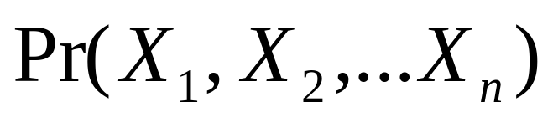
Dealing with Uncertainties
Cons
  Sensitive to noise
  Sensitive to boundary conditions
  Assume isometric deformation between two shapes
Probability measure
states of variables

Slide 22
Dealing with Uncertainties
Probability and Surface Registration
S1
S2
5
1
3
2
X3
X5
4
9
X1
6
X6
X2
X4
X9
7
X7
8
X8
States ➔ Matching Candidates

Slide 23
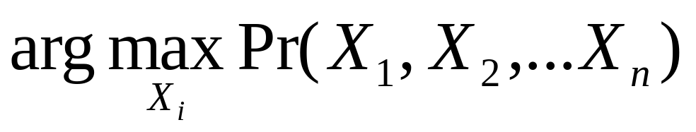
Dealing with Uncertainties
Probability and Surface Registration
S1
S2
5
1
3
2
4
9
6
7
8
Optimal solution ➔ Matching Results

Slide 24
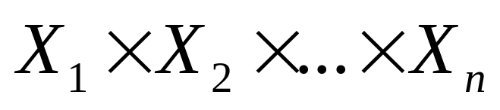
Dealing with Uncertainties
Probability and Surface Registration
Search Space
Continuous / Discrete
Search space can be too large or not convex

Slide 25
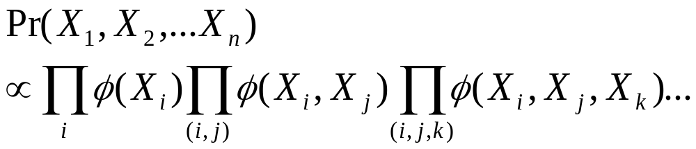







Dealing with Uncertainties
Graphical Models – Factorization

Slide 26
Graphical Models for Surface Registration
Challenges
  Find proper state space (matching candidates)
  Define proper graph structure
  Dense surface registration – complexity
  Optimization: new optimization problems need new algorithms

Slide 27
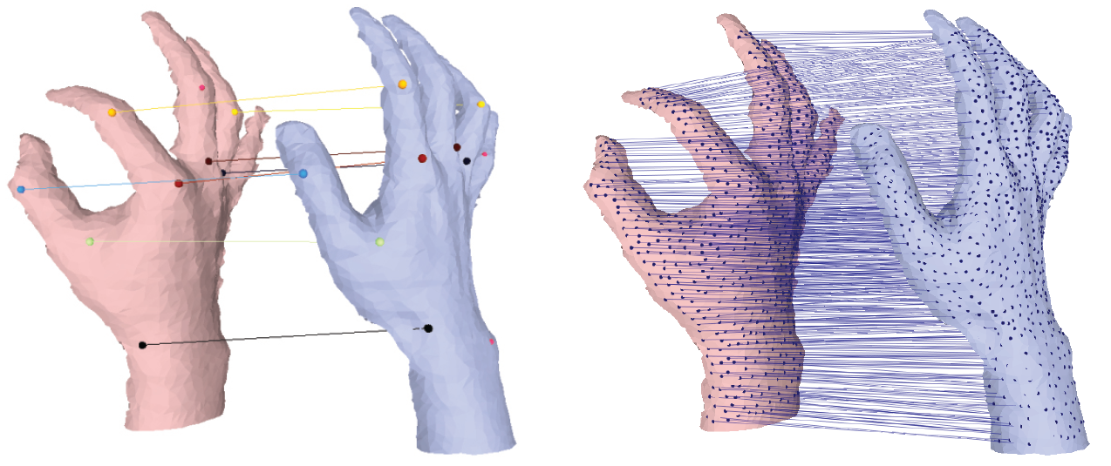
Contribution of this Thesis – Part One
Dense surface registration using high-order graph matching
  A two stage pipeline achieving accurate dense matching
  Efficient candidate selection scheme

Slide 28
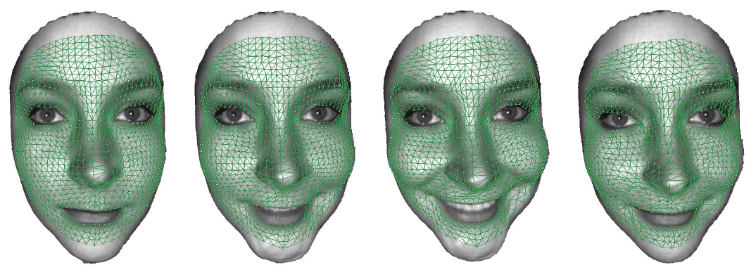
Contribution of this Thesis – Part Two
Intrinsic dense 3D surface tracking
  A robust metric for correspondence match
  A complete probabilistic framework for surface tracking problem

Slide 29
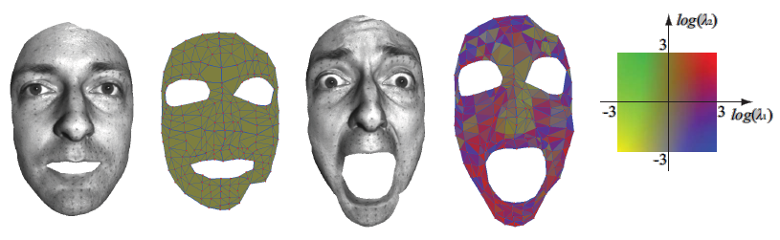
Contribution of this Thesis – Part Three
A generic surface deformation model
  A generic deformation model that handles arbitrary surface deformation
  A high-order Markov Random Fields (MRF) model for dense surface registration

Slide 30
Part One
Dense surface registration using high-order graph matching

Slide 31
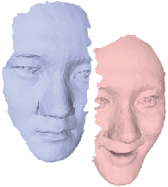
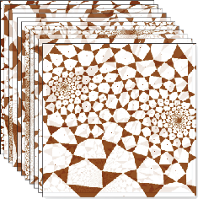
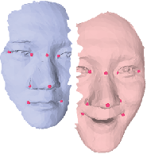
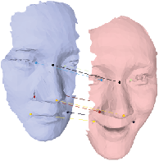
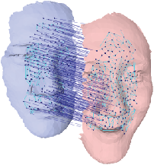
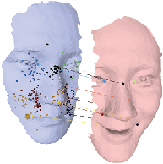
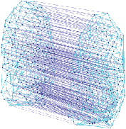
Algorithmic Pipeline
Input
Sparse Graph Matching
Conformal Mapping
Output
Dense Surface Registration

Slide 32
Stage One
Sparse Surface Matching
Sparse feature:
local minima of curvatures [Lipman09]
Graph Matching

Slide 33
A Pseudo-boolean Formulation for Graph Matching
Graph 1
Graph 2

Slide 34

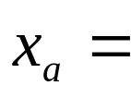
A Pseudo-boolean Formulation for Graph Matching
Boolean Indicator Variable:
1, if is a correspondence
0, otherwise
Graph 1
Graph 2

Slide 35
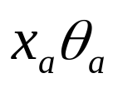
A Pseudo-boolean Formulation for Graph Matching
Single matching cost
Graph 1
Graph 2

Slide 36


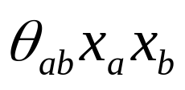
A Pseudo-boolean Formulation for Graph Matching
Pairwise matching cost
Graph 1
Graph 2

Slide 37
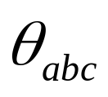

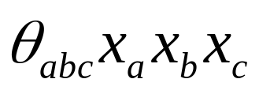
A Pseudo-boolean Formulation for Graph Matching
Graph 1
Graph 2

Slide 38
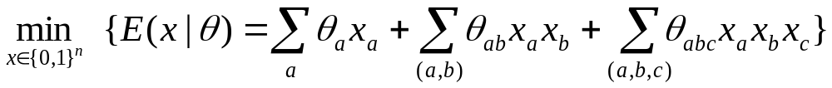
A Pseudo-boolean Formulation for Graph Matching
A pseudo-boolean formulation of graph matching:

Slide 39
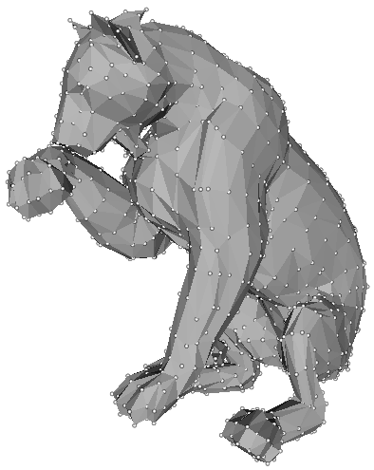
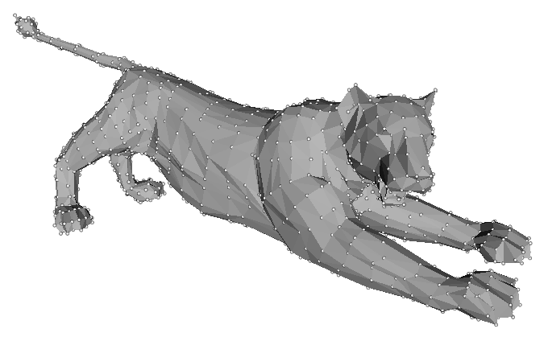
Graph Matching for Surface Registration
– Singleton Terms
Single matching cost:
similarity in local shape
S1
S2

Slide 40
Graph Matching for Surface Registration
– Pairwise Terms
Pairwise matching cost:
Penalty on invalid matching
S1
S2

Slide 41
Graph Matching for Surface Registration
– High-order Terms
High-order matching cost:
Similarity in intrinsic space deformation
S1
S2

Slide 42
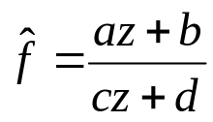
Graph Matching for Surface Registration
– High-order Terms
Intrinsic deformation similarity
f
Isometric deformation
Conformal mapping
Conformal mapping
u
u'
Mobius Transformation
v
v'
Notes:
If two surfaces are isometrically deformed, then the mapping between their conformal mapping parameterizations is another conformal mapping, which can be characterized by the Mobius Transformation.

Slide 43

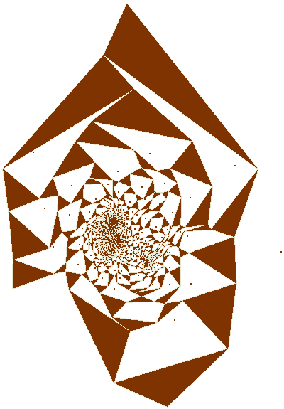
Graph Matching for Surface Registration
– High-order Terms
Intrinsic similarity can be defined for three correspondences [Lipman et.al Siggraph 09]
Notes:
And such Mobius transformation can be computed by only knowing three correspondences.
That is, any three possible correspondences determine a unique mapping between the two surfaces.

Slide 44
Graph Matching for Surface Registration
– High-order Terms
A 2D example
Embedding Space
Intrinsic Space
S1
I
II
Align I and II, we can have one unique intrinsic representation
I
II
S2
d (I , II)
Sparse Matching
Notes:
Here is an illustrative example in 2D showing how we can use this fact to define a measure of deviation from isometry between the two surfaces given two possible correspondences I and II.

Slide 45
From Sparse to Dense Registration
Candidate Selection
Embedding Space
Intrinsic Space
S1
I
II
III
I
II
III
S2
Sparse Matching

Slide 46
From Sparse to Dense Registration
Candidate Selection
Embedding Space
Intrinsic Space
S1
I
II
III
I
III
S2
Sparse Matching
Matching candidate

Slide 47

From Sparse to Dense Registration
Candidate Selection
Embedding Space
Intrinsic Space
P
P
S1
I
II
III
S2
Align II&III
Align I&III
Dense Matching
n sparse matching →
Align I&II
candidates for every point

Slide 48
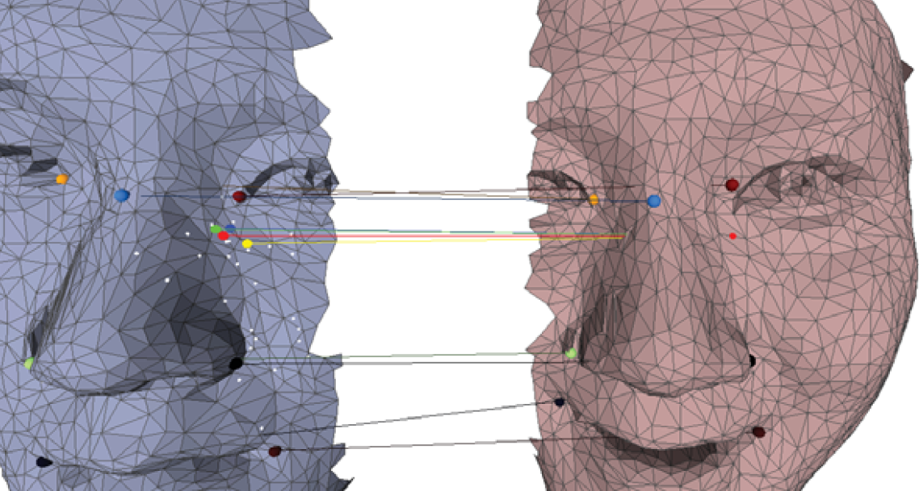
Candidate Selection
Examples
Source Point
Candidate Clustering

Slide 49
Stage Two – Dense Surface Registration
Manifold Matching
Dense Surface Registration

Slide 50
Dense Surface Registration
The Manifold Matching problem
X3
X5
X1
X6
X2
X4
X9
X7
X8
u
u'
v
v'

Slide 51
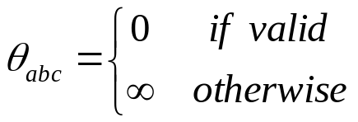


Dense Surface Registration
The Manifold Matching problem
3
Valid Match
1
1
2
1
flip
3
2
Invalid Match
3
2
Notes:
Explain more

Slide 52
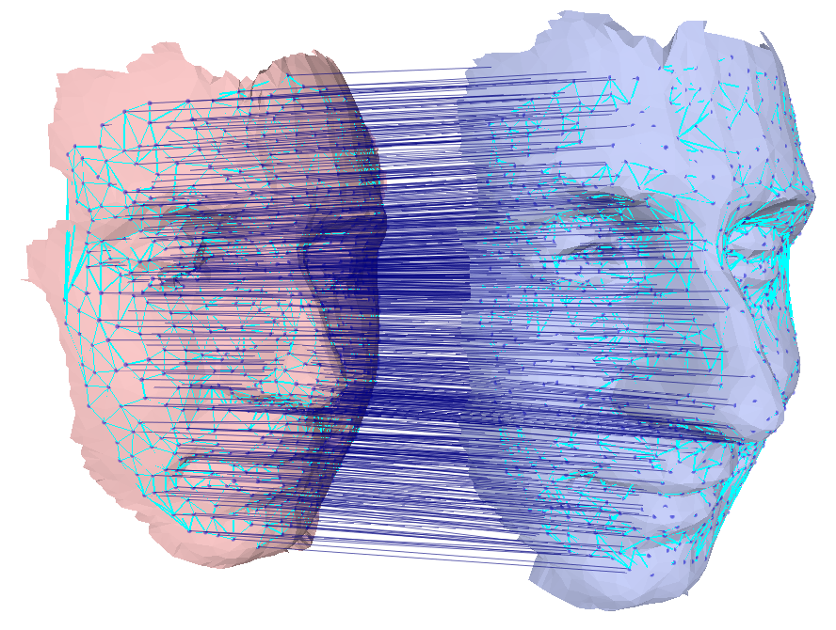
Results

Slide 53
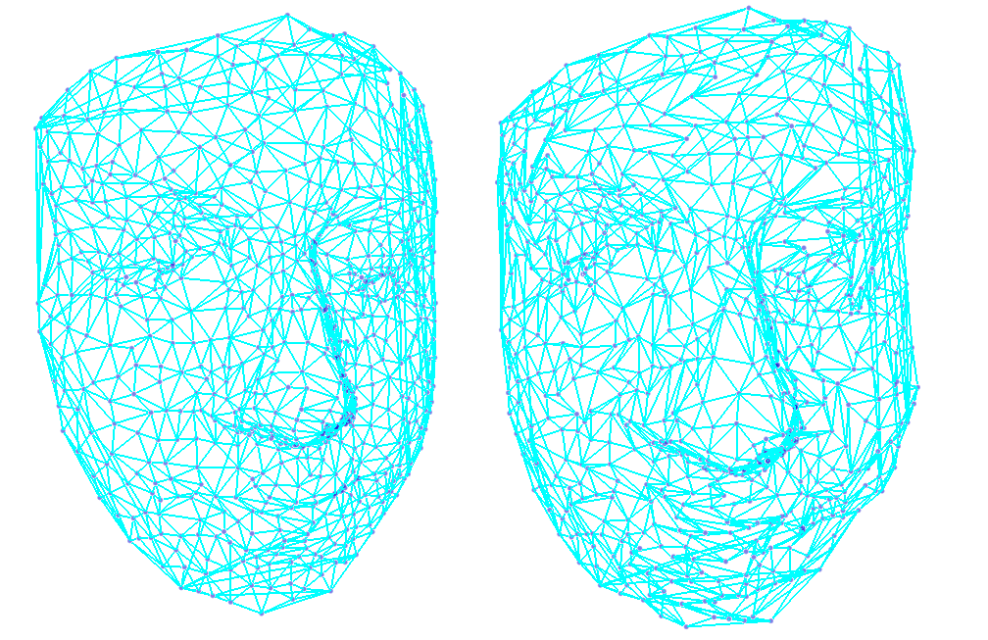
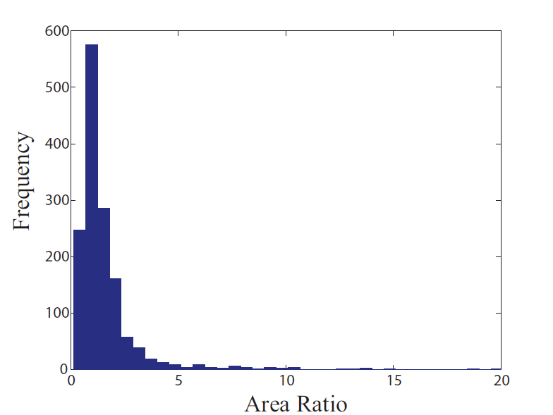
Results
Re-triangulation
Source triangulation
Target triangulation

Slide 54
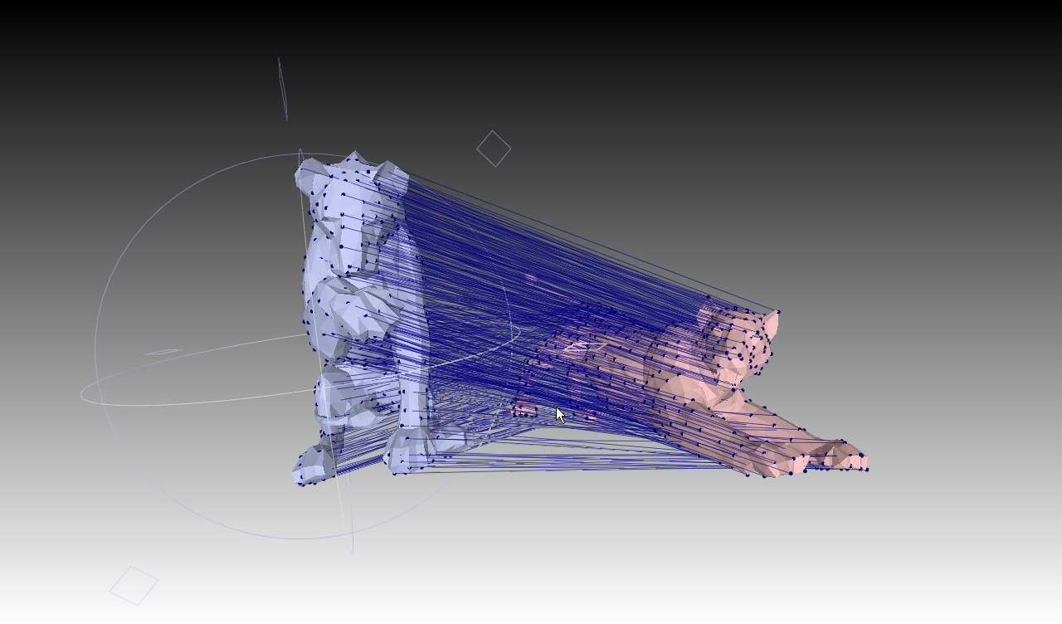
Results
Large Deformation – lion

Slide 55

Results
Large Deformation – Hand

Slide 56
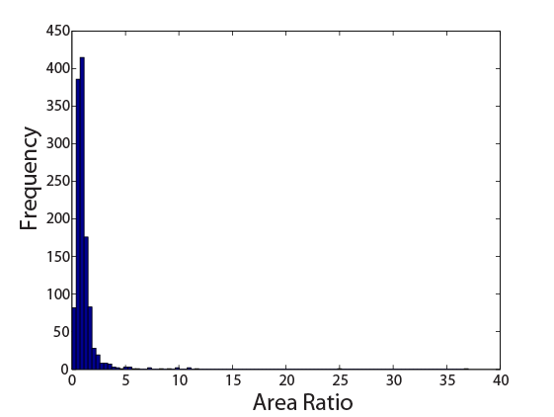
Results
Large Deformation – Hand

Slide 57

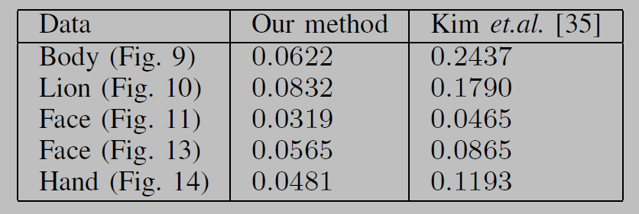
Results – Comparison
Comparison with the latest intrinsic space based approach for dense surface registration [1]
Matching Error
[1] V. G. Kim, Y. Lipman, and T. Funkhouser. Blended intrinsic maps. ACM Trans. Graph. (Proc. of SIGGRAPH 2011), 30:79:1–79:12, August 2011.
Notes:
Explain the details of the formula.

Slide 58
Part Two
Intrinsic Dense 3D Surface Tracking

Slide 59

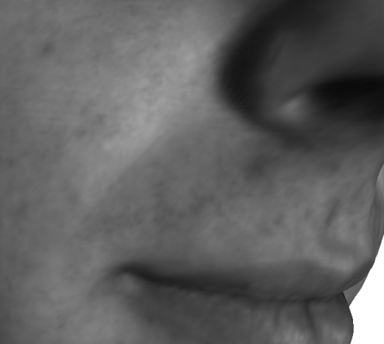
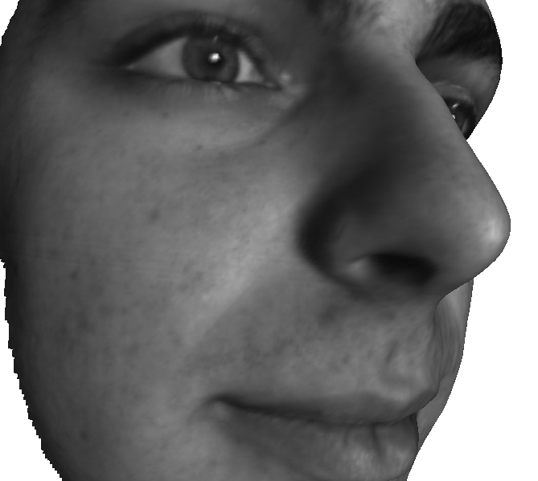
Robust Correspondence Matching
Local informaiton v.s. Global information
Computational Complexity

Slide 60
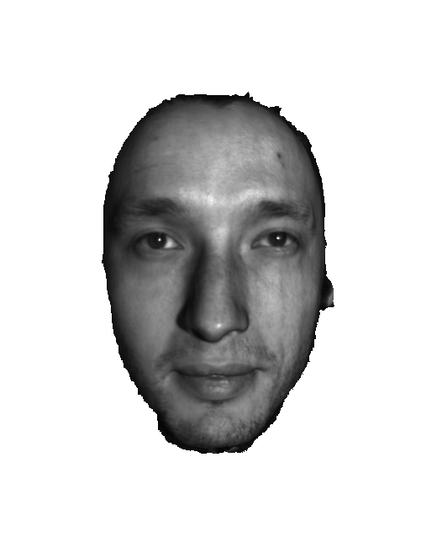
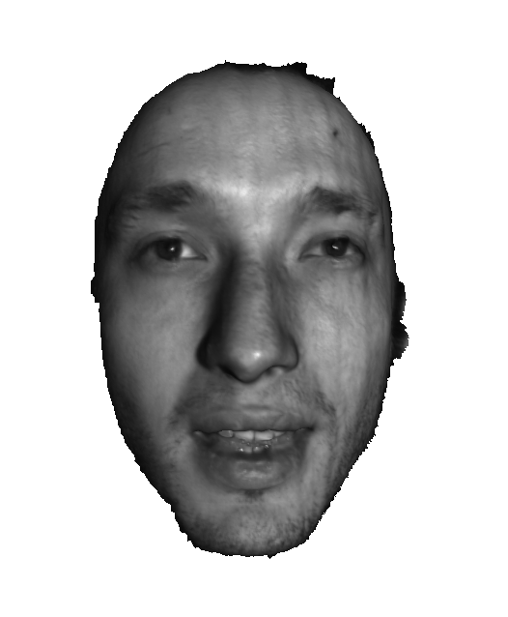
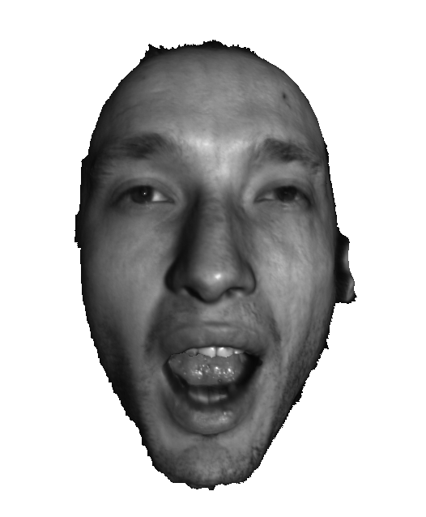
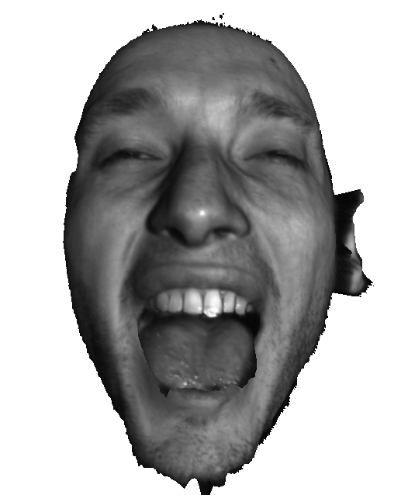
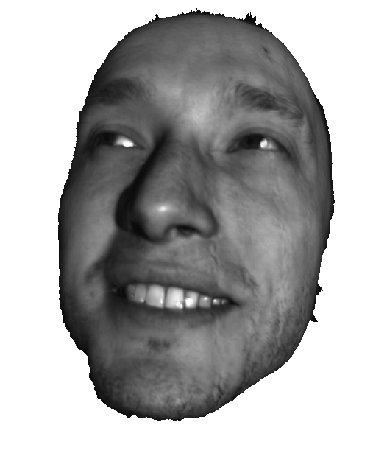
Problem Statement
Template-based Surface Tracking
Frame 1
Frame 40
Frame 80
Frame 120
Frame 160

Slide 61
Problem Statement
Template-based Surface Tracking
Frame 1
Frame 40
Frame 80
Frame 120
Frame 160
Occlusion handling
Notes:
Also if there are no correspondences for some vertices of the template, we want to handle occlusion as well

Slide 62
Intrinsic Dense 3D Surface Tracking
Challenges
  Robust measurement of correspondence match
  Spatio-temporal consistency

Slide 63
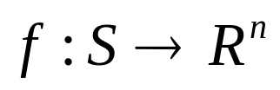

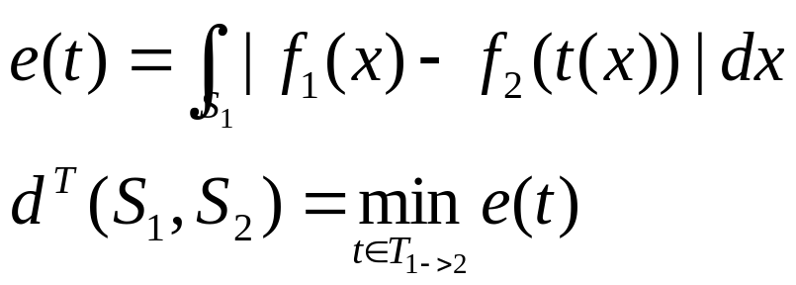
Correspondence Evaluation for Surface Registration
A distance between two surfaces S1 and S2
  : mapping from surface to feature space
  : set of mappings between two surfaces
Notes:
Ok, now let’s consider the meaning of the min-marginal on surfaces.
A distance between two surfaces can be defined as the minimal feature differences among a set of pre-defined mapping between the two surfaces.

Slide 64

Correspondence Evaluation for Surface Registration
A distance for correspondence evaluation
S1
S2
t
p
q
d1(p, q) = d2(f(p), f(q))
Notes:
Hence, the distance for a particular correspondence p to q, can be defined as the minimal feature differences among the transformations that map p to q.
This corresponds to the definition of min-marginal as we just discussed.
The next question is: how can we compute such distance efficiently?

Slide 65

Correspondence distance
p
P’
S1
II
q
S2
Embedding Space
Notes:
Still, we illustrate this using 1d case. In order to compute the distance for a correspondence from p to q, we consider the mapping of the other point p’. Every possible mapping of p’ determines a unique mapping between the two surfaces, and we can evaluate the feature differences under such mapping efficiently. The minimal distance among such mappings is defined as the distance for such a correspondence.

Slide 66

Correspondence distance
Every possible mapping of p’ allows us to evaluate
p
P’
p
P’
S1
II
I
II
q
S2
q
Embedding Space
Intrinsic Space

Slide 67
Correspondence distance
Every possible mapping of p’ allows us to evaluate
p
P’
p
P’
S1
II
I
II
q
S2
q
Embedding Space
Intrinsic Space

Slide 68
Correspondence distance
Every possible mapping of p’ allows us to evaluate
p
P’
p
P’
S1
II
I
II
q
S2
q
Embedding Space
Intrinsic Space

Slide 69
Correspondence distance
Every possible mapping of p’ allows us to evaluate
p
P’
p
P’
S1
II
I
II
q
S2
q
Embedding Space
Intrinsic Space

Slide 70
Correspondence distance
Every possible mapping of p’ allows us to evaluate
p
P’
p
P’
S1
II
I
II
q
S2
q
Embedding Space
Intrinsic Space
Notes:
Remember any triplet

Slide 71
Correspondence distance
Every possible mapping of p’ allows us to evaluate
p
P’
Mapping with minimal feature distance
p
P’
S1
II
I
II
q
S2
q
Embedding Space
Intrinsic Space

Slide 72

Evaluation of correspondence distance
Test Case
Frame One
Frame Two

Slide 73

Evaluation of correspondence distance

Slide 74

A Probabilistic Framework for Surface Tracking
Surface tracking problem:
Data
Template
Notes:
Next, we show how the metric just defined can be used in a probabilistic framework for the template tracking problem.
The problem of template tracking problem can be formulated as given the input data from time 1 to t, and the tracking result up to time t-1, we want to infer the optimal location of the template at time t.

Slide 75

A Probabilistic Framework for Surface Tracking
Surface tracking problem:
  Factorization
Data
Template
Data Fidelity
Spatio-temporal Prior
Notes:
In the first step, we factorize the probability into two terms: one considers the data fidelity given the tracking result, anther reflects the prior on the deformation of the template.

Slide 76

A Probabilistic Framework for Surface Tracking
  Factorization – data fidelity
Data similarity
Error Drift
Notes:
For the data fidelity term, we further decompose it into a term that consider the similarity between current frame and previous frame, and a term that considers the similar between current frame to all the previous frames, which avoids error drift. Both terms are defined based on the correspondence distance we just defined.

Slide 77
A Probabilistic Framework for Surface Tracking
  Factorization – spatio-temporal consistency
Deformation prior
Dynamic motion prior
Notes:
As for the prior for spatial-temporal consistency, we factorize the term into two terms: one is responsible for the deformation between current frame and previous frame, the other is responsible for the dynamic motion prior. For the details of all these terms, please refer to our paper.

Slide 78


Occlusion Handling
Occlusion handling
  Smoothness of occluded parts
Notes:
In order to handle occlusion, we make use of the correspondence distance and add an extra occlusion label. If the distance is great than a threshold, we give it a penalty, unless the label of it is occlusion. At the same time, we constrain that the occluded part is smooth.

Slide 79

Optimization
MRF Energy
  Use existing MRF optimization technique (TRW-S algorithm)
  Fast to solve, the potential can be computed in parallel
Notes:
In summary, the pipeline of our tracking system is shown here.
Note that the most computationally expensive part is the computation for the distance of correspondence match, which we accelerated by graphics hardware.
The final stage of each frame is to solve an standard pairwise MRF problem.

Slide 80

Results – Sponge
Notes:
This result shows the tracking of a deforming sponge.
This example is quite challenging due to nonisometric deformation.

Slide 81

Results – Expressions
Notes:
Here we show some results of different expression changes.
The number of vertices for each template is around 1000.
Note that very subtle expressions are accurately tracked.

Slide 82

Results – Expressions
Notes:
We show some more results on face expression changes.

Slide 83

Results – Occlusion
Notes:
Last, but not least, we consider an very challenging example where there are large deformation, sudden scale change due to the capture device, as well as occlusions.

Slide 84


Quantitative Evaluation
Comparison with Optical Flow Method [1]
Comparison with Harmonic Maps [2]
[1] A. Bruhn, et, al. Lucas/kanade meets horn/schunck: Combining local and global optic flow methods. IJCV, 61:211–231, 2005.
[2] Y. Wang, et.al . High resolution tracking of non-rigid 3d motion of densely sampled data using harmonic maps. In ICCV, 2005.
Notes:
This is a quantitative evaluation of our tracking results.
We compared our results with results by image-based method and one intrinsic space based method.
From the figure on the left, we can see that the performance of the optical flow method degrades significantly when the deformation between two frames are large while our method is relatively stable.
For the comparison with harmonic maps method, its performance is not stable due to inconsistent boundaries.

Slide 85
Part Three
A Generic Surface Deformation Model

Slide 86
A Generic Surface Deformation Model
Surface deformation
Deformation
Rigid
Non-rigid
Isometric
Non-Isometric
Intrinsic methods apply
Fewer methods handle this case

Slide 87



A Generic Surface Deformation Model
Surface parameterization
u
u'
v
v'

Slide 88

A Generic Surface Deformation Model
Mapping between two surfaces
S1
S2
f
u
u'
v
v'

Slide 89

A Generic Surface Deformation Model
Isometric deformation
S1
S2
f
u
u'
v
v'

Slide 90

A Generic Surface Deformation Model
Conformal deformation
S1
S2
f
u
u'
v
v'

Slide 91

A Generic Surface Deformation Model
Arbitrary deformation
S1
S2
f
u
u'
v
v'

Slide 92


A Generic Surface Deformation Model
Discrete Setting
S1
S2
f
u
u'
v
v'

Slide 93
A High-order MRF Formulation for Surface Registration
Surface registration
5
1
3
2
X3
X5
6
4
9
X1
7
X6
X2
X4
X9
8
X7
X8

Slide 94

A High-order MRF Formulation for Surface Registration
Surface registration using high-order MRFs
feature similarity
5
1
3
2
X3
X5
6
4
9
deformation similarity
X1
7
X6
X2
X4
X9
8
X7
X8

Slide 95

A High-order MRF Formulation for Surface Registration
Surface registration using high-order MRFs

Slide 96


Results
Surface registration

Slide 97

Results
Kinect Tracking

Slide 98
Conclusion

Slide 99
Summary
Surface registration : coupling geometry-based methods and combinatorial approaches
  Handle noisy input, partial matching and large deformation.
Surface tracking : robust metric for correspondence match
  Handle spatio-temporal consistency, partial matching and anisometric deformation.
A generic deformation model : characterize arbitrary deformation
  Handle arbitrary deformation

Slide 100
Future Work
Shape transfer and animation
3D object recognition
Facial expression recognition

Slide 101
Publication List
● Yun Zeng, Chaohui Wang, Yang Wang, Xianfeng Gu, Dimitris Samaras, Nikos Paragios. Dense Non-rigid Surface Registration: A High-order Graph Based Approach. Under submission to TPAMI, 2011.
● Yun Zeng, Chaohui Wang, Yang Wang, Xianfeng Gu, Dimitris Samaras, Nikos Paragios. An Generic Local Deformation Model for Shape Registration. Technical Report, INRIA, RR-7676, July, 2011.
● Yun Zeng, Chaohui Wang, Yang Wang, Xianfeng Gu, Dimitris Samaras, Nikos Paragios. Intrinsic Dense 3D Surface Tracking. Computer Vision and Pattern Recognition (CVPR, oral), 2011.
● Yun Zeng, Chaohui Wang, Yang Wang, Xianfeng Gu, Dimitris Samaras, Nikos Paragios. Dense Non-rigid Surface Registration Using High-Order Graph Matching. Computer Vision and Pattern Recognition (CVPR), 2010.
● Yun Zeng, Dimitris Samaras, Wei Chen, and Qunsheng Peng. Topology cuts: A novel min-cut/max-flow algorithm for topology preserving segmentation in n-d images. Comput. Vis. Image Underst., 112:81–90, October 2008.
● Chaohui Wang, Yun Zeng, Loic Simon, Ioannis Kakadiaris, Dimitris Samaras, and Nikos Paragios. Viewpoint invariant 3D landmark model inference from monocular 2d images using higher-order priors. International Conference on Computer Vision, 2011.
● Wei Zeng, Yun Zeng, Yang Wang, Xianfeng Gu, Dimitris Samaras. 3D Non-rigid Surface Matching and Registration Based on Holomorphic Differentials. European Conference on Computer Vision (ECCV, oral), 2008.
● Wei Zeng, Xiaotian Yin, Yun Zeng, Yukun Lai, Xianfeng Gu and Dimitris Samaras. 3D Face Matching and Registration Based on Hyperbolic Ricci Flow. Workshop on 3D Face Processing - CVPR 2008.
● Xianfeng Gu, Sen Wang, Junho Kim, Yun Zeng, Yang Wang, Hong Qin, Dimitris Samaras. Ricci Flow for 3D Shape Analysis. International Conference on Computer Vision (ICCV), 2007.

Slide 102
Thank you

