Slide 1

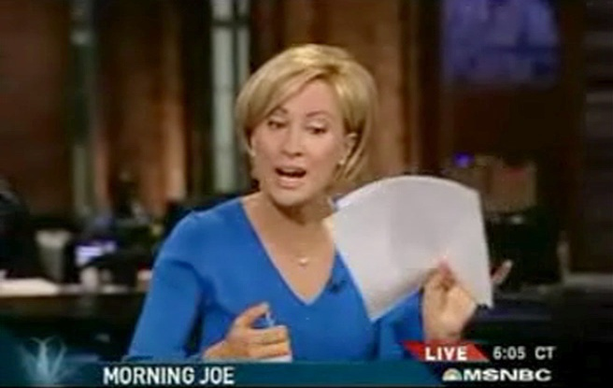
What is News
and Who Decides?
Notes:
(Set it up like this)
This is Mika Brezsinski. She’s the co-anchor of “Morning Joe,” a news talk show on MSNBC
In this segment, The anchors are on camera, chatting, about to launch their daily summary of the top stories of the day.
Mika Brezinski and her co-anchor had been talking about U.S. Sen. Richard Lugar’s critique of the President’s war strategy when she looked down to see the first story on her script was Paris Hilton’s release from jail.

Slide 2
Morningjoe.wmv
Notes:
(After it runs)
Brezinski swears it was a spontaneous response and not a publicity stunt.
ASK: What do you think she is reacting to?
If you are going to be effective consumers of news you need to have an understanding of how Paris Hilton’s term in jail came to be the lead story on so many newscasts.
How, out of all the news in the world, does that story get served to you?
In the survey last month, about 80 percent of you said the press presents too much trivial news. And 60% said the press presents too much bad news.
Why? 13% of you said that’s reality, roughly a quarter said humans are drawn to tragedy and another quarter said the press does it to make money.
That’s the point of today’s lecture. What IS news? And why.

Slide 3
What is News
and Who Decides?
Notes:
We have talked about three kinds of stories that are news in every culture.
What are those? (Alerts, Diverts, Connects)
And what traits differentiate news from other kinds of information? (Verification, Independence, Accountability)
So…it’s pretty simple, right?
We all know what is news and what isn’t…

Slide 4
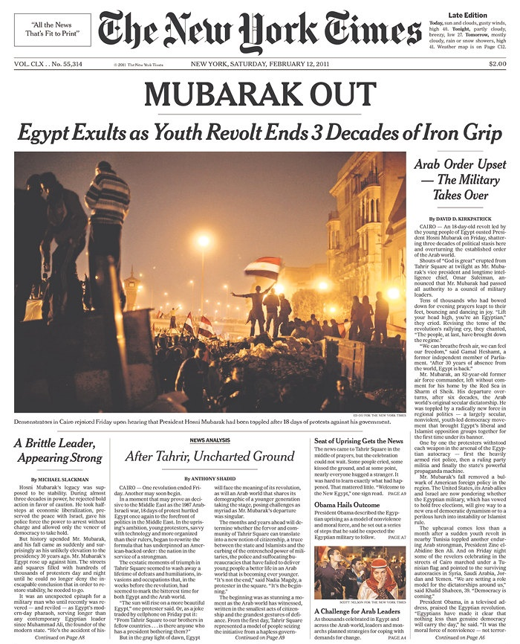


What is News?
Feb. 12th, 2011
Notes:
Like this: Madoff’s Ponzi scheme is discovered to be the cause of a $322M mess at the Mets.
That’s a big deal in New York, so all three New York papers were focused on the Madoff story.
It’s clear from this that everybody agrees what is news, right?

Slide 5
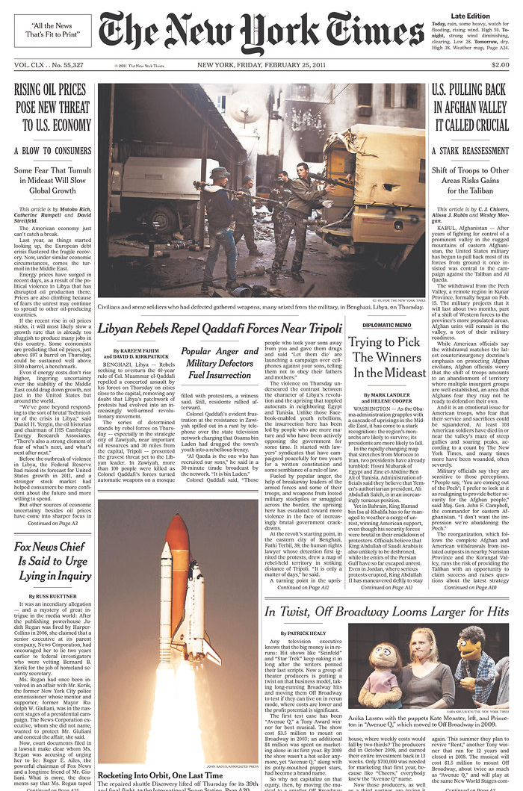
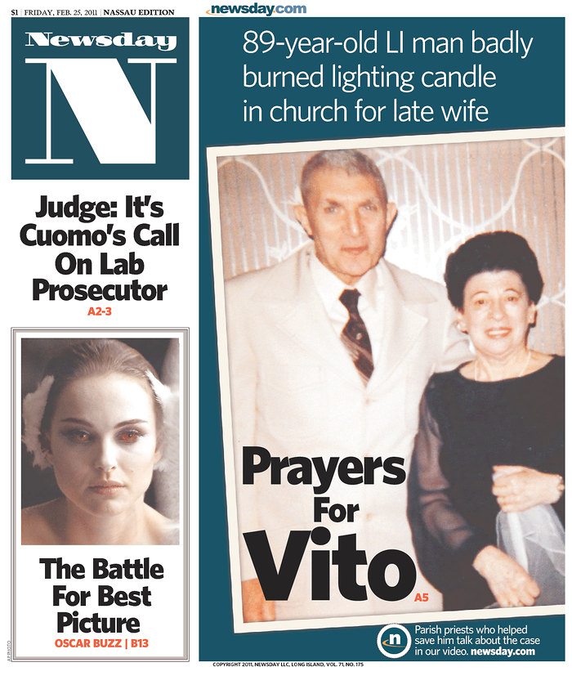
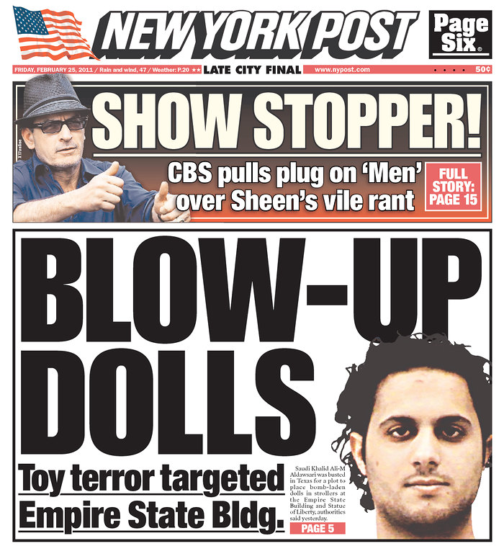
A More Typical News Day:
Differences in News Decisions
Feb. 25, 2011
Notes:
NOTE TO DEAN : If you google it, Newsday has their covers online, but the newseum no longer does it seems. Very odd.
But that was just one day…
Here is a more typical day, on which every paper has a different focus.
Whaaat?
What happened to those timeless story types…those definitive values…?

Slide 6
Definitions of News
Notes:
Maybe we should make the course definition into a systematic way to describe what makes information newsworthy.
If we do that, maybe we can make sense of all those different newspaper covers and the decision to lead a newscast with information about the jail term of a person with no obvious talent or education who is famous for…being famous.
First, let’s think about definitions you might have heard in movies or conversation…

Slide 7
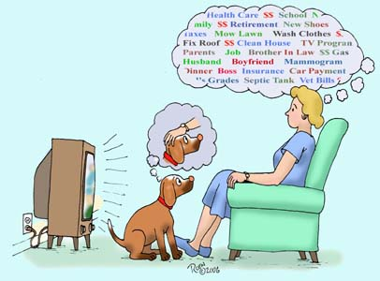
Definitions of News
News is What’s On Society’s Mind
Notes:
Snowdrifts in Brooklyn, coyotes in Jersey, hemlines are rising again, the stock market is…rising and falling…Dead bodies on the South Shore…The Taliban is killing US Soldiers in Afghanistan again…if we’re talking about it, It’s news…

Slide 8
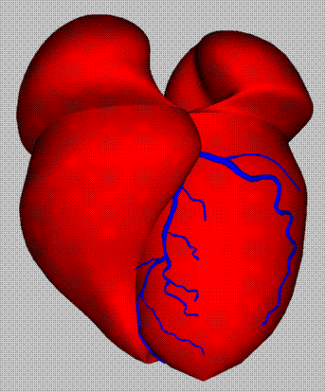
Definitions of News
News Is any “Scoop”:
Information That Makes a
Reporters Primal Heart Beat Faster
Notes:
Any time a reporter finds out something before anyone else, that’s a “scoop” (START THE BEATING HEART WITH SECOND CLICK)
…and that newness in and of itself is sometimes enough to make information newsworthy, whether the scoop is information that alerts, diverts or connects us. Great news organizations are driven by reporting.

Slide 9
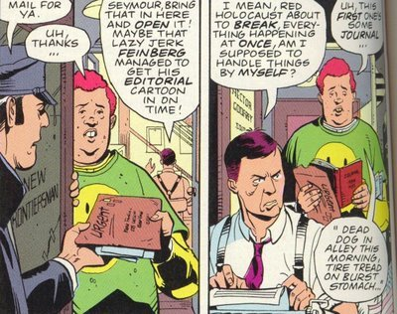
Definitions of News
News is What an Editor Thinks is News
Notes:
Faced with a nearly-endless choice of news reports, someone in the newsroom has to decide what gets attention and that someone is the Editor or Executive Producer.
Cynics like to joke that… “news is what happens to Editors” and that is not a good thing when upper crust newsroom leaders lavish attention on rich folks problems and ignore the problems of lower income neighborhoods.
But…If the husband of Newsday’s editor gets stranded overnight on the LIRR during a snowstorm, it might move her to ask a reporter to find out why and that might be why readers learn there’s an engineering flaw in the power rail system.
Editors are paid for their clear understanding of what makes a story interesting to the public. So, the editor who ordered up the story that uncovers an engineering error scored a scoop because news IS what happens to editors….smart ones, anyway.

Slide 10

Definitions of News
News is Information Powerful People Don’t Want You to Have
Notes:
IRANIAN GREEN REVOLUTION PROTESTER FLASHING HER GREEN HAND
If someone does not want you to know something, doesn’t that make you all the more interested?
That’s a pretty good definition of news.
One kind of news that alerts is news that makes secrets into public information, like the violent repression of street protests in Iran after the Presidential election in 2009…or in Tunisia in January…or Egypt this month, or Libya this week.

Slide 11
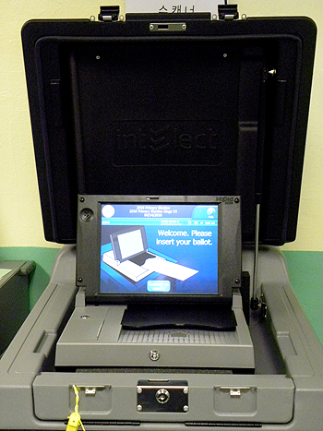
Definitions of News
News is Independent,
Reliable,
Accurate Information That Citizens Need to Be Free
Notes:
(New York’s new electronic voting machine)
Forgive us our idealism…this is a serious definition that doesn’t leave much room for information that diverts or even connects…
But in the context of the First Amendment and citizenship and freedom, information that alerts is vital. That’s the point of this course: that self governance doesn’t work if you don’t know what’s going on.
Ask: What news outlets follow news that matters to voters?

Slide 12

Definitions of News
Notes:
There's an old saying in newsrooms that the story of a dog biting a man is so common it’s not news. It happens all the time…So what?
BUT.
If you’ve got a story about a man biting a dog…now that’s news.

Slide 13
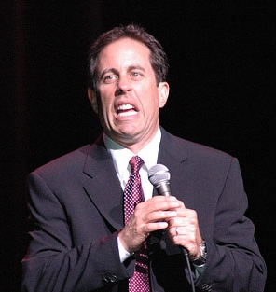
Definitions of News
“It’s amazing that the amount of news that happens in the world every day always
just exactly fits the newspaper.”
Notes:
News is the basis for a lot of stand-up comedy and comedic shows. Not only do the people in news stories do funny things, but as the Daily Show and Colbert Report have shown, the news media itself can be pretty funny, in a serious way.
This is a funny observation by Seinfeld
And, as is always the case with the best jokes, there's some truth in it, too.
Because there’s a limited amount of space on a website’s main page…or a newspaper cover…or in a television news broadcast…not every story gets attention. Scarcity forces choices.
Those choices express priorities.
News, then, is PRIORITY information.
ASK: Whose priorities?

Slide 14

Definitions of News
News is What “We” think is fit and proper
Notes:
Again…Whose priority?
This is the New York Times’ motto, prominently displayed every day on Page One. What they’re saying is, “We sift through all the news in the world and, using our best judgment, pick what we think is suitable for serious people.”
On good days, that means you’ll learn cool things you might have missed.
It can also mean that the overwhelmingly white, rich and well-connected Editors of the Times tend to devote way too much attention to Ivy League universities at the expense of news about the colleges that educate the most New Yorkers: community colleges and state universities.

Slide 15

Definitions of News
News is Information About a Subject of
Some Public Interest That is Shared and
Subject to the Journalistic Process of Verification
Notes:
This is the News Literacy definition of news: “Information of some public interest that is shared and has been subjected to a journalistic process of verification.”
That’s a definition you need to be able to write and speak about, using examples from the news you are now reading every day.
(Every Day…right?)

Slide 16
Four Factors That
Determine News
1. Universal News Drivers
2. Editorial Judgment
3. The Audience
4. Profits and Competition
Notes:
Regardless which definition is in play, there’s a process by which information gets turned into “News” and which information gets ignored, or de-emphasized…
To help you organize you critique news judgments by various outlets, we suggest there are four factors that determine what becomes “News”:
Universal news drivers
Editorial judgment
Audience
Profits and competition
This is the blueprint for the rest of the lecture.
We’ll examine these factors so you can analyze how a piece of information becomes news.
And then we’ll start thinking about how this professional method is being replaced by algorithms and audience metrics and what impact that has on news consumers.

Slide 17
Factor 1: Universal News Drivers
Importance
Timeliness
Proximity
Magnitude
Prominence
Conflict
Human Interest
Change: (Progress and Regress)
Relevance
Unusualness
Notes:
WE assert that in every recorded society, in every part of the world, in every period of history….information that becomes “news” tends to have one or more of these characteristics.
We call these News Drivers.
Write them all down. You don’t have to be able to recite the list, but we’ll use it today and, you’ll do better with the advanced analysis expected in the second half of the course if you can remember them
The “news value” of a given piece of information is not an immutable ratio governed by precise calculations, but you can use these ideas to explain why one story goes viral and another does not.
These are the concrete expressions of our primal need for information that Alerts, Diverts, and Connects us.
You’ll be asked in this course to apply the drivers to every story you read, stopping for a second to say…Why is THIS news? Which Drivers pushed this information to the fore?
You can assume that surrounding all of these is our demand for information about what is happening NOW. Hence the term “NEWs.” Think of immediacy as an accelerant. If a piece of information fits a driver and it is brand new information, that can propel it into newsworthiness.
The fact that there’s a test in week six matters a little today, but on the day of the test, it will matter to you a lot.

Slide 18

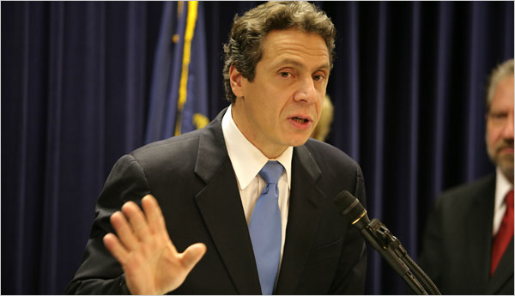
Universal News Drivers
Importance
Notes:
(ON THIS SERIES, A 2ND CLICK BRINGS UP THE DRIVER)
Asked if they read news about politics and government, students universally roll their eyes and say “Boring”
Self-governance is serious stuff: very little Paris Hilton factor there.
Governor Andrew Cuomo’s plan to balance New York’s near-bankrupt government includes trimming the SUNY budget.
When state spending on higher ed. falls, courses are cut, tuitions rise. That means lower-income students have a tougher time getting a college degree. Which means they aren’t likely to get a good-paying job. Which means less tax revenue. Which means SUNY funding has to be cut more. Which means even fewer opportunities for escape from lower-income jobs…
Which driver makes Cuomo’s budget plan news?(CLICK FOR Importance) Which primal need is satisfied by the story?
http://www.sbstatesman.com/cuomos-proposed-budget-calls-for-more-cuts-to-suny786

Slide 19

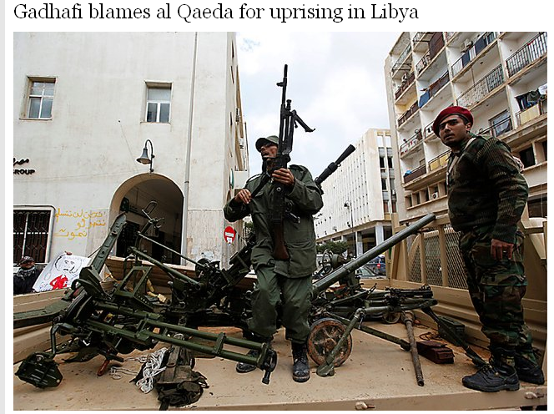
Universal News Drivers
Timeliness
Notes:
(LECTURER NOTE: THE HIDDEN “NEWS DRIVER” WORD COMES UP AFTER 2ND CLICK)
What is the dominant driver that makes this news?
In two weeks, a live or nearly live report from this scene of action will be of little interest, unless something big happens. But because it’s happening RIGHT NOW, and is one small chapter in a historic event, it is timely and therefore news.
All news is driven by that Immediacy effect we talked about.
Sometimes called “Breaking News” or “Spot News” this kind of story gets increased attention because it just happened.
Timeliness can also mean that an event becomes news because it happens in the context of something else that’s news. Reindeer escaping the Central Park Zoo is a minor story in June. But if it happened December 23rd, it would probably get national attention.
ASK: Which primal news need is satisfied
(ALERTS, DIVERTS, CONNECTS)

Slide 20



Universal News Drivers
Proximity
Notes:
(LECTURER NOTE: THE HIDDEN “NEWS DRIVER” WORD COMES UP AFTER 2ND CLICK)
Would this West Virginia Scoutmaster’s award be written up anywhere in your hometown paper?
Even way back deep in the community pages with the weddings and anniversaries?
In Braxton West Virginia, it is on the community page.
ASK: Which Driver makes this news in Braxton and not in Brooklyn?
ASK: Which primal news need is satisfed?
http://www.bcn-news.com/

Slide 21


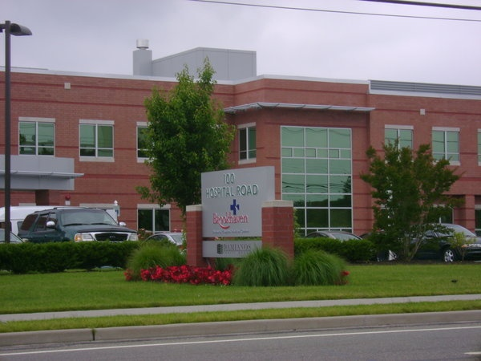
Universal News Drivers
Proximity
Notes:
(LECTURER NOTE: THE HIDDEN “NEWS DRIVER” WORD COMES UP AFTER 2ND CLICK)
A Stony Brook student, Jeanine Rescigno, dies in a wreck on the William Floyd Parkway. Her death is reported by by News 12, Newsday, The Three Village Herald, Patch.com, the Statesman and the Independent…
There are an average of 93 highway fatalities every day in the U.S. Is this death news in Queens? New Haven? Boston? Chicago?
ASK: Which Driver makes this news?
ASK: Which primal news need is satisfied
http://threevillage.patch.com/articles/stony-brook-student-killed-in-shirley-crash

Slide 22

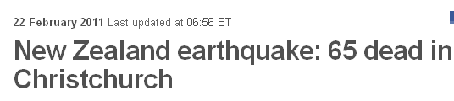
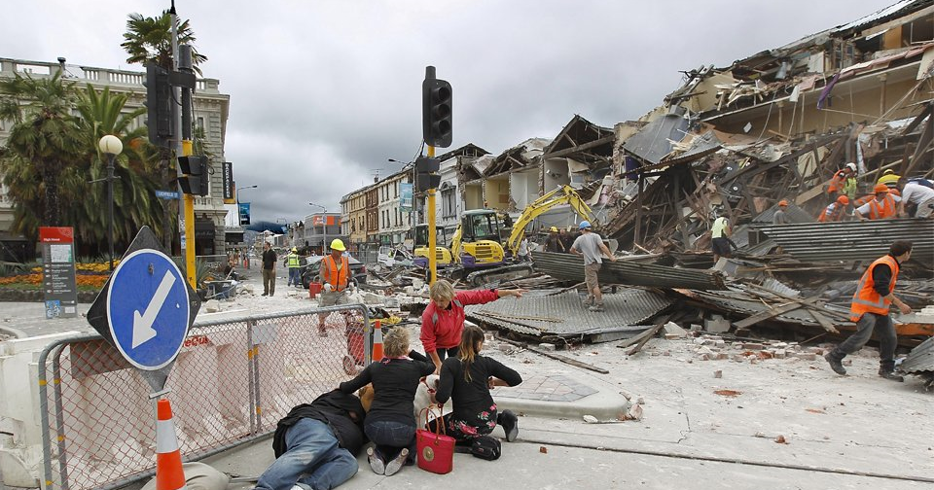
Universal News Drivers
Magnitude
Notes:
(
The USGS records more than a million earthquakes per year.
Let’s think about what makes this one world news.
(Click to launch video)

Slide 23
Universal News Drivers
Quake.wmv
Notes:
(BBC interview with a preternaturally sensible 16-year-old.)
For starters, it was a 6.3 on the Richter Scale, there’s only about 134 of those per year.
But that’s still not very unique. On January 18, there was a Richter 7.2 quake in southern Pakistan. It went unnoticed. A 7.2!
But that caused no known casualties while in New Zealand the death toll continues to rise toward the thousands.
That’s a big death toll, biggest of the year, so far…
ASK: What makes this one world news?
What is the driver? (magnitude: death toll)
(Haiti, btw, was 222,000 quake-caused deaths)
ASK: Which primal news need is satisfied
http://www.independent.co.uk/news/world/australasia/new-zealand-earthquake-caused-by-new-fault-line-2223545.html
http://www.cbsnews.com/2300-202_162-10004744.html
http://www.bbc.co.uk/news/world-asia-pacific-12533291 - great clickable map

Slide 24
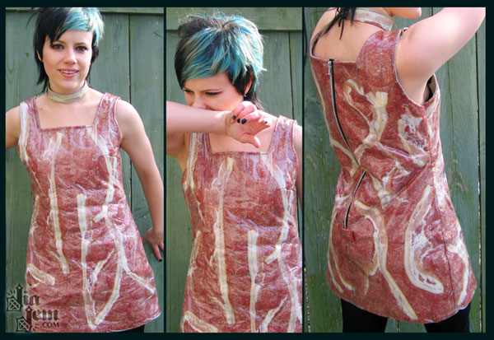
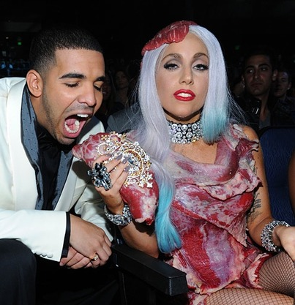
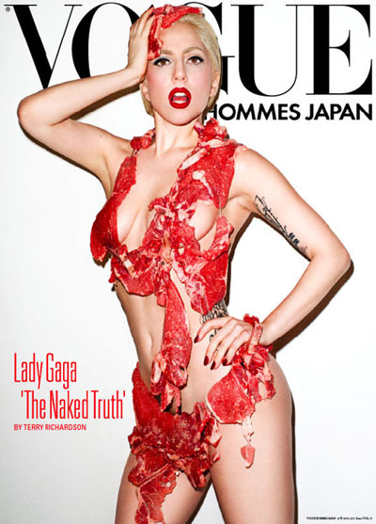
Universal News Drivers
Prominence
Notes:
(LECTURER NOTE: THE HIDDEN “NEWS DRIVER” WORD COMES UP AFTER 2ND CLICK)
When Jia Jem, of Chicago, a fanatical fan of Aqua Teen Hunger Force (a comic) went over the top and made an all-bacon-and-salami dress for her Aqua Teen Hunger Force-themed birthday party…it got a little write-up in the comics/geek blogosphere.
But when Stefani Joanne Angelina Germanotta wore a meat dress to a party in Los Angeleles…it made news worldwide, even if it was her third outfit of the evening.
ASK: What is the driver?
Prominence. Germanotta is Lady Gaga. When she does something, anything…it’s news. (She wore the dress to the MTV VMA Awards at the Nokia Theater in LA)
ASK: Which primal news need is satisfied

Slide 25

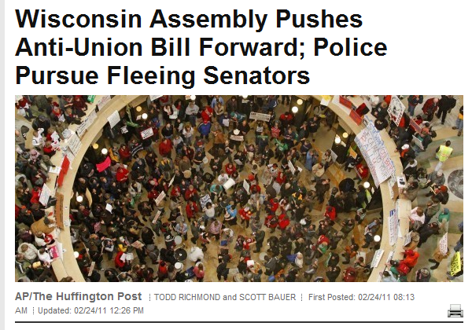
Universal News Drivers
Conflict
Notes:
When Wisconsin’s governor proposed chopping school budgets and taking away certain union rights of teachers, teachers and their supporters took to the streets along with taxpayers who oppose the unions.
ASK: What is the driver?
Information about conflict is news. It illuminates policy issues and defines characters.
ASK: Which primal news need is satisfied
http://www.huffingtonpost.com/2011/02/24/wisconsin-assembly-deal-vote_n_827530.html

Slide 26
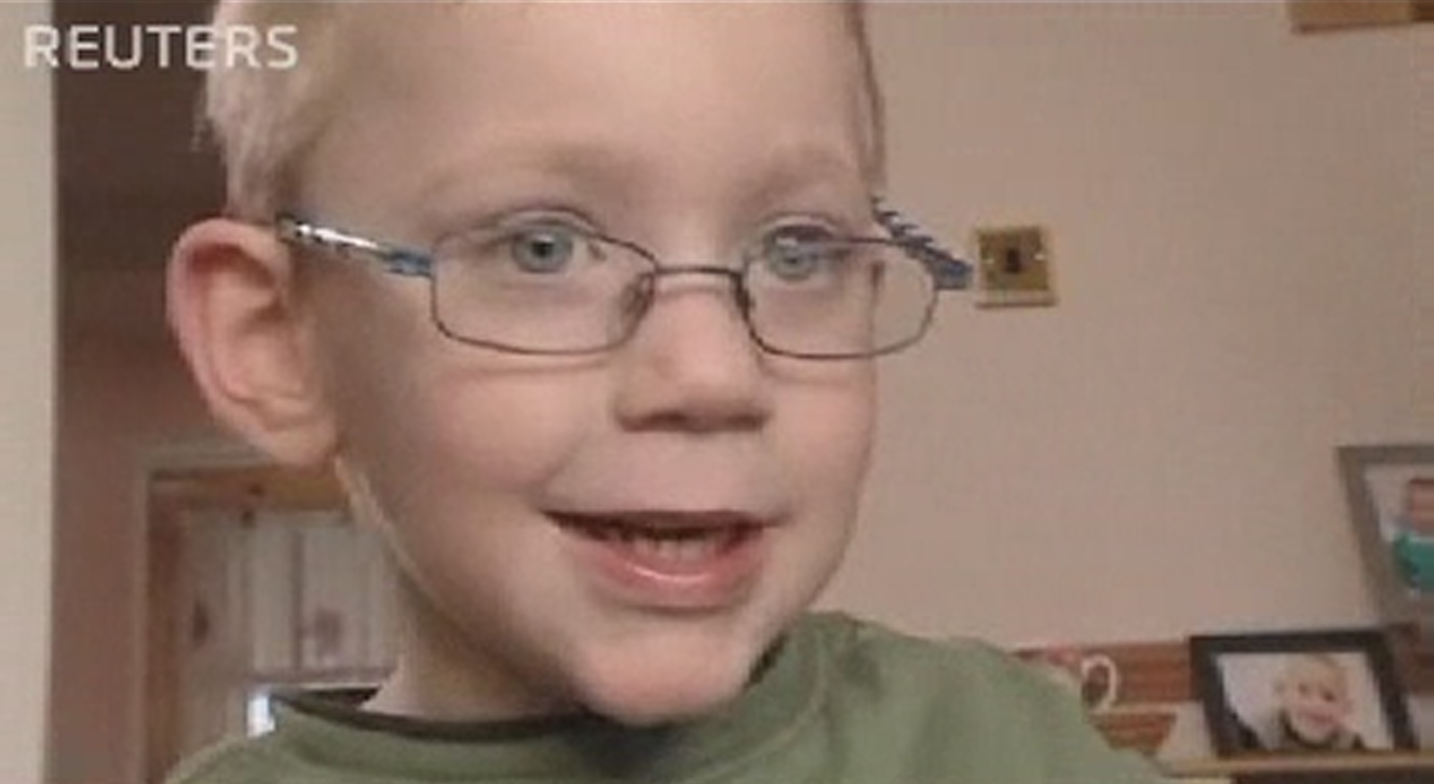
Universal News Drivers
Human Interest
Notes:
(LECTURER NOTE: THE HIDDEN “NEWS DRIVER” COMES UP AFTER 2ND CLICK)
Video set up: when Finlay Lomax had a stroke after his premature birth, doctors said he’d never walk again. Physical therapy didn’t go well. About that time, his family got a baby duck named Ming-Ming.
(Click to start video)

Slide 27
Duckboy.wmv
Notes:
(Lecturer: MingMing is named for the duck on a popular kids show, the Wonder Pets. If you know the Wonder Pets theme song, sing “The Duck….The Duck is Walking…What kind of driver?Huuuman Interest.”)
ASK: What is the driver?
ASK: Which Primal need is satisfied?
Human Interest is any story that makes you go…Awwwww.

Slide 28

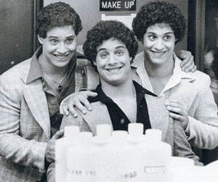
Universal News Drivers
Human³ Interest
Notes:
(Howie’s standby Human Interest story that is really a Magnitude story!)
Robert Shafran, 19, enrolls at Sullivan County Community College in upstate New York and right away, strangers start calling him Eddy and girls he doesn’t know run up to give him hugs. A sophomore at Sullivan, whose best friend, Eddy Galland, had just transferred to Nassau Community College on Long Island, figured it out first and got the separated twins together. Hospital records confirmed what the boys figured out, and the New York press trumpeted the story of reunited twins.
Then the unbelievable happened. David Kellman, a freshman at New York's Queens College saw their picture in the paperand called Eddy Galland’s house. "You're not going to believe this," he began, but documents at Manhattan's Louise Wise adoption agency confirmed it.
ASK: What is the driver?
ASK: Which Primal need is satisfied?
Robert, David and Eddy are triplets, born in that order, within 27 minutes of each other. They were handed to the adoption agency, which separated them without telling the parents of each that they had one of a set of triplets.

Slide 29




Universal News Drivers
Change
Notes:
(LECTURER NOTE: THE HIDDEN “NEWS DRIVER” COMES UP AFTER 2ND CLICK)
The fact that Tabler Quad, built decades ago, is still there? Not News.
But, add a few hundred new dorm rooms and it’s news.
Or another version of the same driver. It costs a lot to ride the MTA, right? So $5 in fares to get across town is no news.
But if they raise your fare on the MTA? That’s NEWS.
ASK: What is the driver?
ASK: Which primal news need is satisfied

Slide 30



Universal News Drivers
Change
Notes:
(LECTURER NOTE: THE HIDDEN “NEWS DRIVER” COMES UP AFTER 2ND CLICK)
For years, surgeons cut out women’s lymph nodes when breast cancer migrated there, a painful surgery with lingering effects.
New research published in the Journal of the American Medical Association shows 92% of women with early-stage breast cancers that have spread to a nearby lymph node do NOT increase their survival by having their lymph nodes removed.
ASK: What is the driver?
ASK: Which Primal information need is satisfied?
http://www.washingtonpost.com/wp-dyn/content/article/2011/02/08/AR2011020806346.html

Slide 31
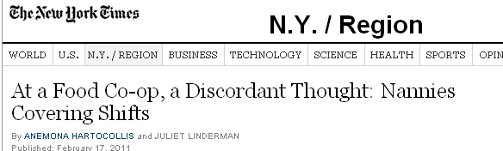
Universal News Drivers
(Ir)Relevance
Notes:
LECTURER NOTE: THE HIDDEN “NEWS DRIVER” WORD COMES UP AFTER 2ND CLICK)
Here’s a tricky one. This story demonstrates the absolute lack of one specific driver.
If you are a member of the Park Slope Food Coop in Brooklyn, you can buy organic beef, artisanal kimchi and the like…but to shop there, members have to work in the store a couple hours a month. Imagine the horror of utopians when they discovered some members of the Coop were having their nannies work their shifts at the Co-op.
Does this story matter to you?
ASK: If the driver isn’t Proximity…what is it?
Relevance…or in this case, irRelevance to all but a few hipsters and yuppies in Brooklyn. (Or people who like to make fun of them.)
If it affects your life…your community…your job…it is relevant, which is a powerful driver.
ASK: Which primal news need is satisfied by RELEVANCE?
http://www.nytimes.com/2011/02/18/nyregion/18coop.html
http://www.fuckedinparkslope.com/home/cool-or-not-cool-having-your-nanny-do-your-coop-shift.html

Slide 32
Universal News Drivers
Relevance
Notes:
Just to reiterate…If it affects your bank account…your housing…your career…as these two stories we already talked about do, it is relevant. We reuse these examples to make another point, which is that a single story, particularly a good one, can be propelled by multiple drivers.

Slide 33
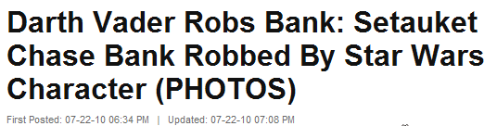

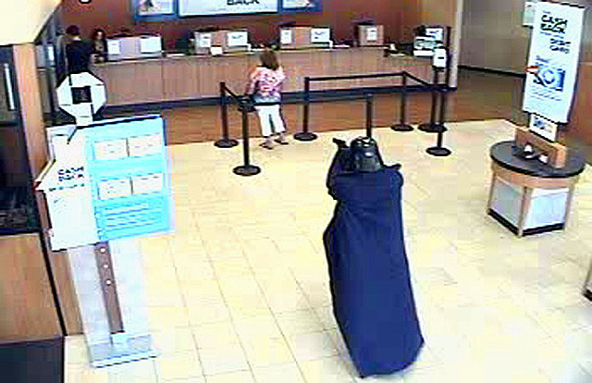
Universal News Drivers
Unusualness
Notes:
(LECTURER NOTE: THE HIDDEN “NEWS DRIVER” WORD COMES UP AFTER 2ND CLICK)
A lot of robbers use force. This one used the Force, when he dressed as Darth Vader to rob a Chase Manhattan branch in Setauket.
Suffolk County alone has a bank robbery every week, according to the FBI. None of those make national news.
Why did this one show up on websites and in newspapers nationwide?
ASK: What’s the driver?
Unusualness
ASK: Which primal news need is satisfied

Slide 34
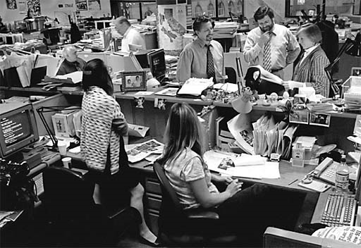
Factor 2: Editorial Judgment
What’s Interesting vs. What’s Important
Who is the Audience?
Do You Give the Audience What it Wants
or What it Needs?
What is the Competition Doing?
News Presentation
Notes:
(Editors photo fades to reveal Editorial Judgment text)
So how does a news organization decide what gets news coverage?
As we said in the last lecture, journalists have no more free press rights than any other citizen, they just get paid for it, while you have to do it on your own time.
In the past, American journalists wrapped themselves in the flag and first amendment and emphasized Importance, Relevance, Conflict and Change when choosing top stories.
As marketing data improved, editors began paying attention to what interests the audience and who is the audience is.
A big part of the job of leading a news organization is finding the balance between what the audience wants, vs. what it may need.
Sometimes editorial judgment is affected by the pressure to keep up with competing news outlets and to make more money.
To be honest, it’s somewhere between gut and science All of that is reflected in which stories are selected AND how they are played.
That’s what we call Presentation… How a story is displayed, illustrated and described…in relation to the other stories that are selected by that TV Station, Web Site, Newspaper or Radio Station.
Presentation is best evaluated in terms of Tone and Weight.
Tone: humorous, serious, conversational, scholarly indicates whether editors think the story alerts, diverts or connects.
Weight: The time and space devoted to a story indicates how important and/or interesting editors think it is.
Let’s work as a class on giving stories the right attention based on importance versus interest.

Slide 35
One exercise to teach this
Place Each Story on the Matrix
Notes:
POINT: THE MATRIX GAME
Let’s say you are now in charge of news coverage for some outlet.
Your colleagues bring to you their final list of stories for the next deadline…Rate these stories on two simple axes: Importance and Interest.
This exercise is intended to help you practice your news judgment skills…to sit in the editors Uneasy Chair

Slide 36
4
3
2
Interest
1
-4
-3
-2
-1
0
1
2
3
4
-1
-2
-3
-4
Importance
Notes:
First you’ll rate the IMPORTANCE of the story on a vertical scale of Negative Four through Positive Four.
Then you’ll rate the INTEREST on the horizontal axis, Negative Four through Positive Four.
You do this by clapping: Decide where you think this story belongs on the Importance scale: from -4 (Utterly Unimportant) to +4 (Utterly Important) .
(Assistant’s Name) will slide the story up the scale. You clap at the moment his/her hand hits the place you think it belongs on the scale. When it passes your number, STOP CLAPPING.
We’ll do the same with the Interest scale, from -4 (BOOOORING) to +4 (WOW! TELL ME MORE!)
Very Scientific…Ready?
Remember, only clap when the meter is correct.

Slide 37

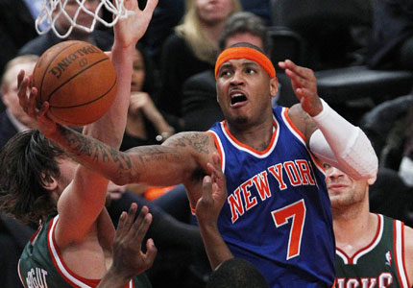
Place the Story on the Matrix
Notes:
The Knicks trade half their roster to get Anthony. Experts at Sporting News say New York will now win at least two more of the remaining 20-odd games and improve their playoff chances by…(Can you believe they calculate this?) 6.2 percent
Importance? AFTER RATING ASK: Why this score?
Interest? AFTER RATING ASK: Why this score?

Slide 38
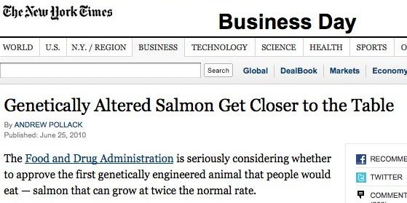
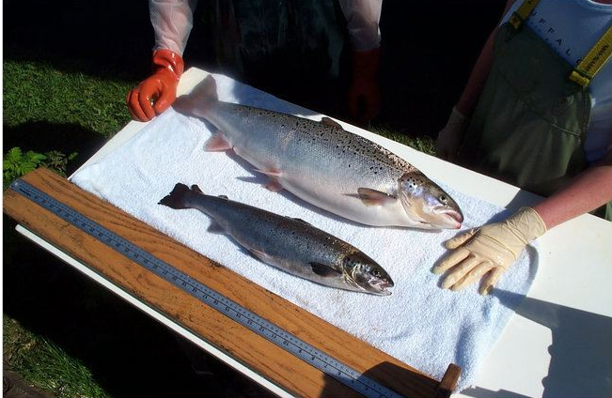
Place the Story on the Matrix
Notes:
If approved by the U.S. Food and Drug Administration, Aqua Bounty's genetically modified salmon would be the first genetically altered animal cleared for human consumption in the United States.
GMO salmon grows twice as fast as natural salmon and the FDA has already said the salmon, which some have dubbed “Frankenfish,” is as safe as traditional salmon. Genetically engineered vegetables such as corn have been on the market for years.
Both Food and Drug Administration staff and the salmon's maker, Aqua Bounty Technologies Inc, have said the fast-growing fish appears to be the same as normal Atlantic salmon and poses little threat to the environment or diners.
But some consumer advocates, environmentalists and others have protested the move. They say there is not enough data to show that eating the genetically modified salmon does not cause side effects such as allergic reactions or that accidental escape will not harm other fish.
Importance? AFTER RATING ASK: Why this score?
Interest? AFTER RATING ASK: Why this score?
ASK:Which drivers are in play?

Slide 39

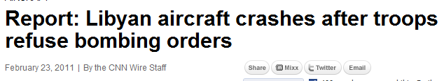

Place the Story on the Matrix
Notes:
A Libyan military aircraft crashed Wednesday southwest of Benghazi after the crew refused to follow orders to bomb the city.
The pilot and co-pilot parachuted out of the craft, and the plane crashed in an uninhabited area, Libya’s official newspaper said.
Importance? AFTER RATING ASK: Why this score?
Interest? AFTER RATING ASK: Why this score?
ASK:Which drivers are in play?
http://news.yahoo.com/s/nm/20110223/wl_nm/us_libya_protests_plane
http://articles.cnn.com/2011-02-23/world/libya.plane.crash_1_parachuted-uninhabited-area-aircraft?_s=PM:WORLD

Slide 40

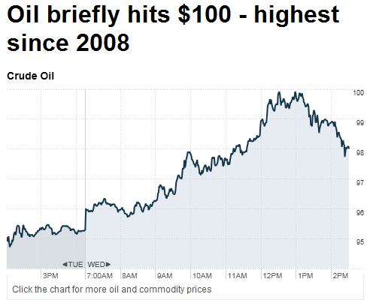
Place the Story on the Matrix
Notes:
If the situation in Libya worsens and spreads to Algeria, oil prices will probably top out at $115 a barrel, analysts predicted last week.
In the U.S., we watch global oil supplies closely because domestic oil makes up less than half our demand. And of the rest, we buy half our oil from OPEC member-states, including Libya and only about a quarter from nearby Mexico and Canada. Importance? AFTER RATING ASK: Why this score?
Interest? AFTER RATING ASK: Why this score?
ASK:Which drivers are in play?

Slide 41
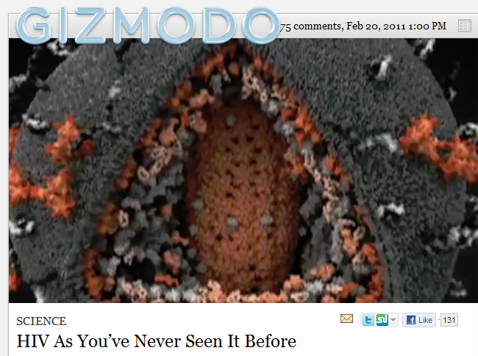
Universal News Drivers
Notes:
(News Fellow Link Video to NEXT slide)
For the first time, scientists have come up with a credible picture of the HIV/AIDS virus, and it looks as nasty as you might imagine.
Here’s a short clip.
http://gizmodo.com/#!5765334/hiv-as-youve-never-seen-it-before

Slide 42
Aids.wmv
Notes:
(After video runs)
Importance?AFTER RATING ASK: Why this score?
Interest? AFTER RATING ASK: Why this score?
ASK:Which drivers are in play?
(We find that each lecture has its own news judgment, so it’s a good thing to reflect on the total package of selections as they hang there on the wall, even if only to tease them for being sensationalists.)
http://gizmodo.com/#!5765334/hiv-as-youve-never-seen-it-before

Slide 43
Factor 3, Audience
What It “Needs”
vs.
What It Wants
Notes:
Our third factor that drives News Judgment by professional editors and producers is the audience. And who is the audience?...YOU
But different media outlets have different audiences. TV watchers are different from website skimmers and from newspaper readers.
And within those groups, men, women, professionals, blue collar workers, retirees and 18-year-olds have different needs and expectations.
Some might want more news that alerts, some might want more news that connects or diverts.
And what about the obligation to serve the public? If the press plays a Fourth Estate role, how can it waste time on Paris Hilton?
ASK: What is an example of news the Stony Brook Undergrad Needs?
Now how about an example of news the Stony Brook Undergrad WANTS?

Slide 44

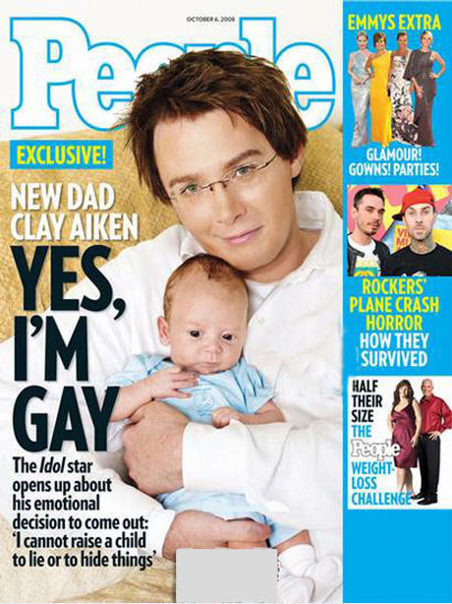
Audience-Driven
The Importance of the Customer
in Making Decisions
Notes:
The Economist Magazine vs. People Magazine
ASK: why are these two front pages so different
ASK: is this pandering , or is it public service, or is it good business?
Editors and producers add value to information and news by how much space or time they give to a story, and by its prominence. Beware of a simplistic dismissal of those who are audience-driven. Often a magazine like People can bring many more people to a serious health story, for instance, because as people browse the celebrity news, they will stop and read an important story.

Slide 45
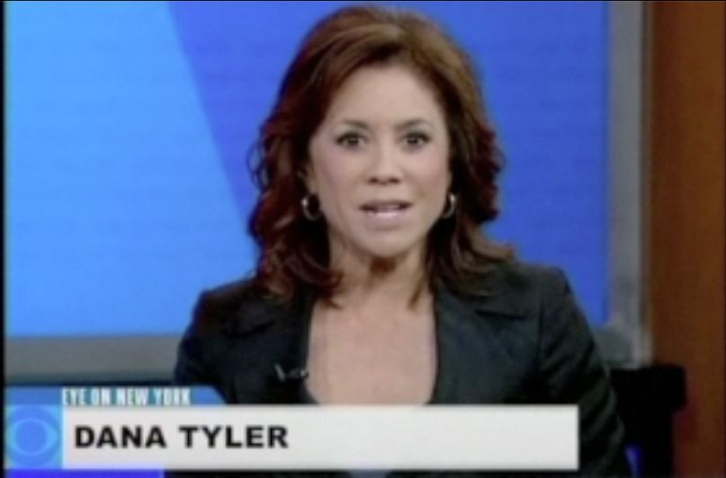
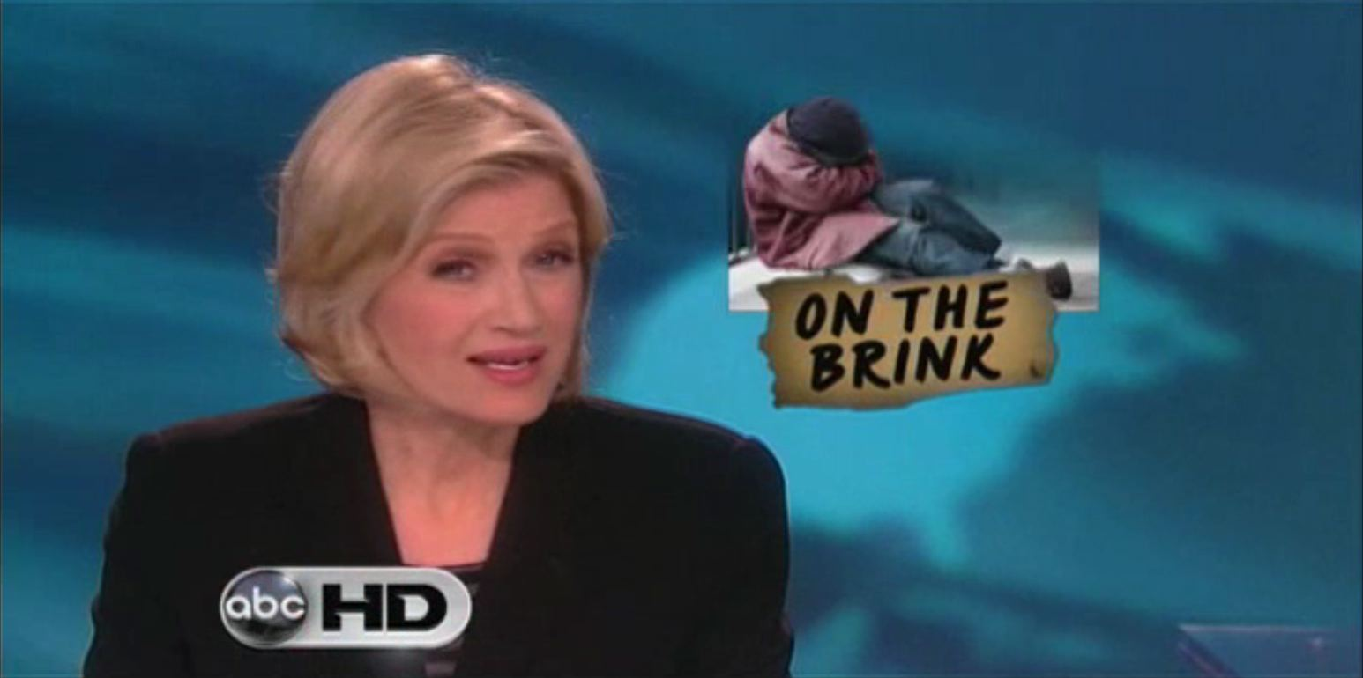
Audiences Dictate (That’s You)
Local and National News Broadcasts
Notes:
LOCAL TV NEWS vs. NETWORK NEWS
Local TV tends to focus on local crime, local heroes and “news you can use” to save money or lose weight.
Network TV News in the evening tends to focus on politics, government, world news and demographic or consumer trend stories, although they also talk a lot about weight loss and health.
Editors and producers add value to information and news by how much space or time they give to a story.
Does it lead the TV newscast? Those kinds of decisions send a signal to news consumers on how important or interesting they think a story is and why you should pay attention.
But they are also responding to your signals. If their story selection causes them to lose ratings, heads roll and new producers are brought in to bring ratings back up, usually by leaning more toward stories people want than what they need..
ASK: SO WHY THE DIFFERENCE BETWEEN LOCAL AND NETWORK TV STORY SELECTION, TONE AND WEIGHT?

Slide 46
worldnews.wmv
Notes:
Here’s an example of Network evening news. Pay attention to presentation, to tone and to the kinds of stories selected.
(AFTER SLIDE RUNS: Now let’s look at a local Long Island newscast)

Slide 47
Eyeon.wmv
Notes:
After Local News video:
ASK: What are the differences between those two clips?
Is that because of who produces it or because of who watches it?

Slide 48
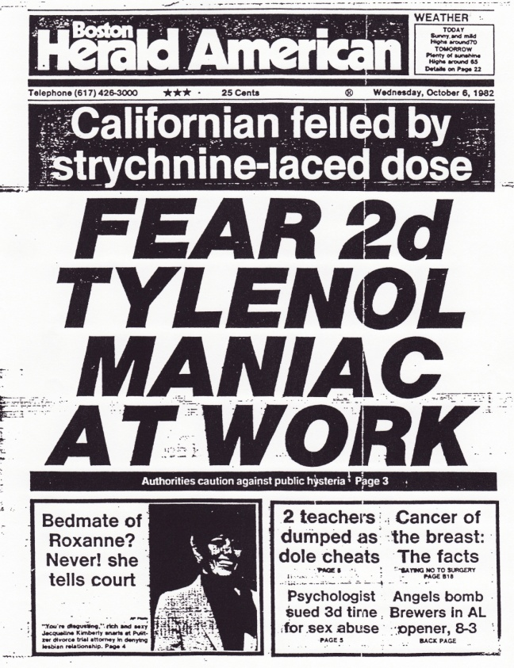
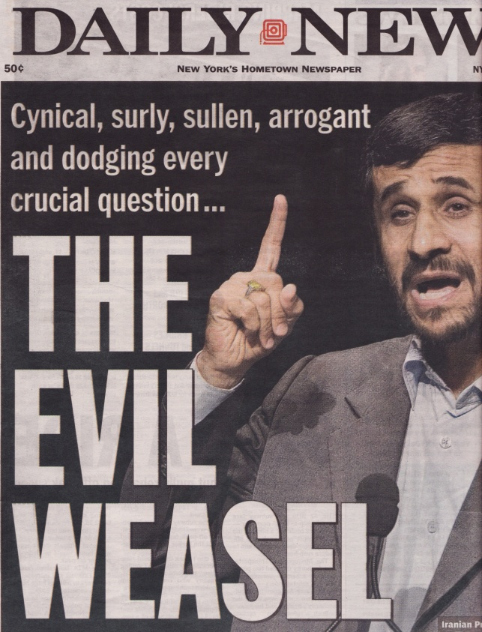
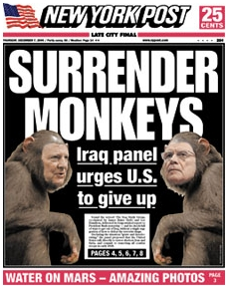

Audience-Driven?
What is Sensationalism?
Notes:
Sensationalism is a negative term that gets slung around. You sense you are reading a sensationalist paper when you see white headlines on giant black bars, wacky stories, clearly opinionated headlines…
Where is the line between serving a specific audience…and pandering to it?
ASK: what is your definition of sensationalism?
ASK: why would news outlets resort to sensationalism?
ASK: what do they gain?
ASK: what do they risk?

Slide 49
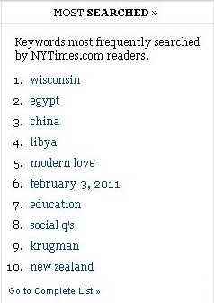
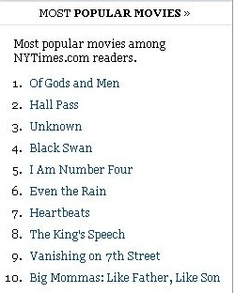
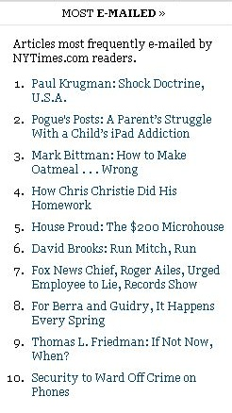
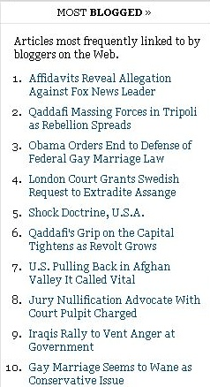
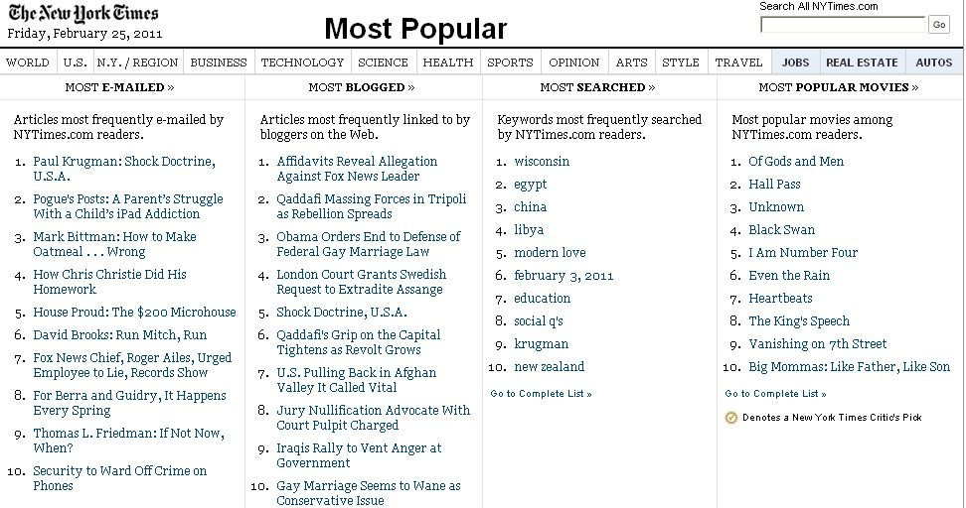
How the Internet Redefines “News Judgment”
Power shifts from editor to consumer
Notes:
(Animation: this slide clicks through the various “most read” and “most emailed” stories on the New York Times promos list.
Since you are reading the New York Times every day, let’s take a look at how your choices drive news judgment. While the editors exercise their judgment each day to select some mix of interesting and important stories, reader data on lists like this re-stacks the editors choices into a virtual newspaper edited by you.
ASK: Who uses these lists to guide their reading?
Why?
How can that affect what you learn each day?
Is there a downside?
Some websites rely entirely on these audience measures. The editorial function-or mediation- has been totally replaced.
ASK: what do you think works best? Why?

Slide 50

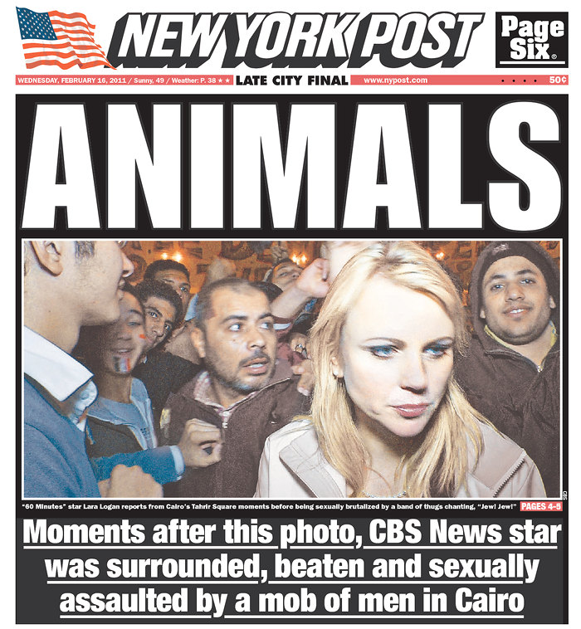

Why News Media Couldn’t Resist This Story
Factor 4: Competition & Profit
Notes:
And now for the Fourth factor that affects news judgment: Competition and Profit.
Of all the thousands of people who were assaulted, injured or killed during last month’s protests in Egypt, none got more press attention than Lara Logan. The news that CBS’ Chief Foreign Affairs Correspondent had been assaulted in Cairo while trying to cover the story became The Story of the day, even bigger than the punching that CNN’s Anderson Cooper got and the beating meted out against a Fox News crew.
Is it Important?
Is it Interesting?
When you came across the story, did you ignore it?
If you were the editor, could you afford to ignore the story when your competitors are running it? What do you tell the Publisher when the competition sells out their newspaper racks and yours sit there unpurchased?
Forget profit….what about your competitive streak? You ok with getting “scooped?”
ASK: WHY DID THE NETWORKS AND CABLE NEWS KEEP RUNNING AND RE-RUNNING IT? (Moves discussion to ratings)
ASK: CAN YOU RUN AN INDEPENDENT NEWS ORGANIZATION IF YOU DON’T BRING IN THE RATINGS OR INCREASE SALES OF THE NEWSPAPER?

Slide 51
What is News
and Who Decides?
(You…sort-of)
Notes:
We’re now well into the News Literacy lessons of the course.
Between the Taxonomy of News and this review of the factors of editorial judgment: News Drivers, Editorial Judgment, Audience, and Profit & Competition, we now expect you to start making skillful comments about how news gets selected and displayed.
Next week’s homework will be an excellent time to start using these terms.

Slide 52
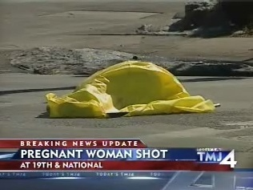
Is There Too Much Bad News?
Notes:
SLIDE: IS THERE TOO MUCH BAD NEWS?
(NEXT SLIDE LAUNCHES THE ANNE MURRAY SONG)
So…we’ve been thinking about four factors that determine what is news: the Universal News Drivers as the day-to-day expression of our need for news that alerts, diverts and connects us…editorial judgment of the stories’ importance and interest…audience impacts on what attracts readers and viewers…and the bare-knuckle fight for market share.
ASK: DO YOU PREFER TO READ SAD STORIES OR UPLIFTING STORIES?
ASK: WHY WOULD NEWS OUTLETS FOCUS ON THE BAD?
(prompt with reference to primal needs for information that ALERTS, DIVERTS, CONNECTS…)
Does bad news serve the audience or the news outlets profits? Is the preponderance of bad news a result of the dark worldview of producers and editors, or is it somehow linked to the watchdog role?
Here are the thoughts of one song-writer about one of the most common complaints leveled against the news media.

Slide 53

Notes:
(LECTURER: NEXT CLICK LAUNCHES ANN MURRAY)

