Slide 1
Marketing meet Library Science
Sharon Silverman & LaSandra Skinner
News Literacy Summer Institute 2013

Slide 2
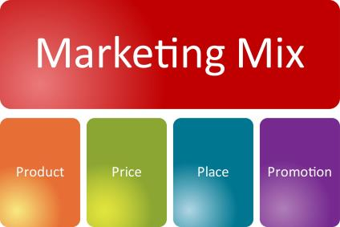

What is this?
The Assignment
The Old Way
The New Way

Slide 3

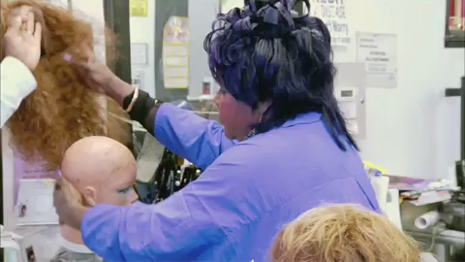
Sample Assignment
Mars Blackmon (Spike Lee) and Michael Jordan & Chris Rock, Good Hair

Slide 4

What’s the point?
Better construction on marketing plans
  Research
    Library
    Survey
    Observation
  Data driven decisions
  http://www.library.ccc.edu

Slide 5

What drives this process?
The Onion (Multiple Layers)
  Research skills
  Inquiry–based
  Networking / Relationship Building
  Value and positioning

Slide 6

How do you know?
Ethics… Just because can, does it mean you should?
What factors go into decision making?
How do you validate the resources? The data? The results?

Slide 7
Materials/Sources
www.library.ccc.edu
Proquest
Business and Company Resource Center (Gale)
Business Source Elite (EBSCO)
Academic Complete and Premiere (EBSCO)
Virtual Reference Library (Gale)
Opposing View Points (Gale)
CQ Researcher
www.cityofchicago.org
www.consumerreports.org
http://www.illinois.gov/idol/Pages/default.aspx
www.dol.gov
www.cyberdrive.com
http://www.claritas.com/MyBestSegments/Default.jsp?ID=0&menuOption=home&pageName=Home
www.encyclopedia.chicago.org

Slide 8
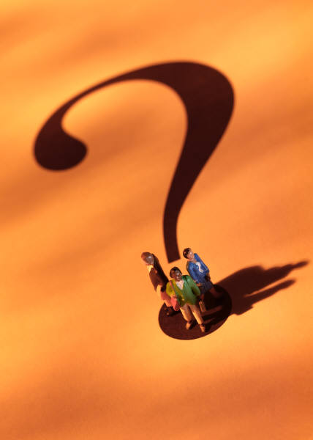
Questions?

